Slide 1
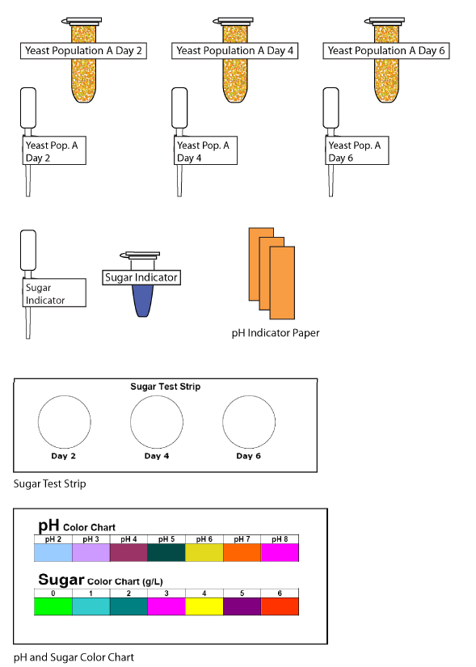
Yeast Populations
Notes:
Should be on screen as participants enter the room.
Start workshop on time—do not wait for “stragglers”
Welcome participants as they enter the room
Do NOT take time for participant introductions unless the workshop group is a very small one (less than 10 people)
Introduce yourself and briefly explain your teaching experience and current position
Explain that this workshop is sponsored by Science Take-Out, a small company that manufactures and sells hands-on science kits for middle or high school biology students
The company began as a “spin-off” initially formed to disseminate hands-on laboratory activities developed by the Life Sciences Learning Center, an outreach center at the University of Rochester.

Slide 2
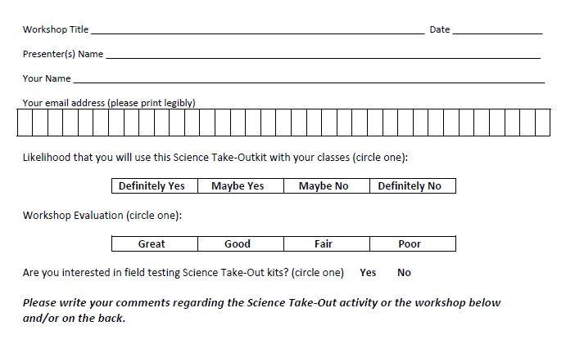
Please complete the “Participant Card”
2
Notes:
Because this workshop is supported through a grant from the National Institutes of Health, it is important that we collect data from workshop participants.
Please fill in the participant card during the workshop.
Use the space at the bottom and the back of the card to provide comments on the workshop or the kits used during the workshop.
2

Slide 3
Put your student hat on
Experience the kit
Put your teacher hat on
Envision classroom use
Curriculum integration
Support for students
Notes:
When we do hands-on workshops we ask you to switch between two hats as you work—your student hat and teacher hat.
We want to you work with partners to experience the kit by completing the activity
We encourage you also have conversations about how you might integrate this into your curriculum and/or support your students.
If you have questions, please call me over while you are working on the activity.
Also, you may find me interrupting to provide further explanation as you work.

Slide 4
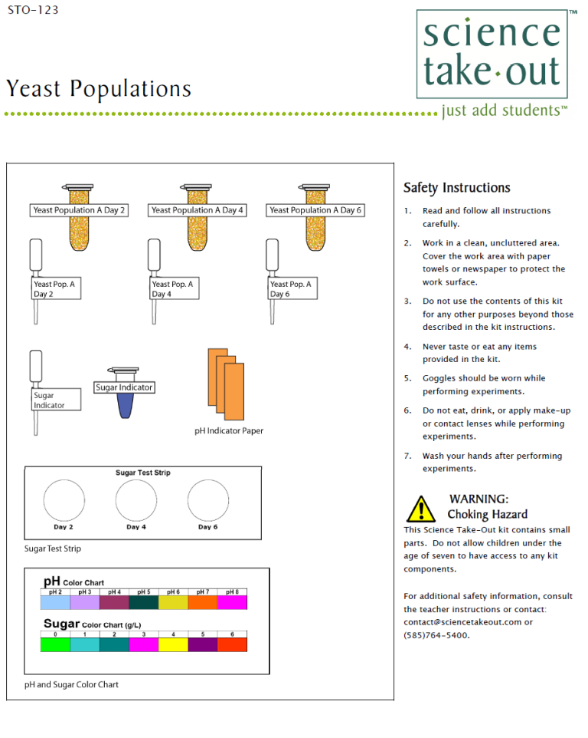
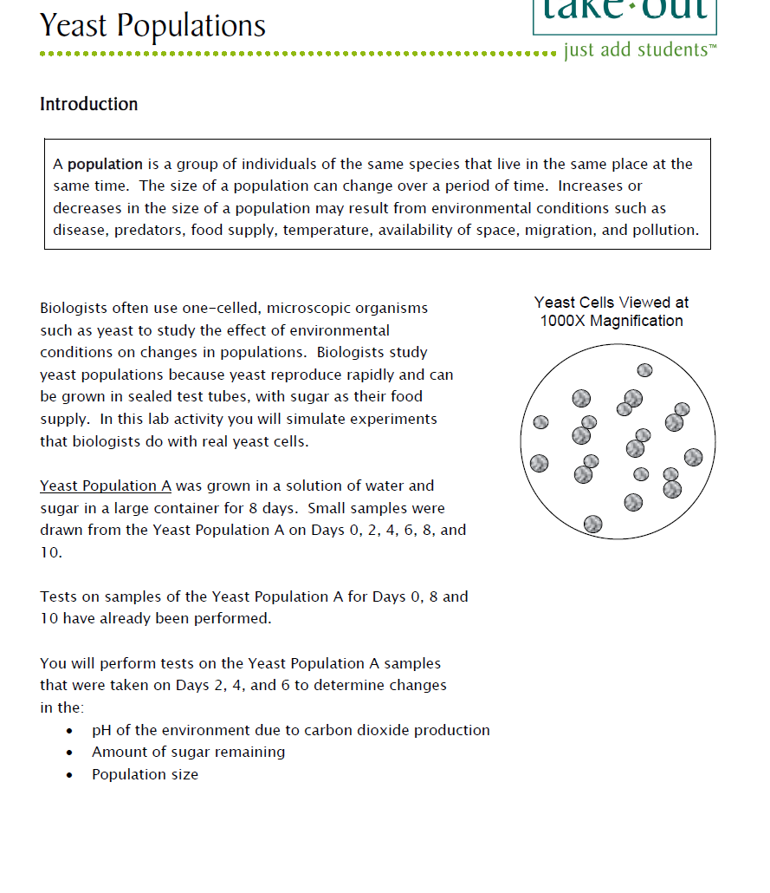
Yeast Populations Student Handouts
Quick Guide
Safety
Student Instructions
Turn to this page
Notes:
DISTRIBUTE Yeast Populations KITS—ONE kit, one student handout, and one bag of cut-outs PER PAIR OF TEACHERS
For today, you will be working in teams of 2. Kits typically come with ONE student handout in the bag. One teacher should use the student handout that comes in the kit. The other teacher should use the extra copy at the desk.
Teachers may make additional copies if their students are working in teams.
Notice that each kit contains safety instructions and also a graphic quick guide. Students can refer to the quick guide to identify the materials they will need. We do not make a materials list. Instead, students are encouraged to get what they need from the bag as they work.
Some teachers have enlarged and laminated the quick guides to make “placemats” to help students organize kit materials.

Slide 5
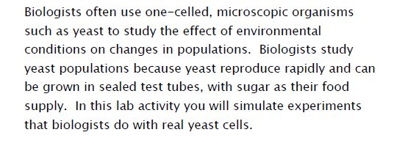
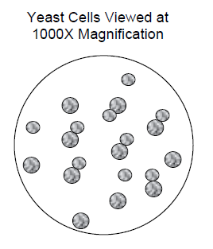
Notes:
Ask one participant to read the introduction to read the introduction aloud.—first two paragraphs.
Ask participants why scientists use yeast to do research on the effects of environmental conditions.

Slide 6
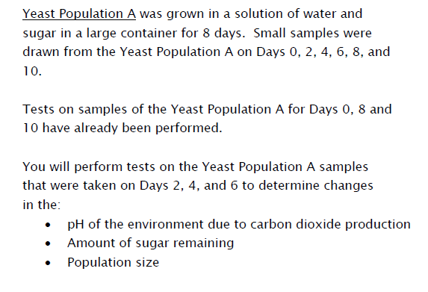
Notes:
Ask a second participant to read the last three paragraphs aloud.
Note: To avoid repetition in data collection, students only collect some of the data (for days 2, 4, and 6). Additional data for days 0, 8, and 10 are already provided in the data tables.

Slide 7
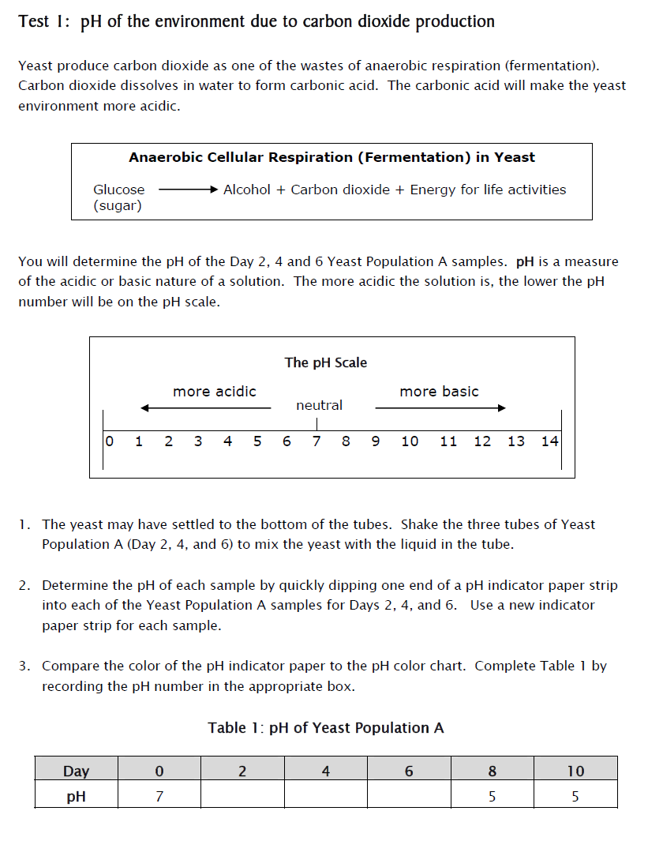
Notes:
Ask participants to work with their partner to complete Part 1: pH of the environment due to carbon dioxide production
When they work, one should read the instructions and the other should follow the instructions. This is a strategy to promote teamwork and to keep “speedy” and “slow” students together. It also helps keep students on task.
Encourage them to tear off the graph page at the end of their lab packet. This makes graphing the data easier.
Note: Participants work at very different paces. You may stop and discuss each part OR you may simply tell participants to feel free to move on to the next part as appropriate for them.

Slide 8
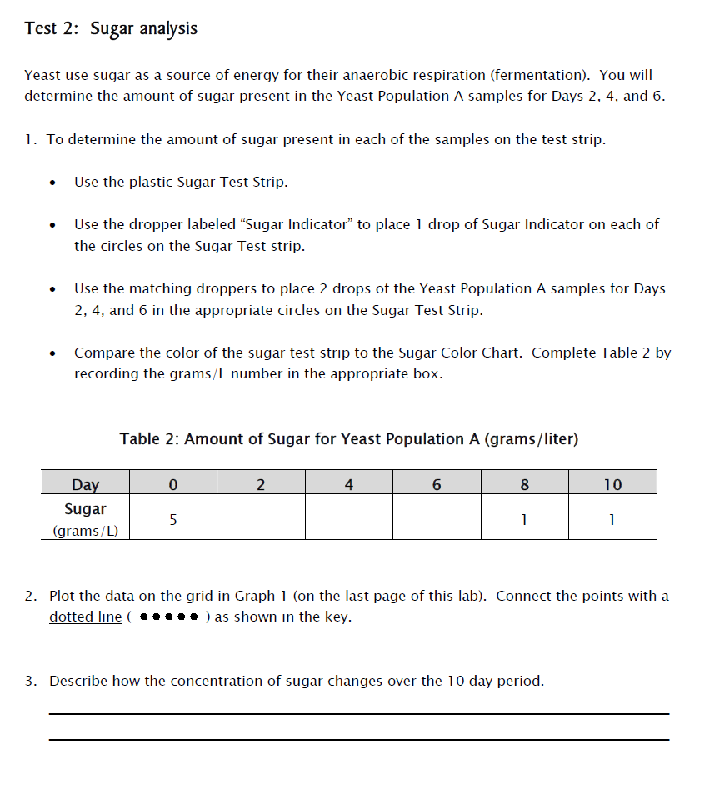
Notes:
Ask participants to work with their partner to complete Part 2: Sugar analysis

Slide 9
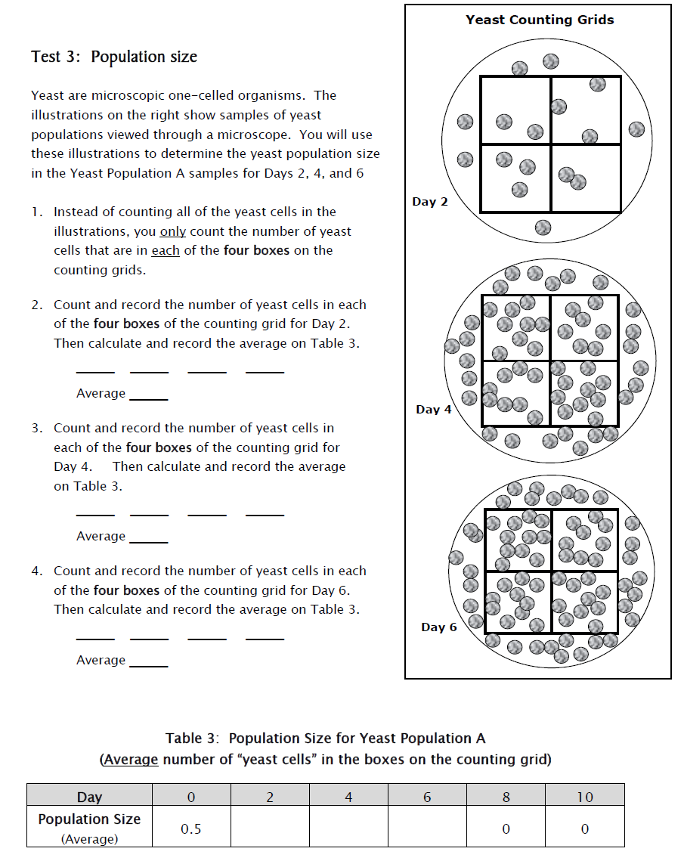
Notes:
Ask participants to work with their partner to complete Part 3: Population size
Note: Many teachers have limited access to microscopes. To avoid the need for microscopes we have simulated yeast with small beads.
Also, students often have difficulty with counting yeast cells viewed under microscopes.

Slide 10
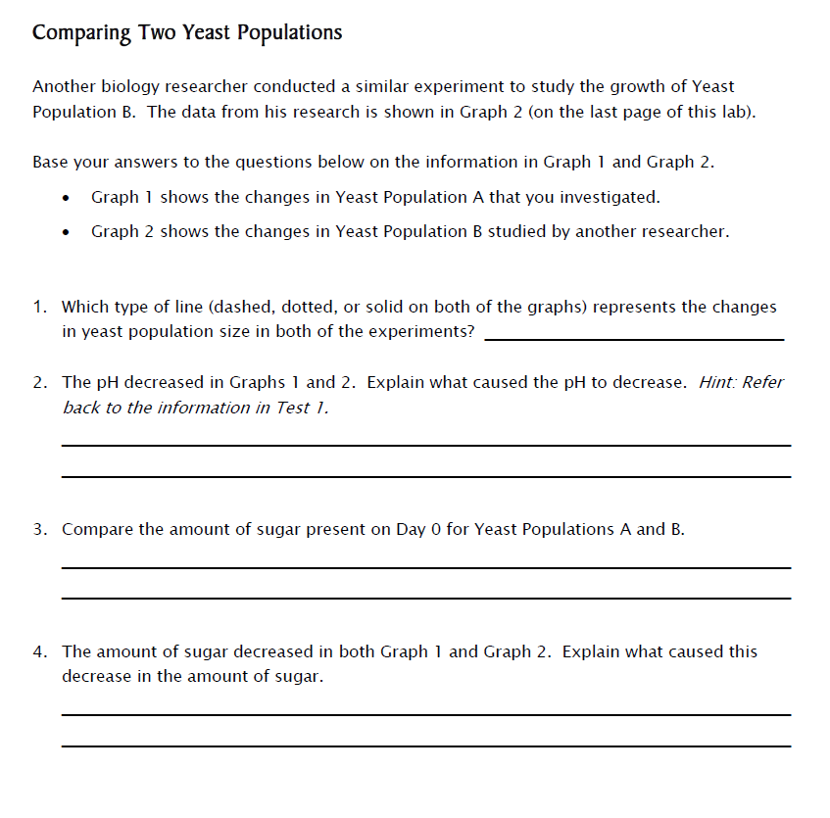
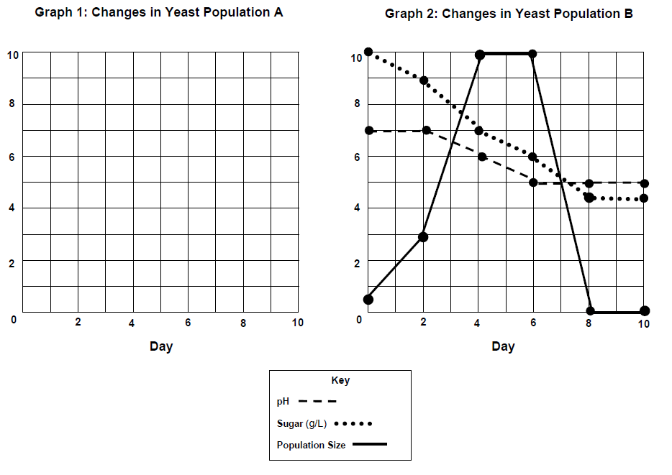
Notes:
Ask participants to work together to complete Comparing Two Yeast Populations
To avoid the need to collect data on yeast population B, students use data provided in the lab activity.

Slide 11
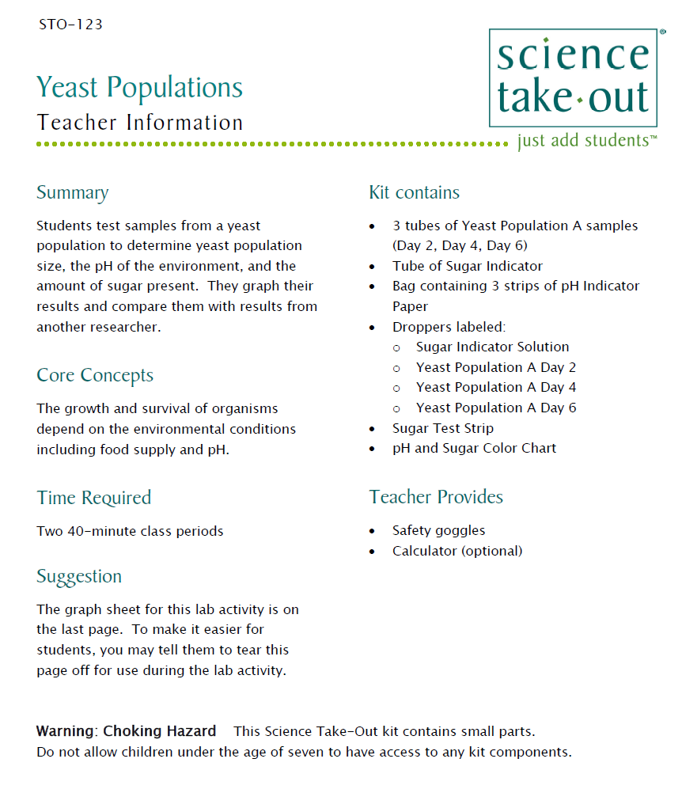
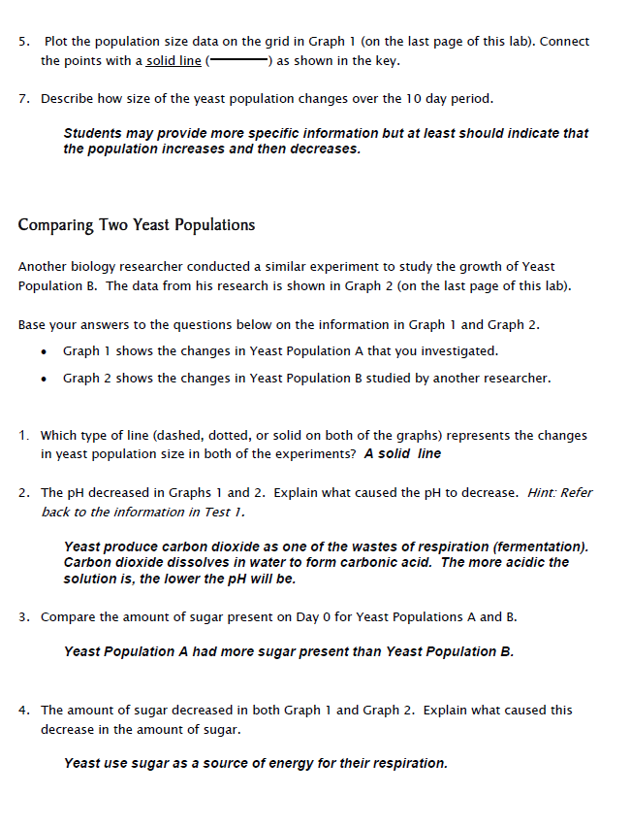
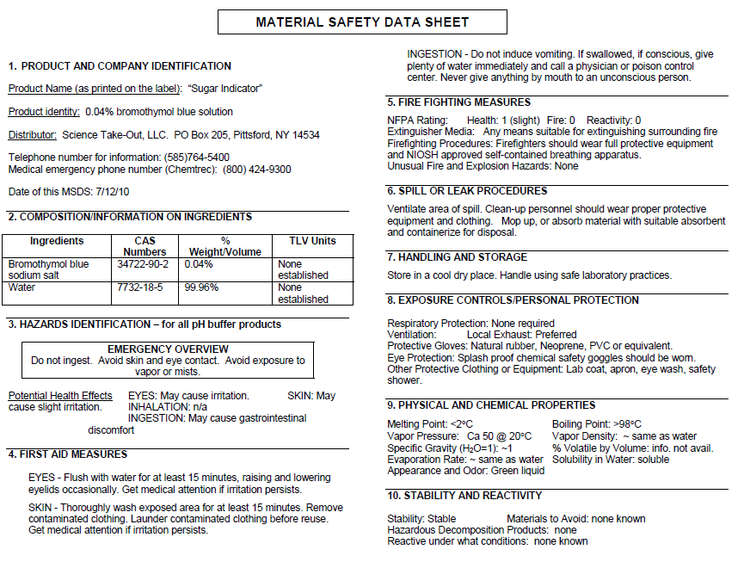
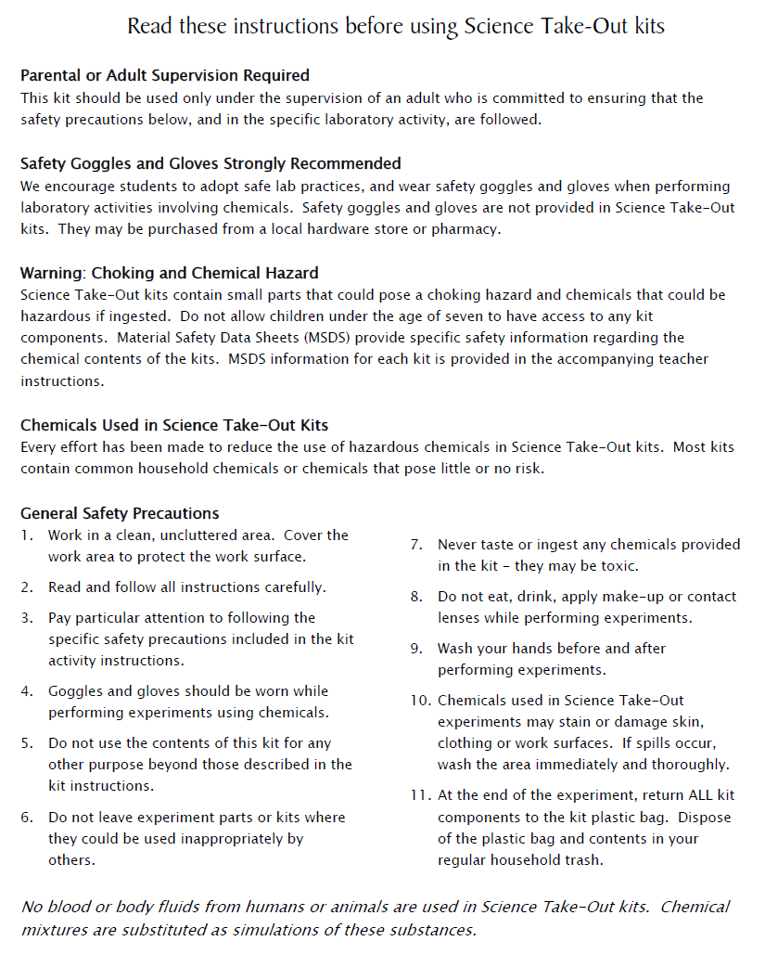
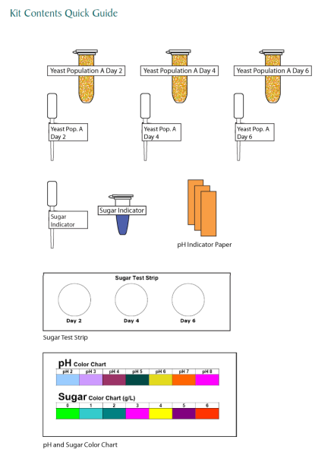
Teacher Information
MSDS
Key
Safety
Quick Guide
Notes:
One copy of the Teacher Information is provided when you purchase kits. You can also download the teacher information (without answers) from the website.
The teacher information includes: Summary, Core Concepts, Kit Contains, Teacher Provides, Time Required, Hints for Reusing, and information of refill kit contents.
Science Take-Out also sells refill kits so that basic kit contents can be reused.

Slide 12
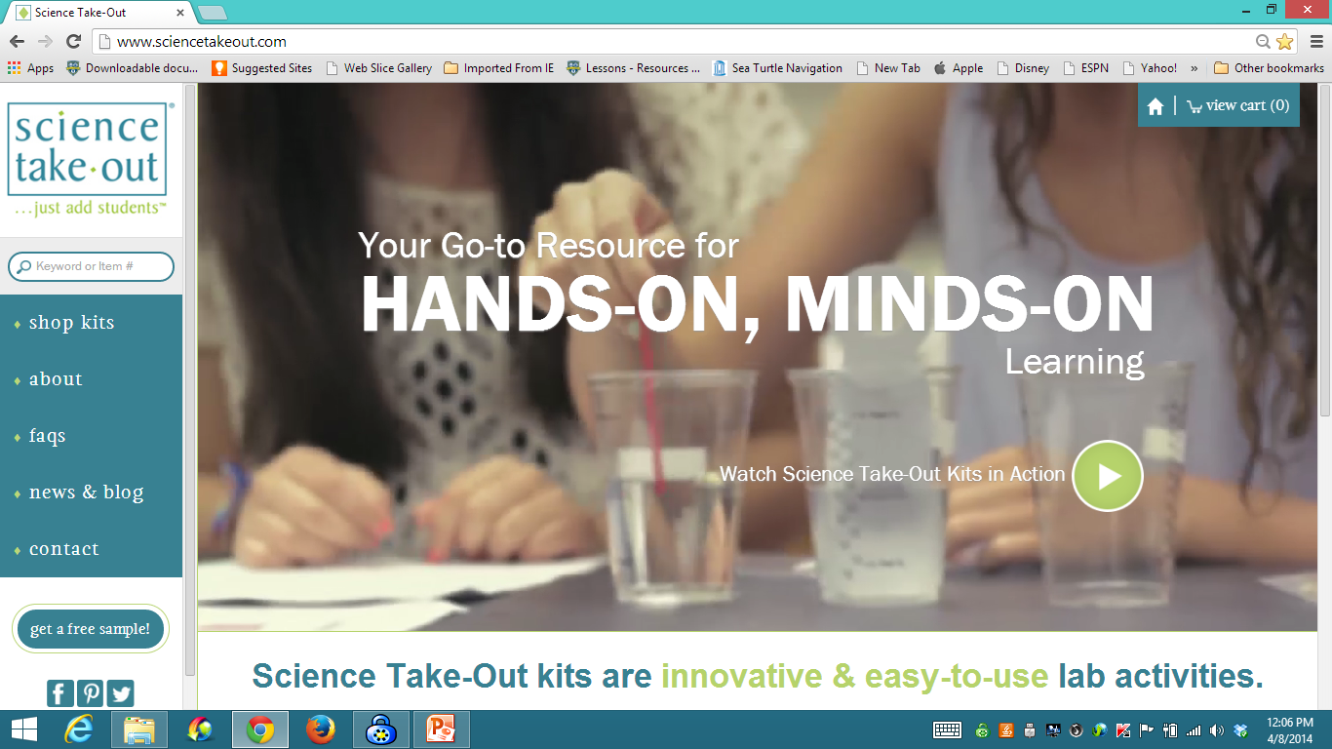
www.sciencetakeout.com
Purchase kits from
Notes:
The kit you used today is available from Science Take-Out as a completely assembled student kit.
Please explore the website to learn about other STO kits.
You can download the complete teacher instructions so that you can see what you are buying.

Slide 13
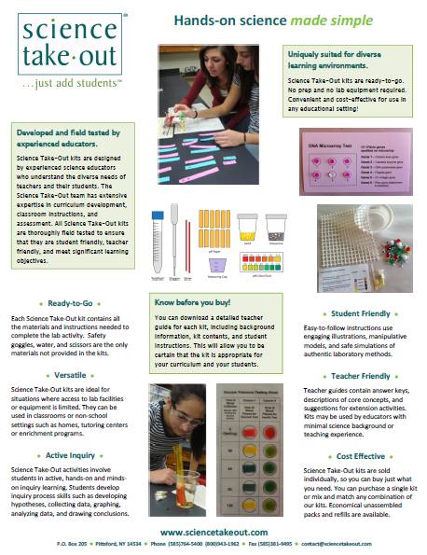
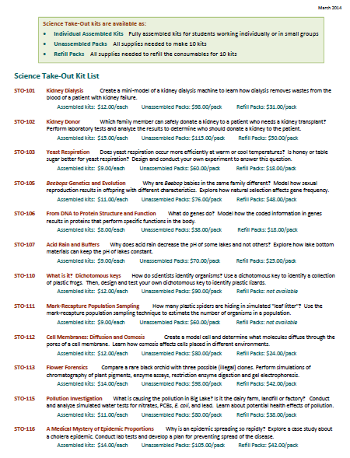
Individual Assembled Kits Fully assembled individual kits
Unassembled Packs All supplies needed to make 10 kits
Refill Packs All supplies needed to refill 10 kits
Notes:
You have a brochure that includes information on other Science Take-Out kits and a price list. Visit the Science Take-Out website to get further information for each kit.
At the website, you can download the teacher information for each kit to help you decide which kits you would like to purchase.
Science Take-Out kits are available as:
Individual Assembled Kits like the kits you used in this workshop
Unassembled Packs that contain all supplies needed to make 10 kits
Refill Packs that contain supplies needed to refill the consumables for 10 kits

Slide 14
Become Involved
as a Field Test Teacher
Help us make new Science Take-Out kits teacher and student friendly.
Indicate this on your card. Science Take-Out will contact you with further information
14
Notes:
Science Take-Out has received an NIH Small Business grant. Support from this grant will allow us to field test Science Take-Out kits
If you would like to be a field test teacher, indicate this by circling yes on your participant card. We will add you to our email list for field test teacher recruitment.
14

Slide 15
Become Involved
as a Workshop Presenter
Present a workshop to introduce colleagues to Science Take-Out kits
Visit the Science Take-Out website for further information
15
Notes:
Science Take-Out has received an NIH Small Business grant. Support from this grant will allow us to field test Science Take-Out kits
If you would like to be a field test teacher, indicate this by circling yes on your participant card. We will add you to our email list for field test teacher recruitment.
15

Slide 16
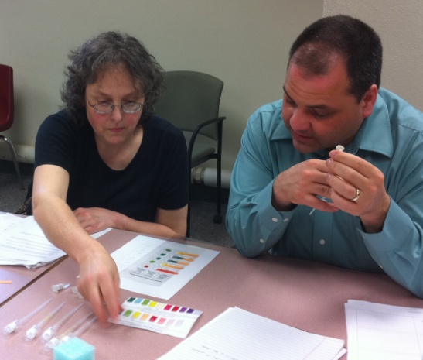
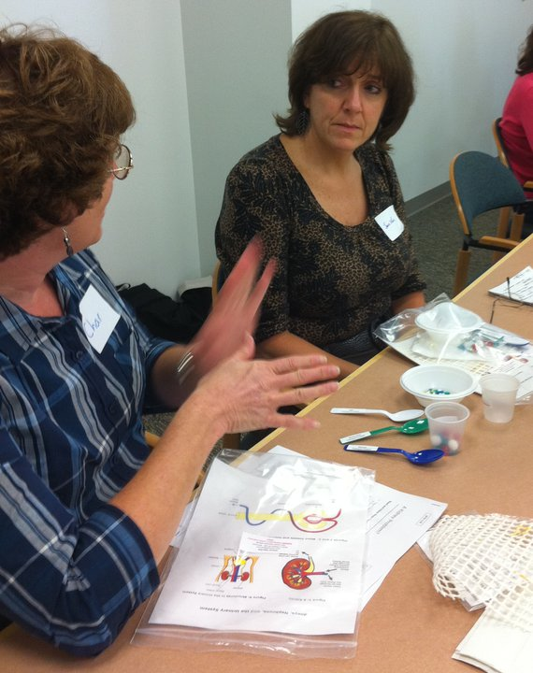
Thanks for being a GREAT group!!!
Please turn in your participant card
before you leave.
Notes:
Encourage teachers to write comments on the back of the participant survey card.
Please remember to collect participant feedback cards!!

