Slide 1
A Case of Skin Cancer Note: You will need to provide paper towels for participants. To make efficient use of workshop time, consider cutting out the pictures and captions needed for Part 4.

Slide 2
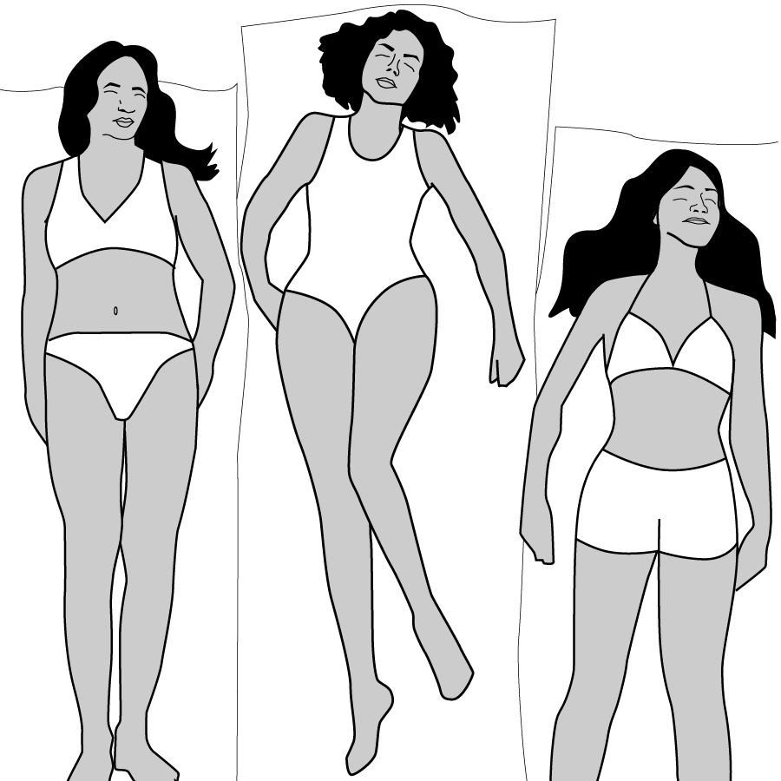
A Case of Skin Cancer
Notes:
This slide should be on screen as participants enter the room.
Start workshop on time—do not wait for “stragglers”
Welcome participants as they enter room
Do NOT do participant introductions unless the workshop group is a very small one (less than 10 people). Introduce self and briefly explain teaching experience and current position.

Slide 3
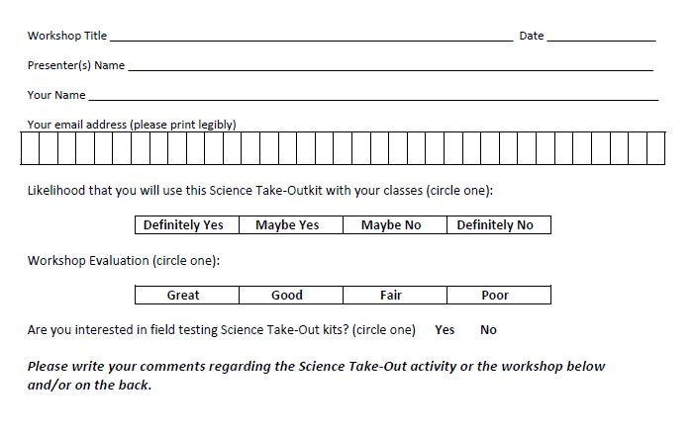
Please complete the “Participant Card”
Notes:
Because this workshop is supported through a grant from the National Institutes of Health, it is important that we collect data from workshop participants.
Please fill in the participant card during the workshop.
Use the space at the bottom and the back of the card to provide comments on the workshop or the kits used during the workshop.
3

Slide 4
Put your student hat on
Experience the kit
Put your teacher hat on
Envision classroom use
Curriculum integration
Support for students
Notes:
When we do hands-on workshops we ask you to switch between two hats as you work—your student hat and teacher hat.
We want to you work with partners to experience the kit by completing the activity
We encourage you also have conversations about how you might integrate this into your curriculum and/or support your students.
If you have questions, please call me over while you are working on the activity.
Also, you may find me interrupting to provide further explanation as you work.

Slide 5
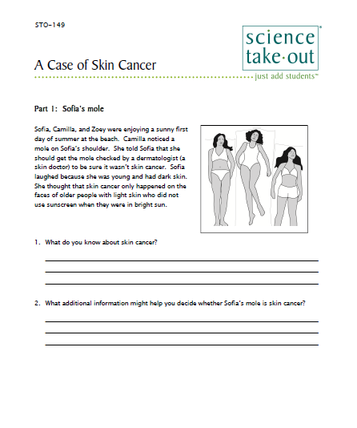
A Case of Skin Cancer
Student Instructions
Quick Guide
Safety
Turn to this page
Notes:
For today, you will be working in teams of 2.
DISTRIBUTE 1 KIT and 1 STUDENT INSTRUCTIONS to EACH PER PAIR OF TEACHERS
Every kit comes with a colored quick guide and safety instructions sheet. Keep this colored sheet in the kit bag if they plan to refill and reuse the kit.
Each kit comes with ONE student instruction handout. Teachers may make additional copies if their students are working in teams.
One of you should use the student instructions in the bag. The other person should use the additional handout that we have provided.
Explain that the A Case of Skin Cancer kit fits well with an environmental science unit or human physiology unit.
Explain that students will use the kit materials to explore the role of UV light exposure in increasing the risk of skin cancer.
Note that the kit components are shown on the quick guide.
You can download the complete teacher information from the Science Take-Out website.

Slide 6
Part 1: Sofia’s mole
Sofia, Camilla, and Zoey were enjoying a sunny first day of summer at the beach. Camilla noticed a mole on Sofia’s shoulder. She told Sofia that she should get the mole checked by a dermatologist (a skin doctor) to be sure it wasn’t skin cancer.
Sofia laughed because she was young and had dark skin. She thought that skin cancer only happened on the faces of older people with light skin who did not use sunscreen when they were in bright sun.
Notes:
Part 1: Sofia’s mole
Suggest that partners take turns reading/doing as they work through the activity. Explain that keeps partners working together. Also explain that it is a great way to keep students on task.
Ask one participant to read the information in the box at the beginning of Part 1.
Ask two participant to read their answers to question 1.
Ask two participant to read their answers to question 2.
Explain that Part 1 could be done for homework. However, having students share their answers to questions 1 and 2 can engage students in bringing their prior knowledge to the activity.

Slide 7
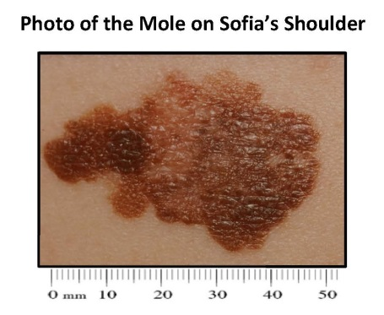
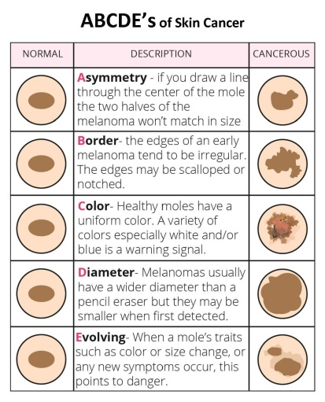
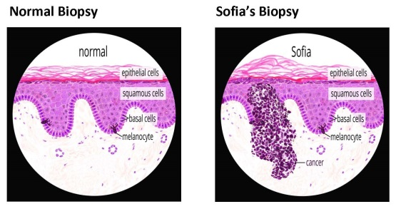
Your lab kit contains a photo of the mole on Sofia’s shoulder and a Skin Cancer Fact Sheet. Use the ABCDE’s of Skin Cancer designed to help people recognize the characteristics of moles that might be skin cancer.
Sofia decided to have the mole removed. The dermatologist who removed the mole sent a sample of the mole to a lab for a biopsy (a lab test to determine if a tissue is cancerous). Your lab kit contains photos of a normal skin biopsy and the skin biopsy from Sofia’s mole.

Slide 8
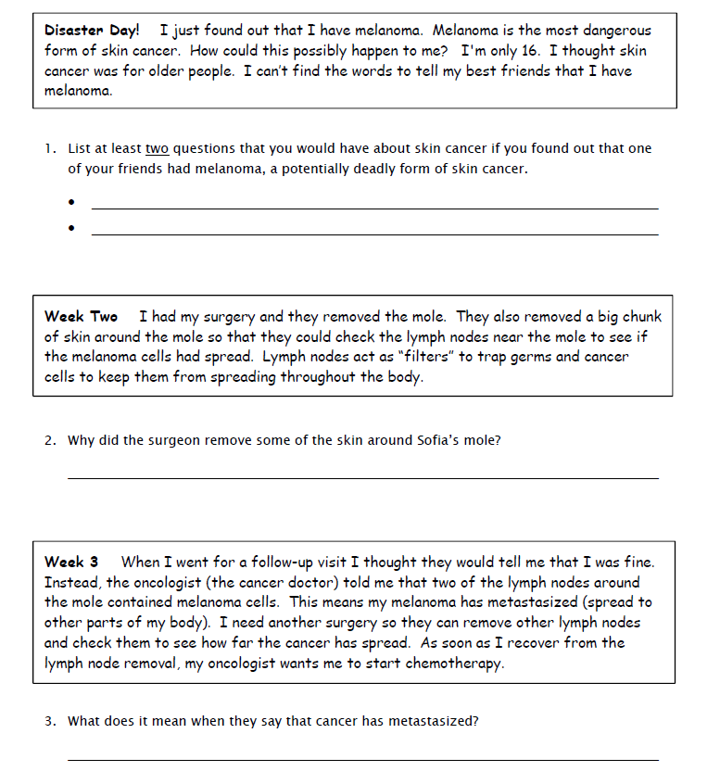
Part 2: Sofia Tells Her Story
Notes:
Part 2: Sophia Tells Her Story
Students read short reading passages and answer simple questions about skin cancer.
Part 2 helps students understand that skin cancer may be a serious disease.
Part 2 may be done in class or for homework.
Ask participants to work with their partner to answer the questions in Part 2.
Allow 5 minutes. Then explain you would like to move on so that they have time to experience Part 3.

Slide 9
Part 3: Sun Safety Research
The list below describes three things that some people say will work as well as using sunscreen to reduce exposure to UV radiation from the sun.
You will design and conduct an experiment to compare the effectiveness of ONE of these to the effectiveness of sunscreen.
Research Question: Does (circle the one you will be testing below) work as well as or better than sunscreen for protecting your skin from harmful UV light that may cause skin cancer?
Going into the water (swimming or lake)
Wearing long pants and long-sleeved shirts
Sitting in the shade of an umbrella
Notes:
Part 3: Sun Safety Research
Students design and conduct research on ways to reduce exposure to UV radiation.
Ask participants to work with their partner to select one of the things that some people think reduces UV exposure.
Next slide

Slide 10
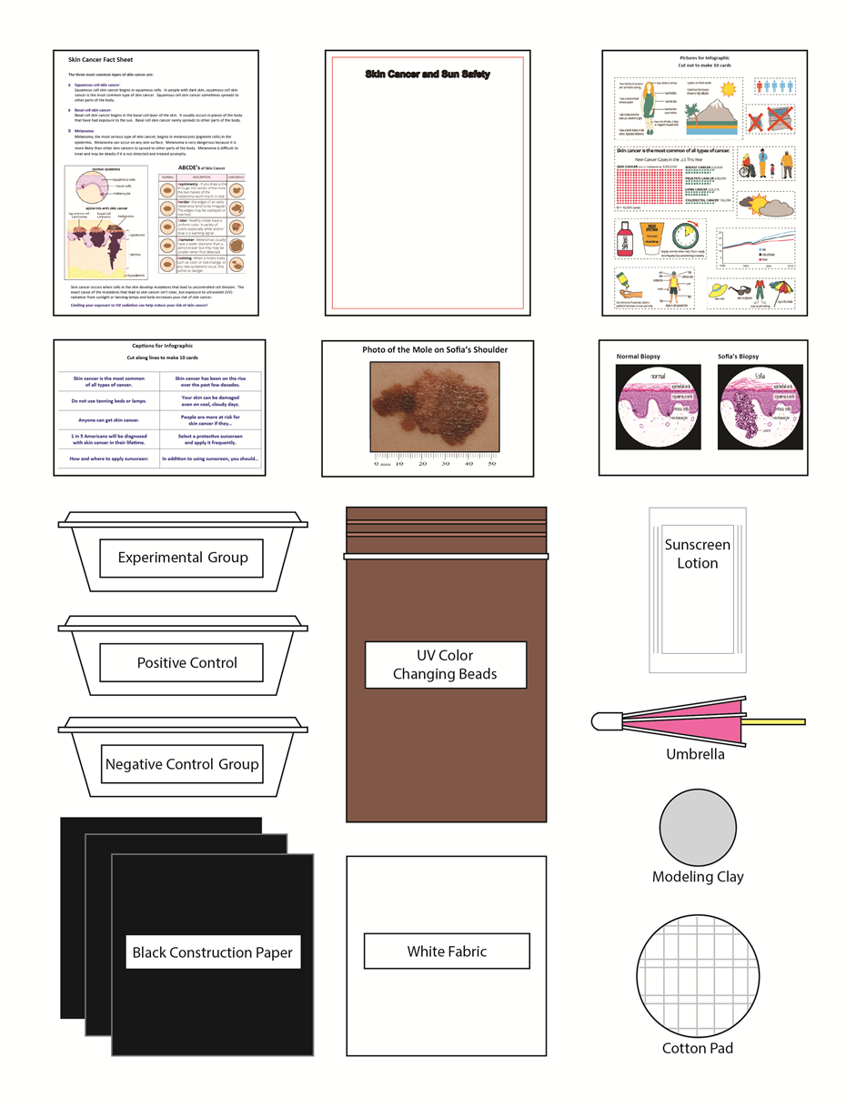
You have these items in your lab kit that you can use for your experiment:
Notes:
Part 3: Sun Safety Research
Students design and conduct research on ways to reduce exposure to UV radiation.
Ask participants to work with their partner to select one of the things that some people think reduces UV exposure.
Next slide

Slide 11
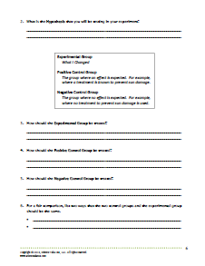
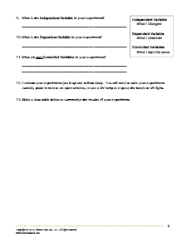
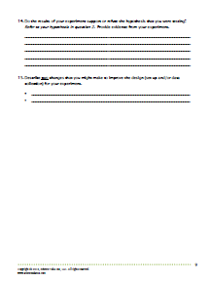
Questions serve as scaffolding for students who need support for designing and conducting scientific research.
Notes:
Part 3: Sun Safety Research
Questions serve as scaffolding for students who need support for designing and conducting scientific research.
Ask participants to follow the instructions and answer the questions as they work on their experiment.

Slide 12
Part 4: Sofia’s Story Continued - Preventing Melanoma
I hope my story will help people change the way they think about tanning. Camilla, Zoey, and I decided we should do something to make people aware of the dangers of tanning and importance of sun safety.
I made a list of things people should know about skin cancer. Zoey said that my list was boring. She suggested that an infographic would be a more interesting way to get information across to our friends. Zoey explained that an infographic takes a large amount of information and condenses it into pictures and brief text so that viewers can quickly grasp information.
Notes:
Part 4: Sofia’s Story Continued
Ask a participant to read the information in the box.
Ask to participants to work with their partner to match the skin cancer pictures with the appropriate captions.
Then select the 5 most important pictures and use them to make a Skin Cancer and Sun Safety sheet.
Ask several participants to share which 5 they chose and explain why they chose those 5.

Slide 13
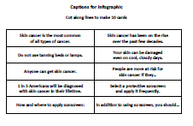
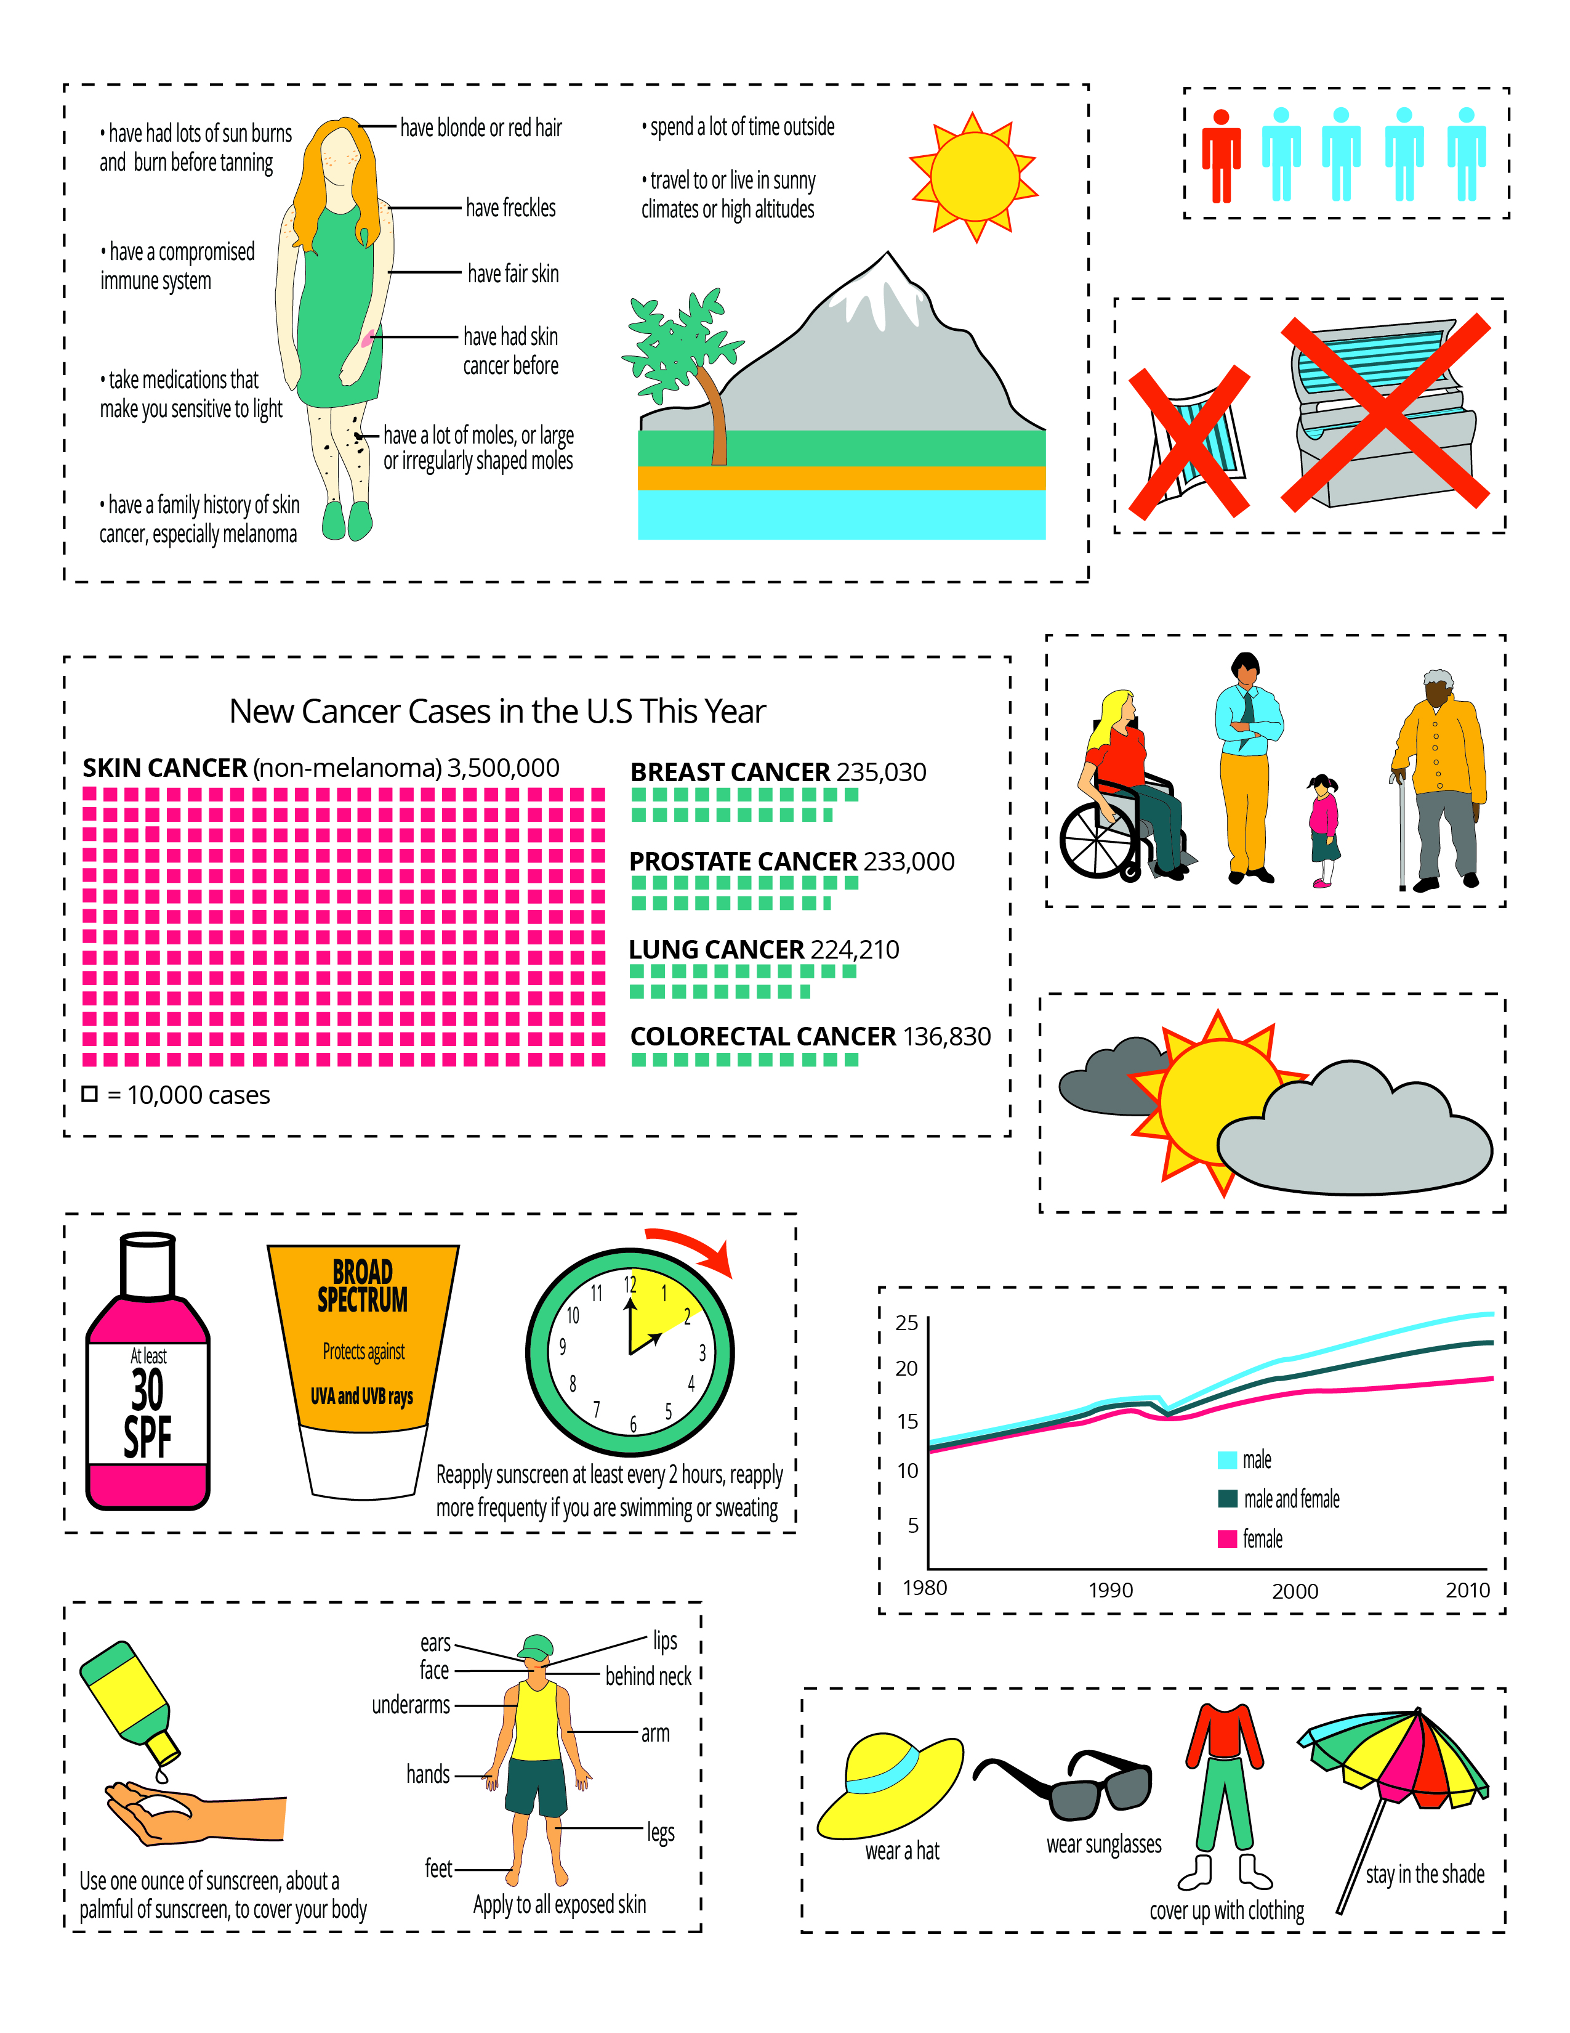
Notes:
Part 4: Sophia’s Story Continued
Ask a participant to read the information in the box.
Ask them to work with their partner to match the skin cancer pictures with the appropriate captions.
Then select the 5 most important pictures and use them to make a Skin Cancer and Sun Safety sheet.
Ask several participants to share which 5 they chose and explain why they chose those 5.

Slide 14
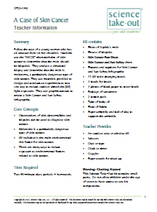
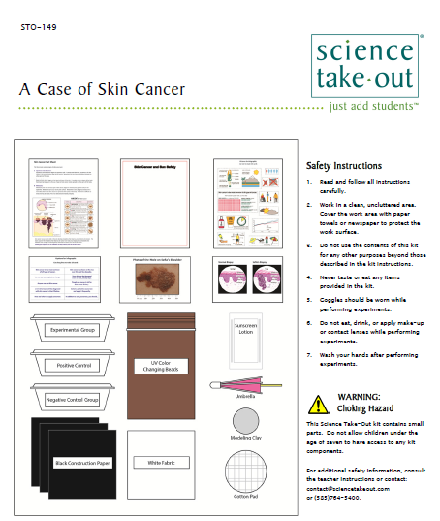
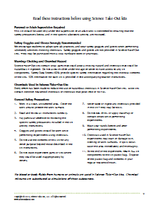
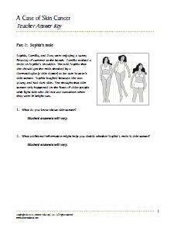
Teacher Information
Quick Guide
Safety
Key
Notes:
One copy of the Teacher Information is provided with each order. And also can be downloaded from the website (minus the key)
The teacher information includes: Summary, Core Concepts, Kit Contains, Teacher Provides, Time Required, Reusing, and information of refill kit contents.
Additional materials needed for this lab are safety goggles, scissors, tape or glue, and paper towel (for clean up).
Refills are available for the kits so that basic kit contents can be reused.
The teacher information includes hints for reusing kits and information on what is included in a refill kit.

Slide 15
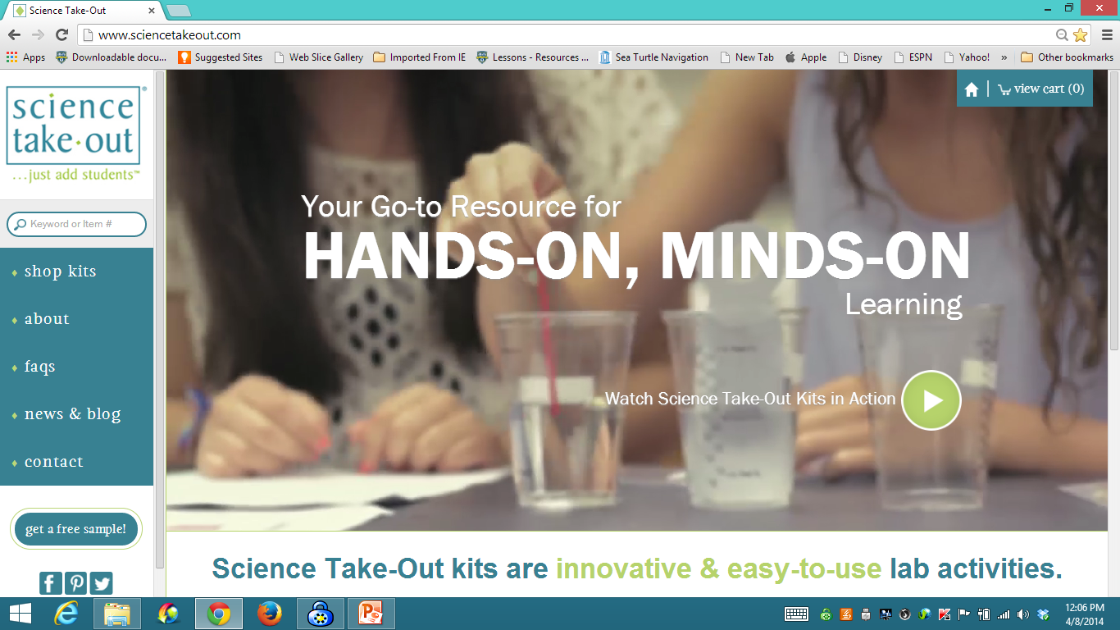
www.sciencetakeout.com
Purchase kits from
Notes:
The kit you used today is available from Science Take-Out as a completely assembled student kit.
Please explore the website to learn about other STO kits.
You can download the complete teacher instructions so that you can see what you are buying.

Slide 16
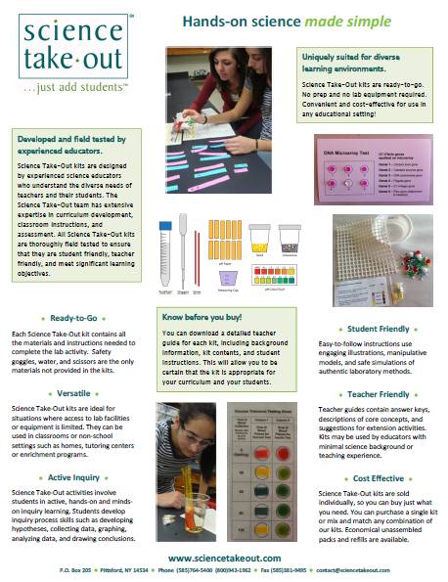
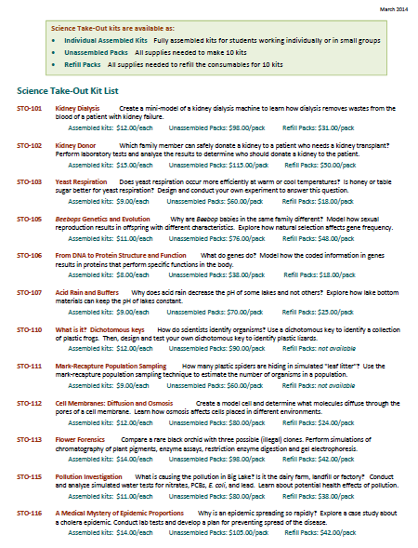
Individual Assembled Kits Fully assembled individual kits
Unassembled Packs All supplies needed to make 10 kits
Refill Packs All supplies needed to refill 10 kits
Notes:
You have a brochure that includes information on other Science Take-Out kits and a price list. Visit the Science Take-Out website to get further information for each kit.
At the website, you can download the teacher information for each kit to help you decide which kits you would like to purchase.
Science Take-Out kits are available as:
Individual Assembled Kits like the kits you used in this workshop
Unassembled Packs that contain all supplies needed to make 10 kits
Refill Packs that contain supplies needed to refill the consumables for 10 kits

Slide 17
Become Involved
as a Field Test Teacher
Help us make new Science Take-Out kits teacher and student friendly.
Indicate this on your card. Science Take-Out will contact you with further information
17
Notes:
Science Take-Out has received an NIH Small Business grant. Support from this grant will allow us to field test Science Take-Out kits
If you would like to be a field test teacher, indicate this by circling yes on your participant card. We will add you to our email list for field test teacher recruitment.
17

Slide 18
Become Involved
as a Workshop Presenter
Present a workshop to introduce colleagues to Science Take-Out kits
Visit the Science Take-Out website for further information
18
Notes:
Receive free kits for presenting Science Take-Out workshops
18

Slide 19
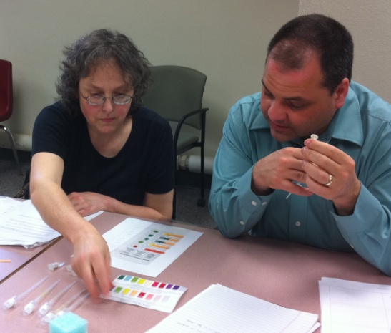
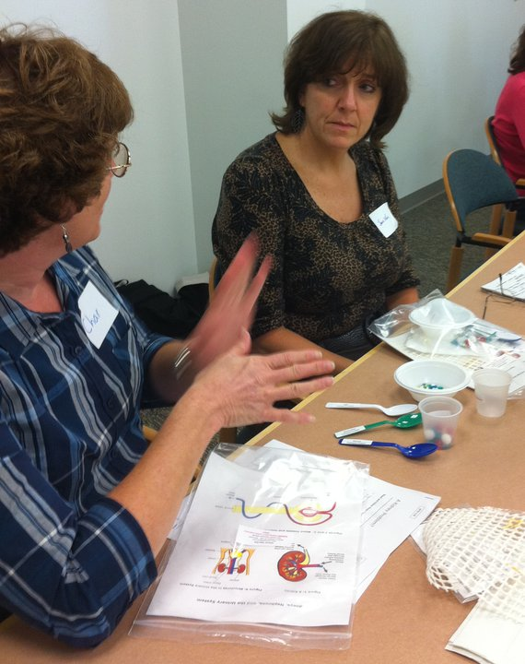
Thanks for being a GREAT group!!!
Please turn in your participant card
before you leave.
Notes:
Encourage teachers to write comments on the back of the participant survey card.
Please remember to collect participant feedback cards!!

