Slide 1
Modeling: Photosynthesis and Cellular Respiration
Notes:
Should be on screen as participants enter the room.
Start workshop on time—do not wait for “stragglers”
Welcome participants
Do NOT do participant introductions unless the workshop group is a very small one (less than 10 people)
Introduce yourself and explain your teaching experience and current position
Explain that this workshop is sponsored by Science Take-Out, a small company that manufactures and sells hands-on science kits for middle or high school biology students
The company is a “spin-off” initially formed to disseminate hands-on laboratory activities developed by the Life Sciences Learning Center, an outreach center at the University of Rochester.

Slide 2
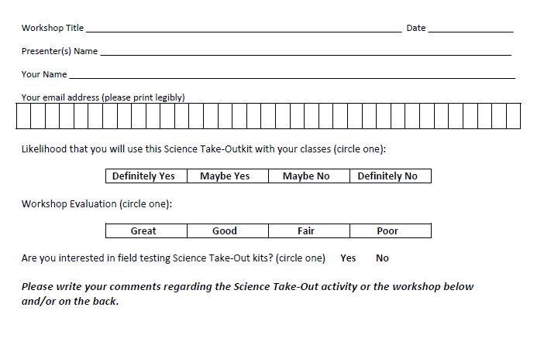
Please complete the “Participant Card”
2
Notes:
Because this workshop is supported through a grant from the National Institutes of Health, it is important that we collect data from workshop participants.
Please fill in the participant card during the workshop.
Use the space at the bottom and the back of the card to provide comments on the workshop or the kits used during the workshop.
2

Slide 3
Put your student hat on
Experience the kit
Put your teacher hat on
Envision classroom use
Curriculum integration
Support for students
Notes:
When we do hands-on workshops we ask you to switch between two hats as you work—your student hat and teacher hat.
We want to you work with partners to experience the kit by completing the activity
We encourage you also have conversations about how you might integrate this into your curriculum and/or support your students.
If you have questions, please call me over while you are working on the activity.
Also, you may find me interrupting to provide further explanation as you work.

Slide 4
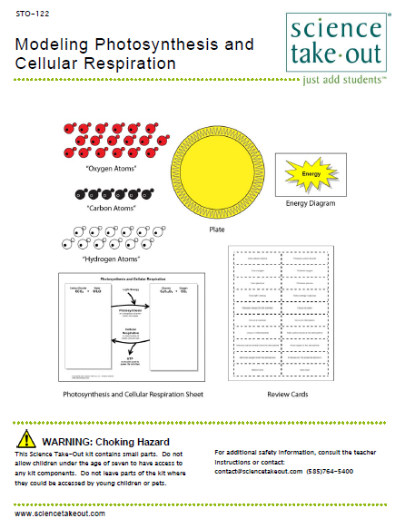
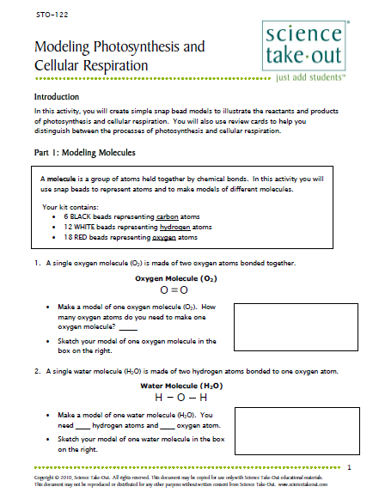
Photosynthesis and Respiration
Quick Guide
Safety
Turn to this page
Notes:
Distribute 1 KIT and 1 copy of the STUDENT INSTRUCTIONS to each PAIR OF TEACHERS
Each kit already comes with ONE student instruction handout.
Every kit comes with a cover sheet with a colored quick guide and safety instructions. Teachers should keep this in the kit if they are refilling it.
Teachers may make additional copies of the student instructions if their students are working in teams.
For today, you will be working in teams of 2.
One of you should use the student instructions in the kit bag. The other person should use the additional handout that we have provided.
This kit is designed as a very basic introduction to photosynthesis and respiration. The materials are intentionally kept very simple so that students can focus on the big picture of the relationship between photosynthesis and respiration.

Slide 5
Introduction
In this activity, you will create simple snap bead models to illustrate the reactants and products of photosynthesis and cellular respiration. You will also use review cards to help you distinguish between the processes of photosynthesis and cellular respiration.
Part 1: Modeling Molecules
A molecule is a group of atoms held together by chemical bonds. In this activity you will use snap beads to represent atoms and to make models of different molecules.
Your kit contains:
6 BLACK beads representing carbon atoms
12 WHITE beads representing hydrogen atoms
18 RED beads representing oxygen atoms
Notes:
Read introduction
Explain that students will not be making “realistic” molecular models. Part 1 introduces students to the models that they will use to represent molecules.
We suggest that you give teachers an overview of Parts 1 through 5 by showing the next 5 slides that summarize what students do in Parts 1 through 5. Then allow teachers to work at their own pace to complete the kit activities.

Slide 6
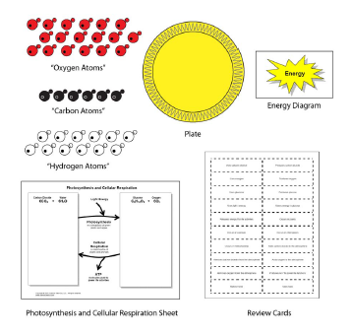
Notes:
In Part 1, students become familiar with molecular models—converting formulas to bead models.

Slide 7
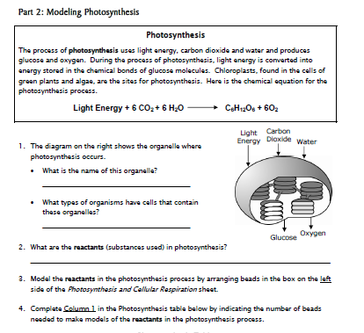
Notes:
In Part 2, students use a graphic organizer and beads to model the process of photosynthesis.
Explain that the Photosynthesis and Respiration graphic organizer helps students visualize the relationship between photosynthesis and respiration.

Slide 8
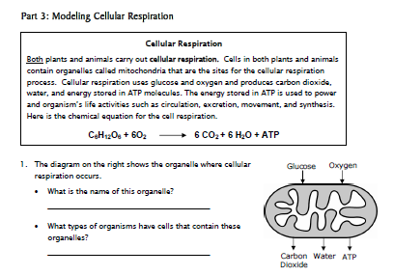
Notes:
In Part 3, students use the graphic organizer and beads to model the process of respiration.
Explain that the Photosynthesis and Respiration graphic organizer helps students visualize the relationship between photosynthesis and respiration.

Slide 9
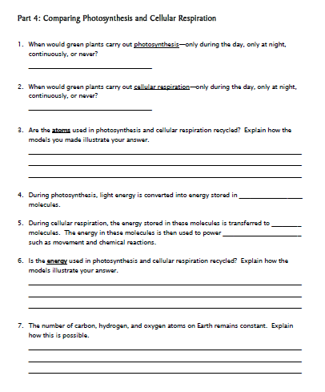
Notes:
In Part 4, students to compare the processes of photosynthesis and respiration.

Slide 10
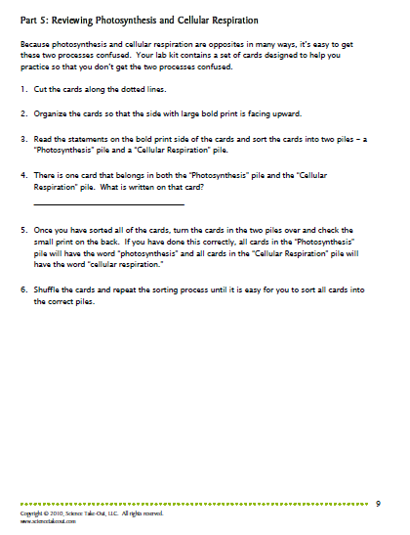
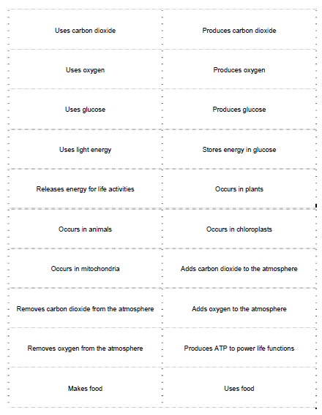
Notes:
Because many of the words are the same in the two processes, students easily get them confused. Part 5 allows students to practice distinguishing between the two processes. Notice that the answers are on the back of the cards so that students can check their own work.
Please work with your partner to complete the kit activities. As you finish each part, simply move on to the next part.

Slide 11
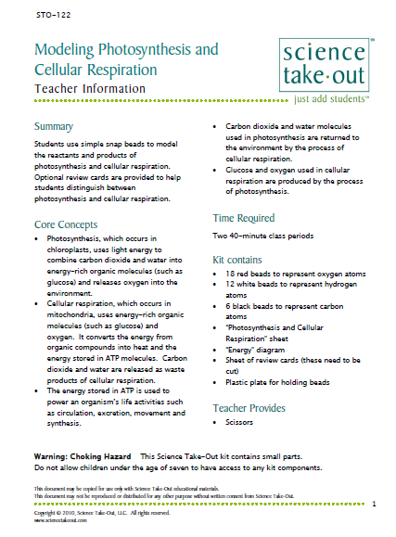
Teacher Information
Notes:
You can download the teacher information for Science Take-Out kits from the Science Take-Out website.

Slide 12
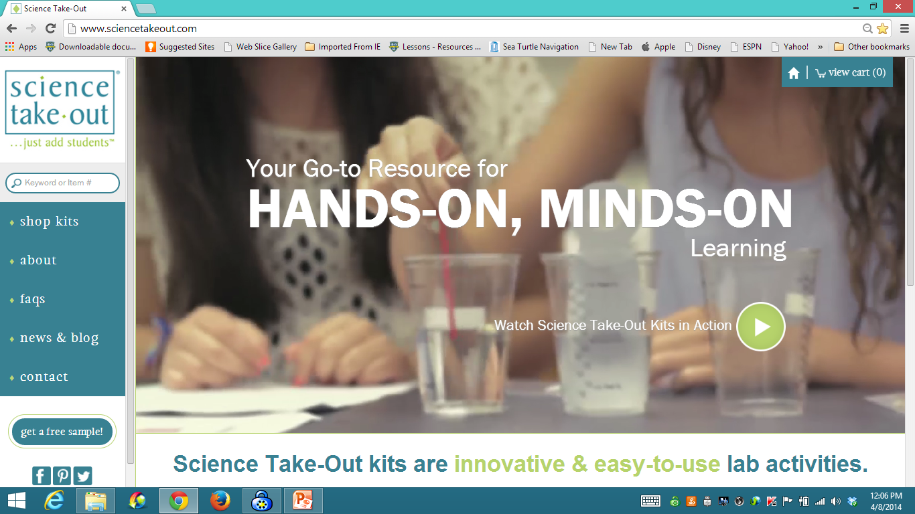
www.sciencetakeout.com
Purchase kits from
Notes:
The kit you used today is available from Science Take-Out as a completely assembled student kit.
Please explore the website to learn about other STO kits.
You can download the complete teacher instructions so that you can see what you are buying.

Slide 13
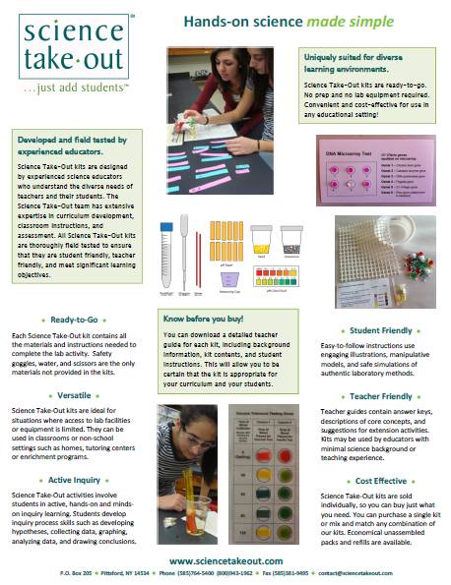
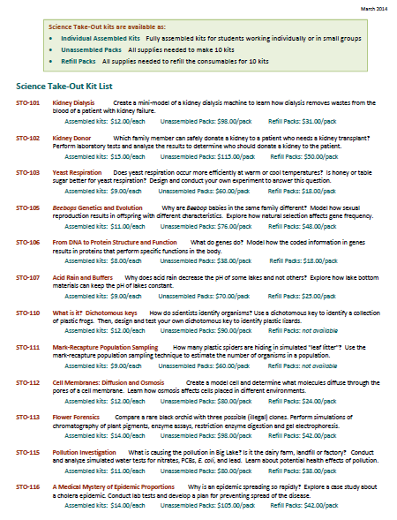
Individual Assembled Kits Fully assembled individual kits
Unassembled Packs All supplies needed to make 10 kits
Refill Packs All supplies needed to refill 10 kits
Notes:
You have a brochure that includes information on other Science Take-Out kits and a price list. Visit the Science Take-Out website to get further information for each kit.
At the website, you can download the teacher information for each kit to help you decide which kits you would like to purchase.
Science Take-Out kits are available as:
Individual Assembled Kits like the kits you used in this workshop
Unassembled Packs that contain all supplies needed to make 10 kits
Refill Packs that contain supplies needed to refill the consumables for 10 kits

Slide 14
Become Involved
as a Field Test Teacher
Help us make new Science Take-Out kits teacher and student friendly.
Indicate this on your card. Science Take-Out will contact you with further information
14
Notes:
Science Take-Out has received an NIH Small Business grant. Support from this grant will allow us to field test Science Take-Out kits
If you would like to be a field test teacher, indicate this by circling yes on your participant card. We will add you to our email list for field test teacher recruitment.
14

Slide 15
Become Involved
as a Workshop Presenter
Present a workshop to introduce colleagues to Science Take-Out kits
Visit the Science Take-Out website for further information
15
Notes:
Science Take-Out has received an NIH Small Business grant. Support from this grant will allow us to field test Science Take-Out kits
If you would like to be a field test teacher, indicate this by circling yes on your participant card. We will add you to our email list for field test teacher recruitment.
15

Slide 16
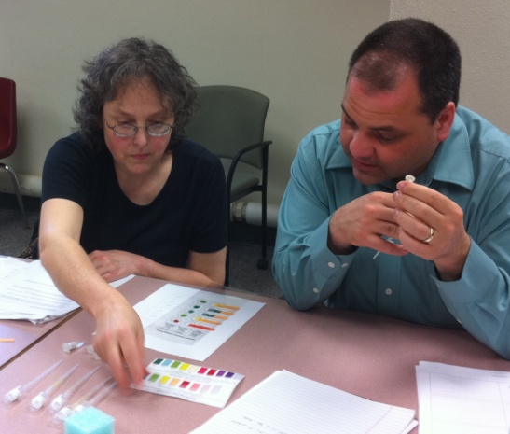
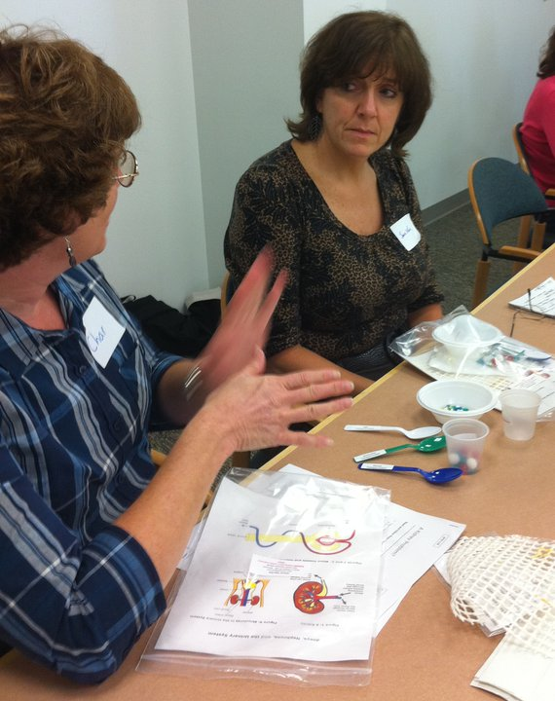
Thanks for being a GREAT group!!!
Please turn in your participant card
before you leave.
Notes:
Encourage teachers to write comments on the back of the participant survey card.
Please remember to collect participant feedback cards!!

