Slide 1
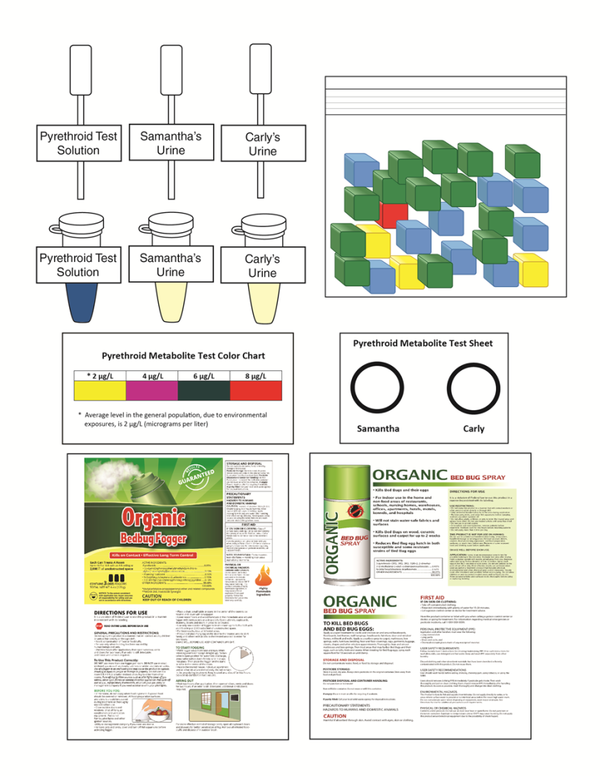

A Case of
Pesticide Poisoning
Notes:
This slide should be on screen as participants enter the room.
Start workshop on time—do not wait for “stragglers”
Welcome participants as they enter room
Do NOT do participant introductions unless the workshop group is a very small one (less than 10 people). Introduce self and briefly explain teaching experience and current position.

Slide 2
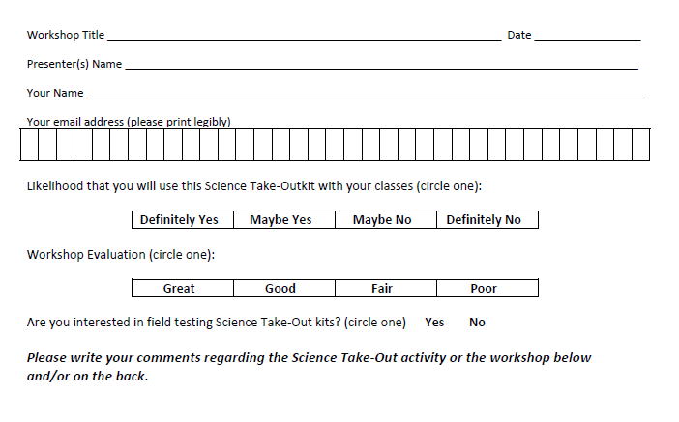
Please complete the “Participant Card”
2
Notes:
Because this workshop is supported through a grant from the National Institutes of Health, it is important that we collect data from workshop participants.
Please fill in the participant card during the workshop.
Use the space at the bottom and the back of the card to provide comments on the workshop or the kits used during the workshop.
2

Slide 3


Put your student hat on
Experience the kit
Put your teacher hat on
Envision classroom use
  Curriculum integration
  Support for students
Notes:
When we do hands-on workshops we ask you to switch between two hats as you work—your student hat and teacher hat.
We want to you work with partners to experience the kit by completing the activity
We encourage you also have conversations about how you might integrate this into your curriculum and/or support your students.
If you have questions, please call me over while you are working on the activity.
Also, you may find me interrupting to provide further explanation as you work.

Slide 4
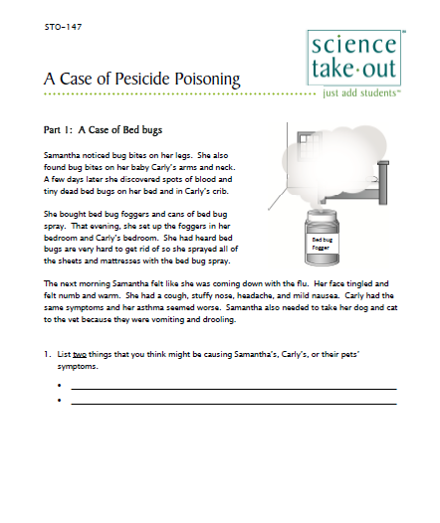
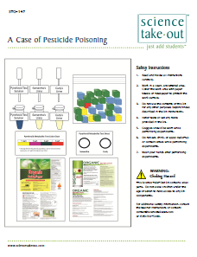
A Case of Pesticide Poisoning
Student Handouts
Student Instructions
Quick Guide
Safety
Turn to this page
Notes:
For today, you will be working in teams of 2.
DISTRIBUTE 1 KIT and 1 STUDENT INSTRUCTIONS to EACH PER PAIR OF TEACHERS
Every kit comes with a colored quick guide and safety instructions sheet. Keep this colored sheet in the kit bag if they plan to refill and reuse the kit.
Each kit comes with ONE student instruction handout. Teachers may make additional copies if their students are working in teams.
One of you should use the student instructions in the bag. The other person should use the additional handout that we have provided.

Slide 5
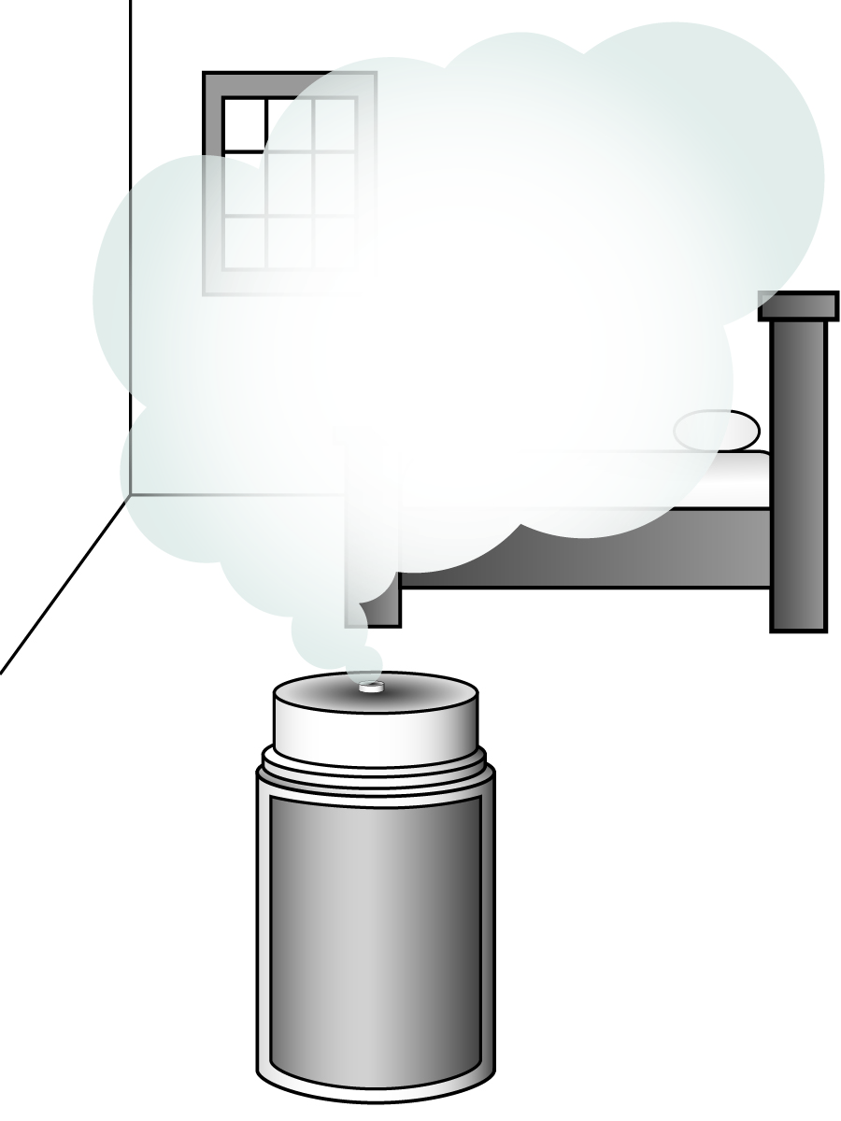
Part 1: A Case of Bed Bugs
Samantha noticed bug bites on her legs. She also found bug bites on her baby Carly’s arms and neck. A few days later she discovered spots of blood and tiny dead bed bugs on her bed and in Carly’s crib.
She bought bed bug foggers and cans of bed bug spray. That evening, she set up the foggers in her bedroom and Carly’s bedroom. She had heard bed bugs are very hard to get rid of so she sprayed all of the sheets and mattresses with the bed bug spray.
The next morning Samantha felt like she was coming down with the flu. Her face tingled and felt numb and warm. She had a cough, stuffy nose, headache, and mild nausea. Carly had the same symptoms and her asthma seemed worse. Samantha also needed to take her dog and cat to the vet because they were vomiting and drooling.
Notes:
Explain that this kit fits well with an environmental science or human impact unit.
Part 1: A Case of Bed Bugs
Ask a participant to read the case.
Ask several participants for things that might be causing the family’s symptoms.
Suggest that partners take turns reading/doing as they work through the activity. Explain that keeps partners working together. Also explain that it is a great way to keep students on task.

Slide 6
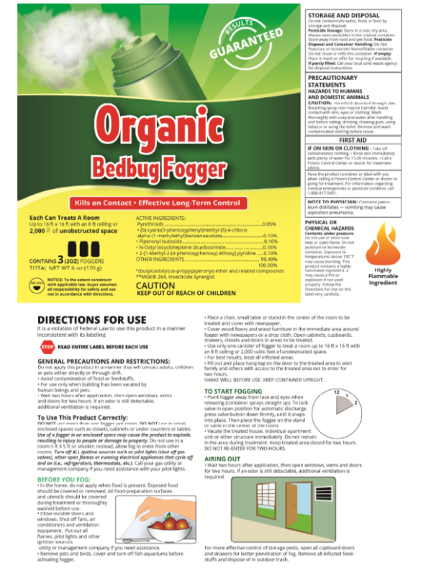

Part 2: What the Labels Say
Samantha took her dog and cat to the vet because she was worried that they had a disease carried by bed bugs. The vet reassured her that bed bugs do not carry cat, dog or human diseases. However, he explained that the pesticides often used to get rid of bed bugs are even more toxic for cats and dogs than they are for humans because their livers do not remove the pesticides quickly.
When Samantha told the vet that she had used bed bug foggers and sprays, he was concerned about not just the pets but also about Samantha and Carly. The vet told Samantha that it was important to go to the hospital emergency room because she and Carly might have pesticide poisoning too. He was most worried about Carly because a young child’s liver is not as efficient at removing pesticides as an adult’s liver.
When they got to the emergency room, Samantha told the doctors she and Carly might have been poisoned by bed bug pesticides. Luckily, Samantha had thought to bring the empty pesticide fogger and spray cans with her.
Notes:
Part 2: What the Labels Say
Ask a participant to read this part of the case.
Ask participants to work with their partner to complete Part 2.
They will need the labels from the kit. Suggest that each person be responsible for one label.
YES…there is a lot of reading on the label. These labels were modeled after the REAL labels on pesticide containers.
Consider a brief discussion about the importance of reading labels, particularly the directions for use.
Allow 5 minutes for completing Part 2.

Slide 7
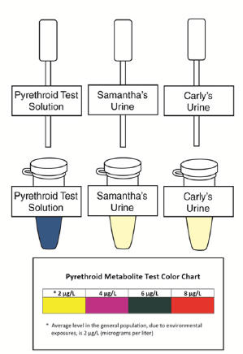
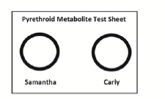
Part 3: Testing for Pyrethroid Metabolites
Pyrethroids may act as skin and respiratory allergens. Other symptoms include sneezing, nasal stuffiness, headache, nausea, incoordination, tremors, convulsions, facial flushing and swelling, and burning and itching sensations. Young children may have higher concentrations of pyrethroids because they are more likely to put contaminated hands and objects in their mouths.
The emergency room doctor explained that pyrethroids in the pesticide Samantha had used could enter the body by absorption through the skin, by inhalation, or by eating contaminated food. The doctor ordered medical tests to determine the concentration of pesticide metabolites in Samantha’s and Carly’s urine.
1. You will test urine samples from Samantha and Carly for the presence of pesticide metabolites. Pesticide metabolites are chemicals produced by the partial breakdown of pesticides.
Notes:
Part 3: Testing for Pyrethroid Metabolites
Read the case and ask participants to complete Part 3.

Slide 8
Part 4: Pesticides Made From Flowers
Notes:
Part 4: Pesticides Made From Flowers
This part includes two readings with related questions. It could be done for homework because no materials are needed.
Consider skipping this part during the workshop if you run short on time.

Slide 9
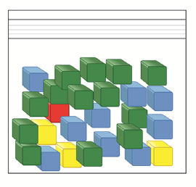
Part 5: Pyrethroids and Your Environment
Notes:
Part 5: Pyrethroids and Your Environment
Ask participants to work together to complete Part 5.

Slide 10
Teacher Information
Quick Guide
Safety
Key
SDS
Notes:
One copy of the Teacher Information is provided with each order. And also can be downloaded from the website (minus the key)
The teacher information includes: Summary, Core Concepts, Kit Contains, Teacher Provides, Time Required, Reusing, and information of refill kit contents.
Additional materials needed for this lab are safety goggles, scissors, tape or glue, and paper towel (for clean up).
Refills are available for the kits so that basic kit contents can be reused.
The teacher information includes hints for reusing kits and information on what is included in a refill kit.

Slide 11
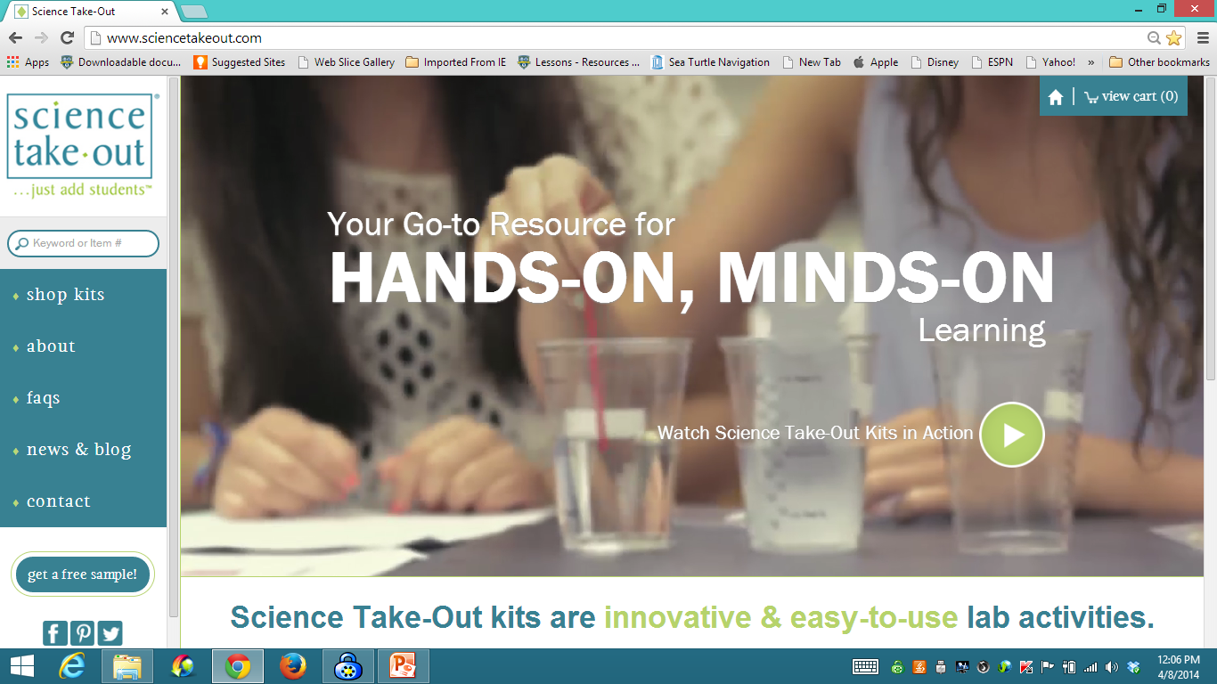
www.sciencetakeout.com
Purchase kits from
Notes:
The kit you used today is available from Science Take-Out as a completely assembled student kit.
Please explore the website to learn about other STO kits.
You can download the complete teacher instructions so that you can see what you are buying.

Slide 12
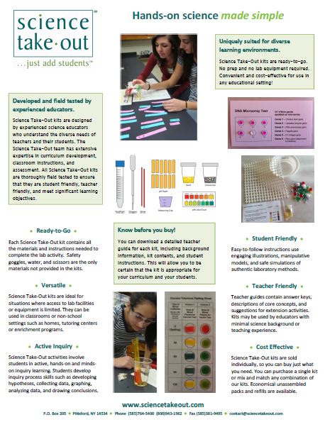
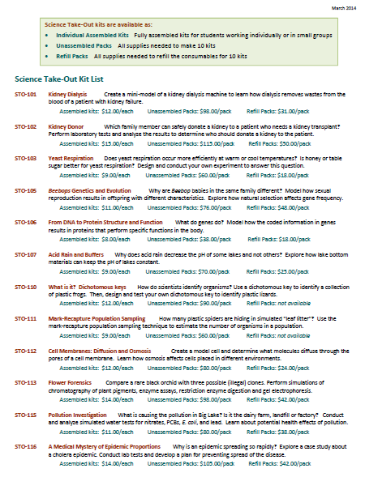
Individual Assembled Kits Fully assembled individual kits
Unassembled Packs All supplies needed to make 10 kits
Refill Packs All supplies needed to refill 10 kits
Notes:
You have a brochure that includes information on other Science Take-Out kits and a price list. Visit the Science Take-Out website to get further information for each kit.
At the website, you can download the teacher information for each kit to help you decide which kits you would like to purchase.
Science Take-Out kits are available as:
Individual Assembled Kits like the kits you used in this workshop
Unassembled Packs that contain all supplies needed to make 10 kits
Refill Packs that contain supplies needed to refill the consumables for 10 kits

Slide 13
Become Involved
as a Field Test Teacher
Help us make new Science Take-Out kits teacher and student friendly.
Indicate this on your card. Science Take-Out will contact you with further information
13
Notes:
Science Take-Out has received an NIH Small Business grant. Support from this grant will allow us to field test Science Take-Out kits
If you would like to be a field test teacher, indicate this by circling yes on your participant card. We will add you to our email list for field test teacher recruitment.
13

Slide 14
Become Involved
as a Workshop Presenter
Present a workshop to introduce colleagues to Science Take-Out kits
Visit the Science Take-Out website for further information
14
Notes:
Receive free kits for presenting Science Take-Out workshops
14

Slide 15
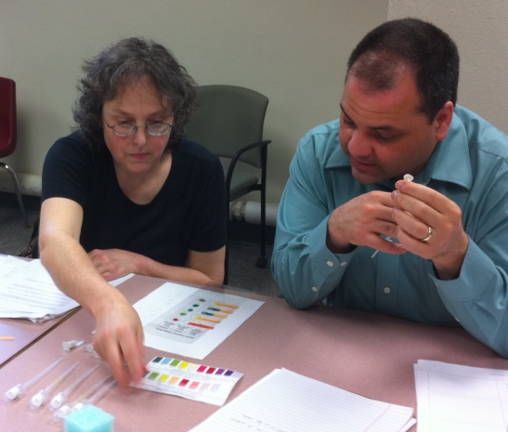
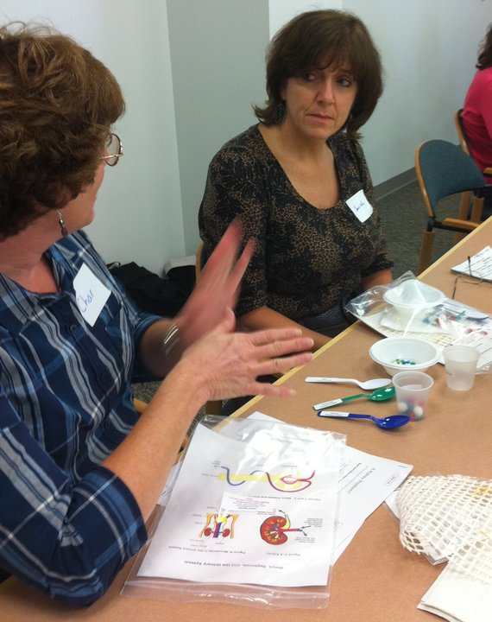
Thanks for being a GREAT group!!!
Please turn in your participant card
before you leave.
Notes:
Encourage teachers to write comments on the back of the participant survey card.
Please remember to collect participant feedback cards!!

