Slide 1
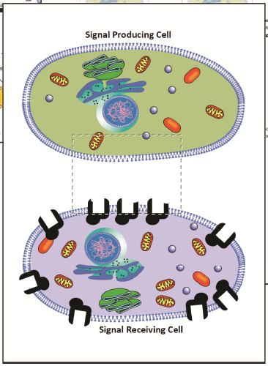
Cell Communication
Notes:
This slide should be on screen as participants enter the room.
Start workshop on time—do not wait for “stragglers”
Welcome participants as they enter room
Do NOT do participant introductions unless the workshop group is a very small one (less than 10 people). Introduce self and briefly explain teaching experience and current position.

Slide 2
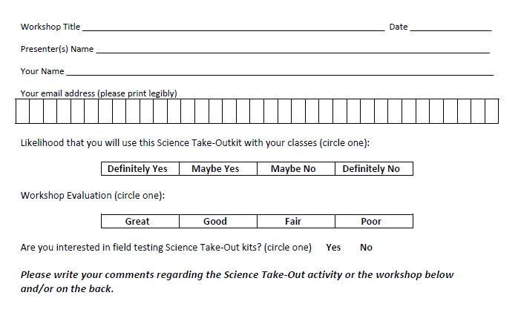
Please complete the “Participant Card”
2
Notes:
Because this workshop is supported through a grant from the National Institutes of Health, it is important that we collect data from workshop participants.
Please fill in the participant card during the workshop.
Use the space at the bottom and the back of the card to provide comments on the workshop or the kits used during the workshop.
2

Slide 3
Put your student hat on
Experience the kit
Put your teacher hat on
Envision classroom use
Curriculum integration
Support for students
Notes:
When we do hands-on workshops we ask you to switch between two hats as you work—your student hat and teacher hat.
We want to you work with partners to experience the kit by completing the activity
We encourage you also have conversations about how you might integrate this into your curriculum and/or support your students.
If you have questions, please call me over while you are working on the activity.
Also, you may find me interrupting to provide further explanation as you work.

Slide 4
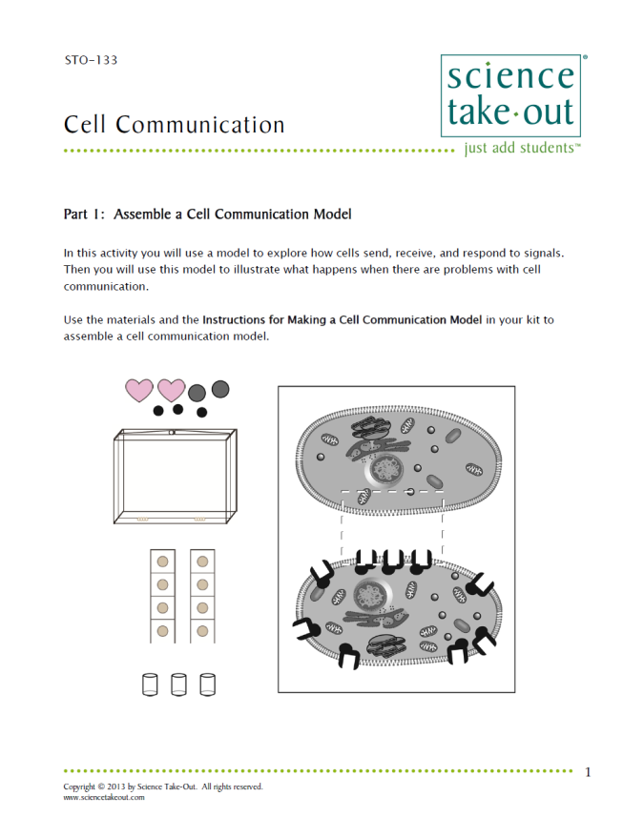
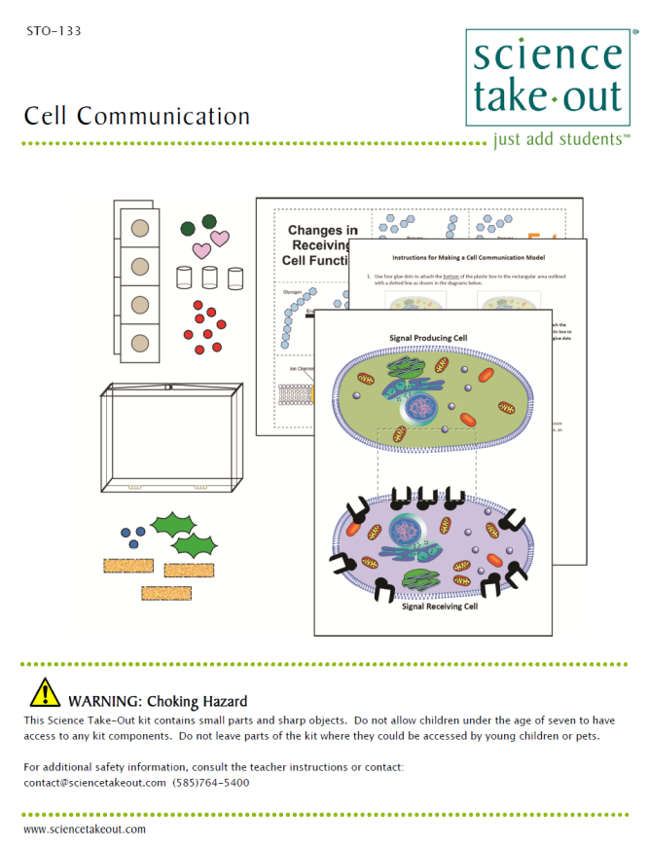
Cell Communication Student Handouts
Student Instructions
Quick Guide
Safety
Turn to this page
Notes:
For today, you will be working in teams of 2.
DISTRIBUTE 1 KIT and 1 STUDENT INSTRUCTIONS to EACH PER PAIR OF TEACHERS
Every kit comes with a colored quick guide and safety instructions sheet. Keep this colored sheet in the kit bag if they plan to refill and reuse the kit.
Each kit comes with ONE student instruction handout. Teachers may make additional copies if their students are working in teams.
One of you should use the student instructions in the bag. The other person should use the additional handout that we have provided.

Slide 5
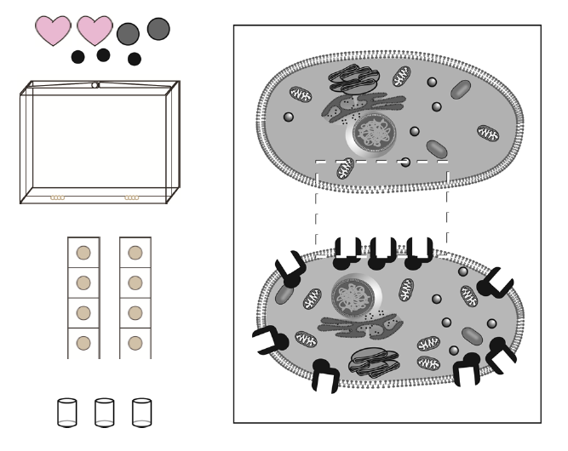
Notes:
Explain that this activity fits well with a cell unit or a nervous system/endocrine system unit.
Part 1: Assemble a Cell Communication Model
Explain that students will use the kit materials to make a cell communication model.
Note that the kit components are shown on the quick guide. If you want to make your own kits, you can look at the quick guide that is part of the teacher information.
You can download the complete teacher information from the Science Take-Out website.
Suggest that partners take turns reading/doing as they work through the activity. Explain that keeps partners working together. Also explain that it is a great way to keep students on task.

Slide 6
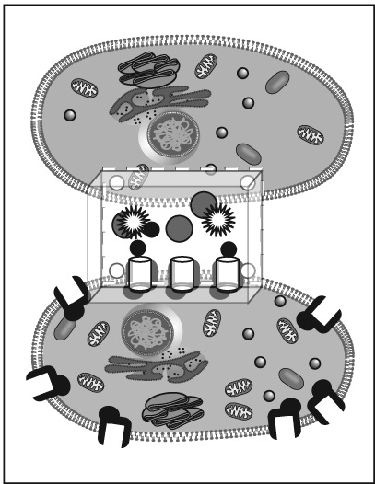
Notes:
Part 2: Play with your model
Once our focus group teachers made their model, they took some time to play with the model. So….we incorporated a bit of play into the lesson.
Ask participants to work with their partner to complete Part 1 and Part 2.
Participants should call you over if they need help with using the glue dots.
Allow 5 minutes for completing Part 1 and Part 2.

Slide 7
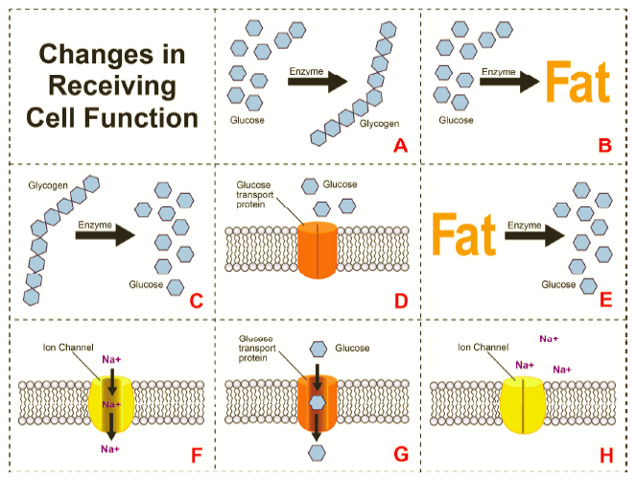
Notes:
Part 3: Cells Communicate to Regulate Blood Glucose Levels
Glucose regulation is a topic that most biology teachers use as an example of cell communication. The reading at the top of the page provides information on glucose regulation. Students are asked to relate their model to how insulin works to reduce blood sugar.
Explain that they will need the colored diagram sheet in the kit.

Slide 8
Notes:
Part 4: Diabetes—A Cell Communication Problem
Students are asked to think about how their model could be changed to represent what happens if someone has Type 1 or Type 2 diabetes.
Ask teachers to read and do Parts 3 and 4.
Allow 10 minutes for Parts 3 and 4.

Slide 9
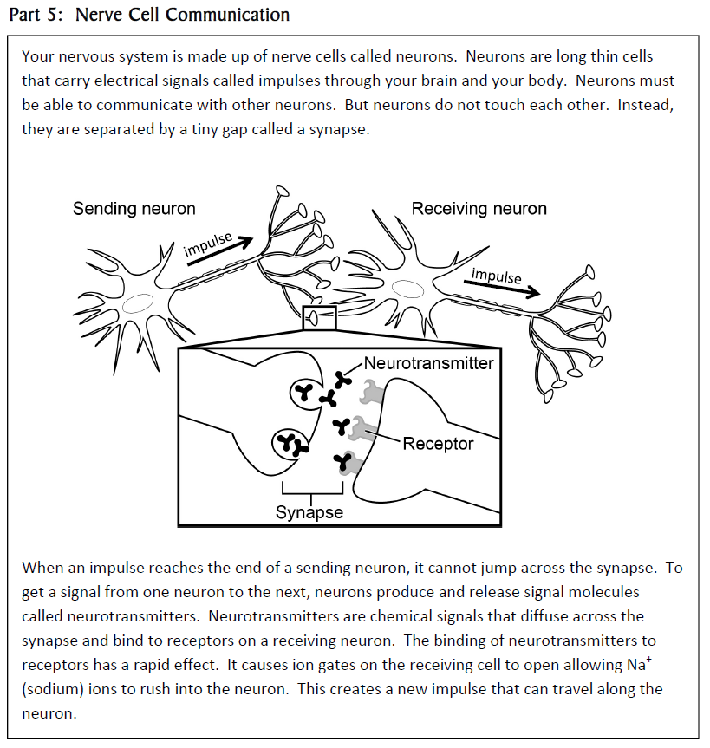
Notes:
Part 5: Nerve Cell Communication
Some teachers wait to do this part until they do the nervous system. Others do the complete activity at one time.
Students appreciate discovering that they can also apply their model to nerve cell communication.

Slide 10
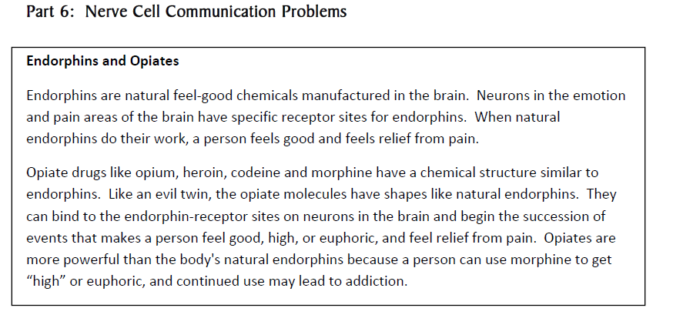
Notes:
Part 6: Nerve Cell Communication Problems
Endorphins and opiates are examples of how other chemicals can interfere with cell communication.
Ask participants to work together to complete Parts 5 and 6.
Allow 10 minutes for Parts 5 and 6.

Slide 11
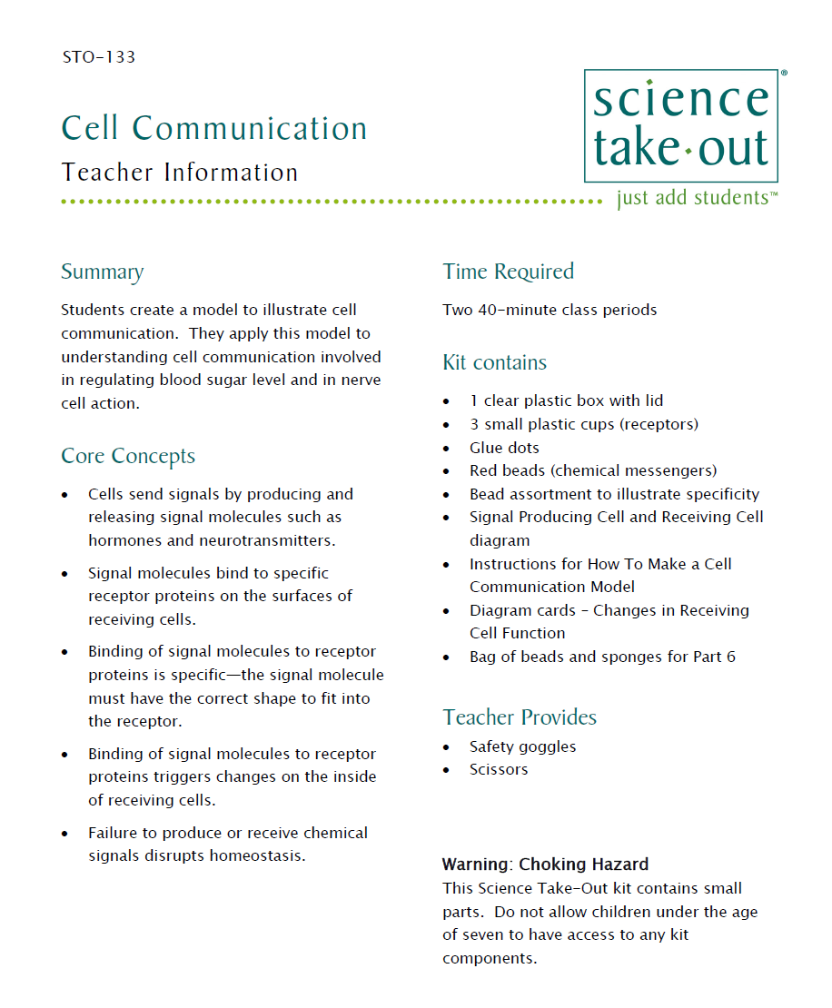
Teacher Information
Quick Guide
Safety
Key
MSDS
Notes:
One copy of the Teacher Information is provided with each order. And also can be downloaded from the website (minus the key)
The teacher information includes: Summary, Core Concepts, Kit Contains, Teacher Provides, Time Required, Reusing, and information of refill kit contents.
Additional materials needed for this lab are safety goggles, scissors, tape or glue, and paper towel (for clean up).
Refills are available for the kits so that basic kit contents can be reused.
The teacher information includes hints for reusing kits and information on what is included in a refill kit.

Slide 12
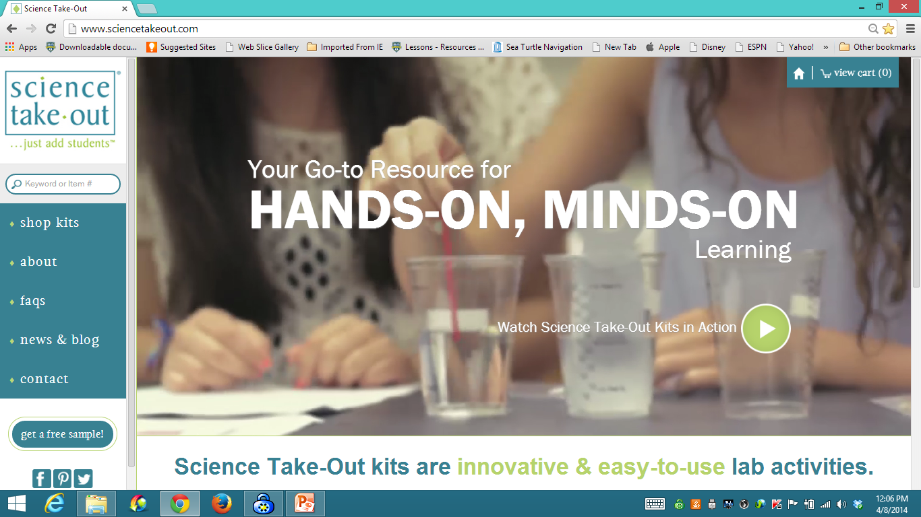
www.sciencetakeout.com
Purchase kits from
Notes:
The kit you used today is available from Science Take-Out as a completely assembled student kit.
Please explore the website to learn about other STO kits.
You can download the complete teacher instructions so that you can see what you are buying.

Slide 13
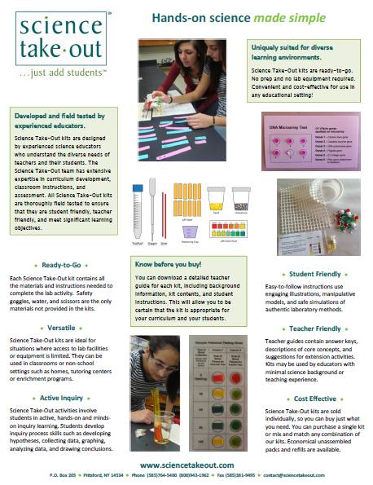
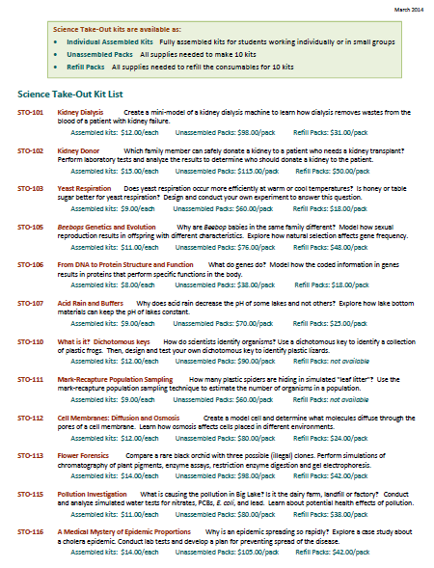
Individual Assembled Kits Fully assembled individual kits
Unassembled Packs All supplies needed to make 10 kits
Refill Packs All supplies needed to refill 10 kits
Notes:
You have a brochure that includes information on other Science Take-Out kits and a price list. Visit the Science Take-Out website to get further information for each kit.
At the website, you can download the teacher information for each kit to help you decide which kits you would like to purchase.
Science Take-Out kits are available as:
Individual Assembled Kits like the kits you used in this workshop
Unassembled Packs that contain all supplies needed to make 10 kits
Refill Packs that contain supplies needed to refill the consumables for 10 kits

Slide 14
Become Involved
as a Field Test Teacher
Help us make new Science Take-Out kits teacher and student friendly.
Indicate this on your card. Science Take-Out will contact you with further information
14
Notes:
Science Take-Out has received an NIH Small Business grant. Support from this grant will allow us to field test Science Take-Out kits
If you would like to be a field test teacher, indicate this by circling yes on your participant card. We will add you to our email list for field test teacher recruitment.
14

Slide 15
Become Involved
as a Workshop Presenter
Present a workshop to introduce colleagues to Science Take-Out kits
Visit the Science Take-Out website for further information
15
Notes:
Science Take-Out has received an NIH Small Business grant. Support from this grant will allow us to field test Science Take-Out kits
If you would like to be a field test teacher, indicate this by circling yes on your participant card. We will add you to our email list for field test teacher recruitment.
15

Slide 16
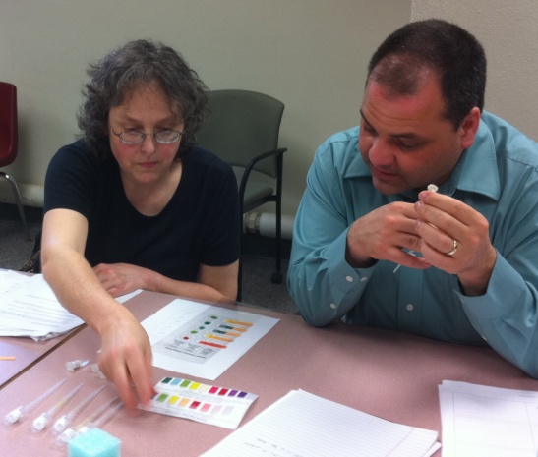
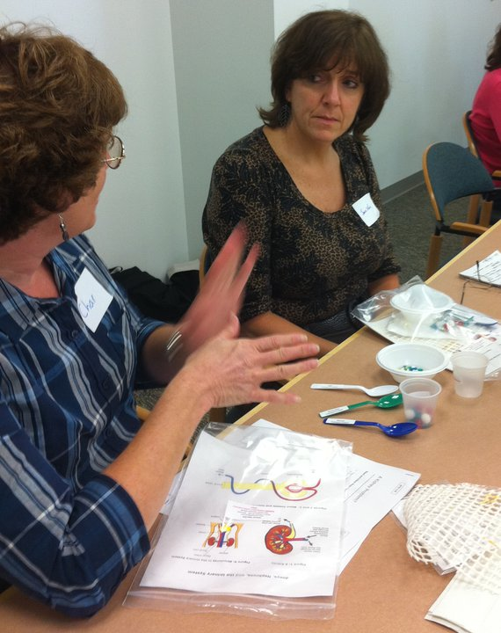
Thanks for being a GREAT group!!!
Please turn in your participant card
before you leave.
Notes:
Encourage teachers to write comments on the back of the participant survey card.
Please remember to collect participant feedback cards!!

