Slide 1
An Unhealthy Home
Note: You will need to provide paper towels for participants.

Slide 2
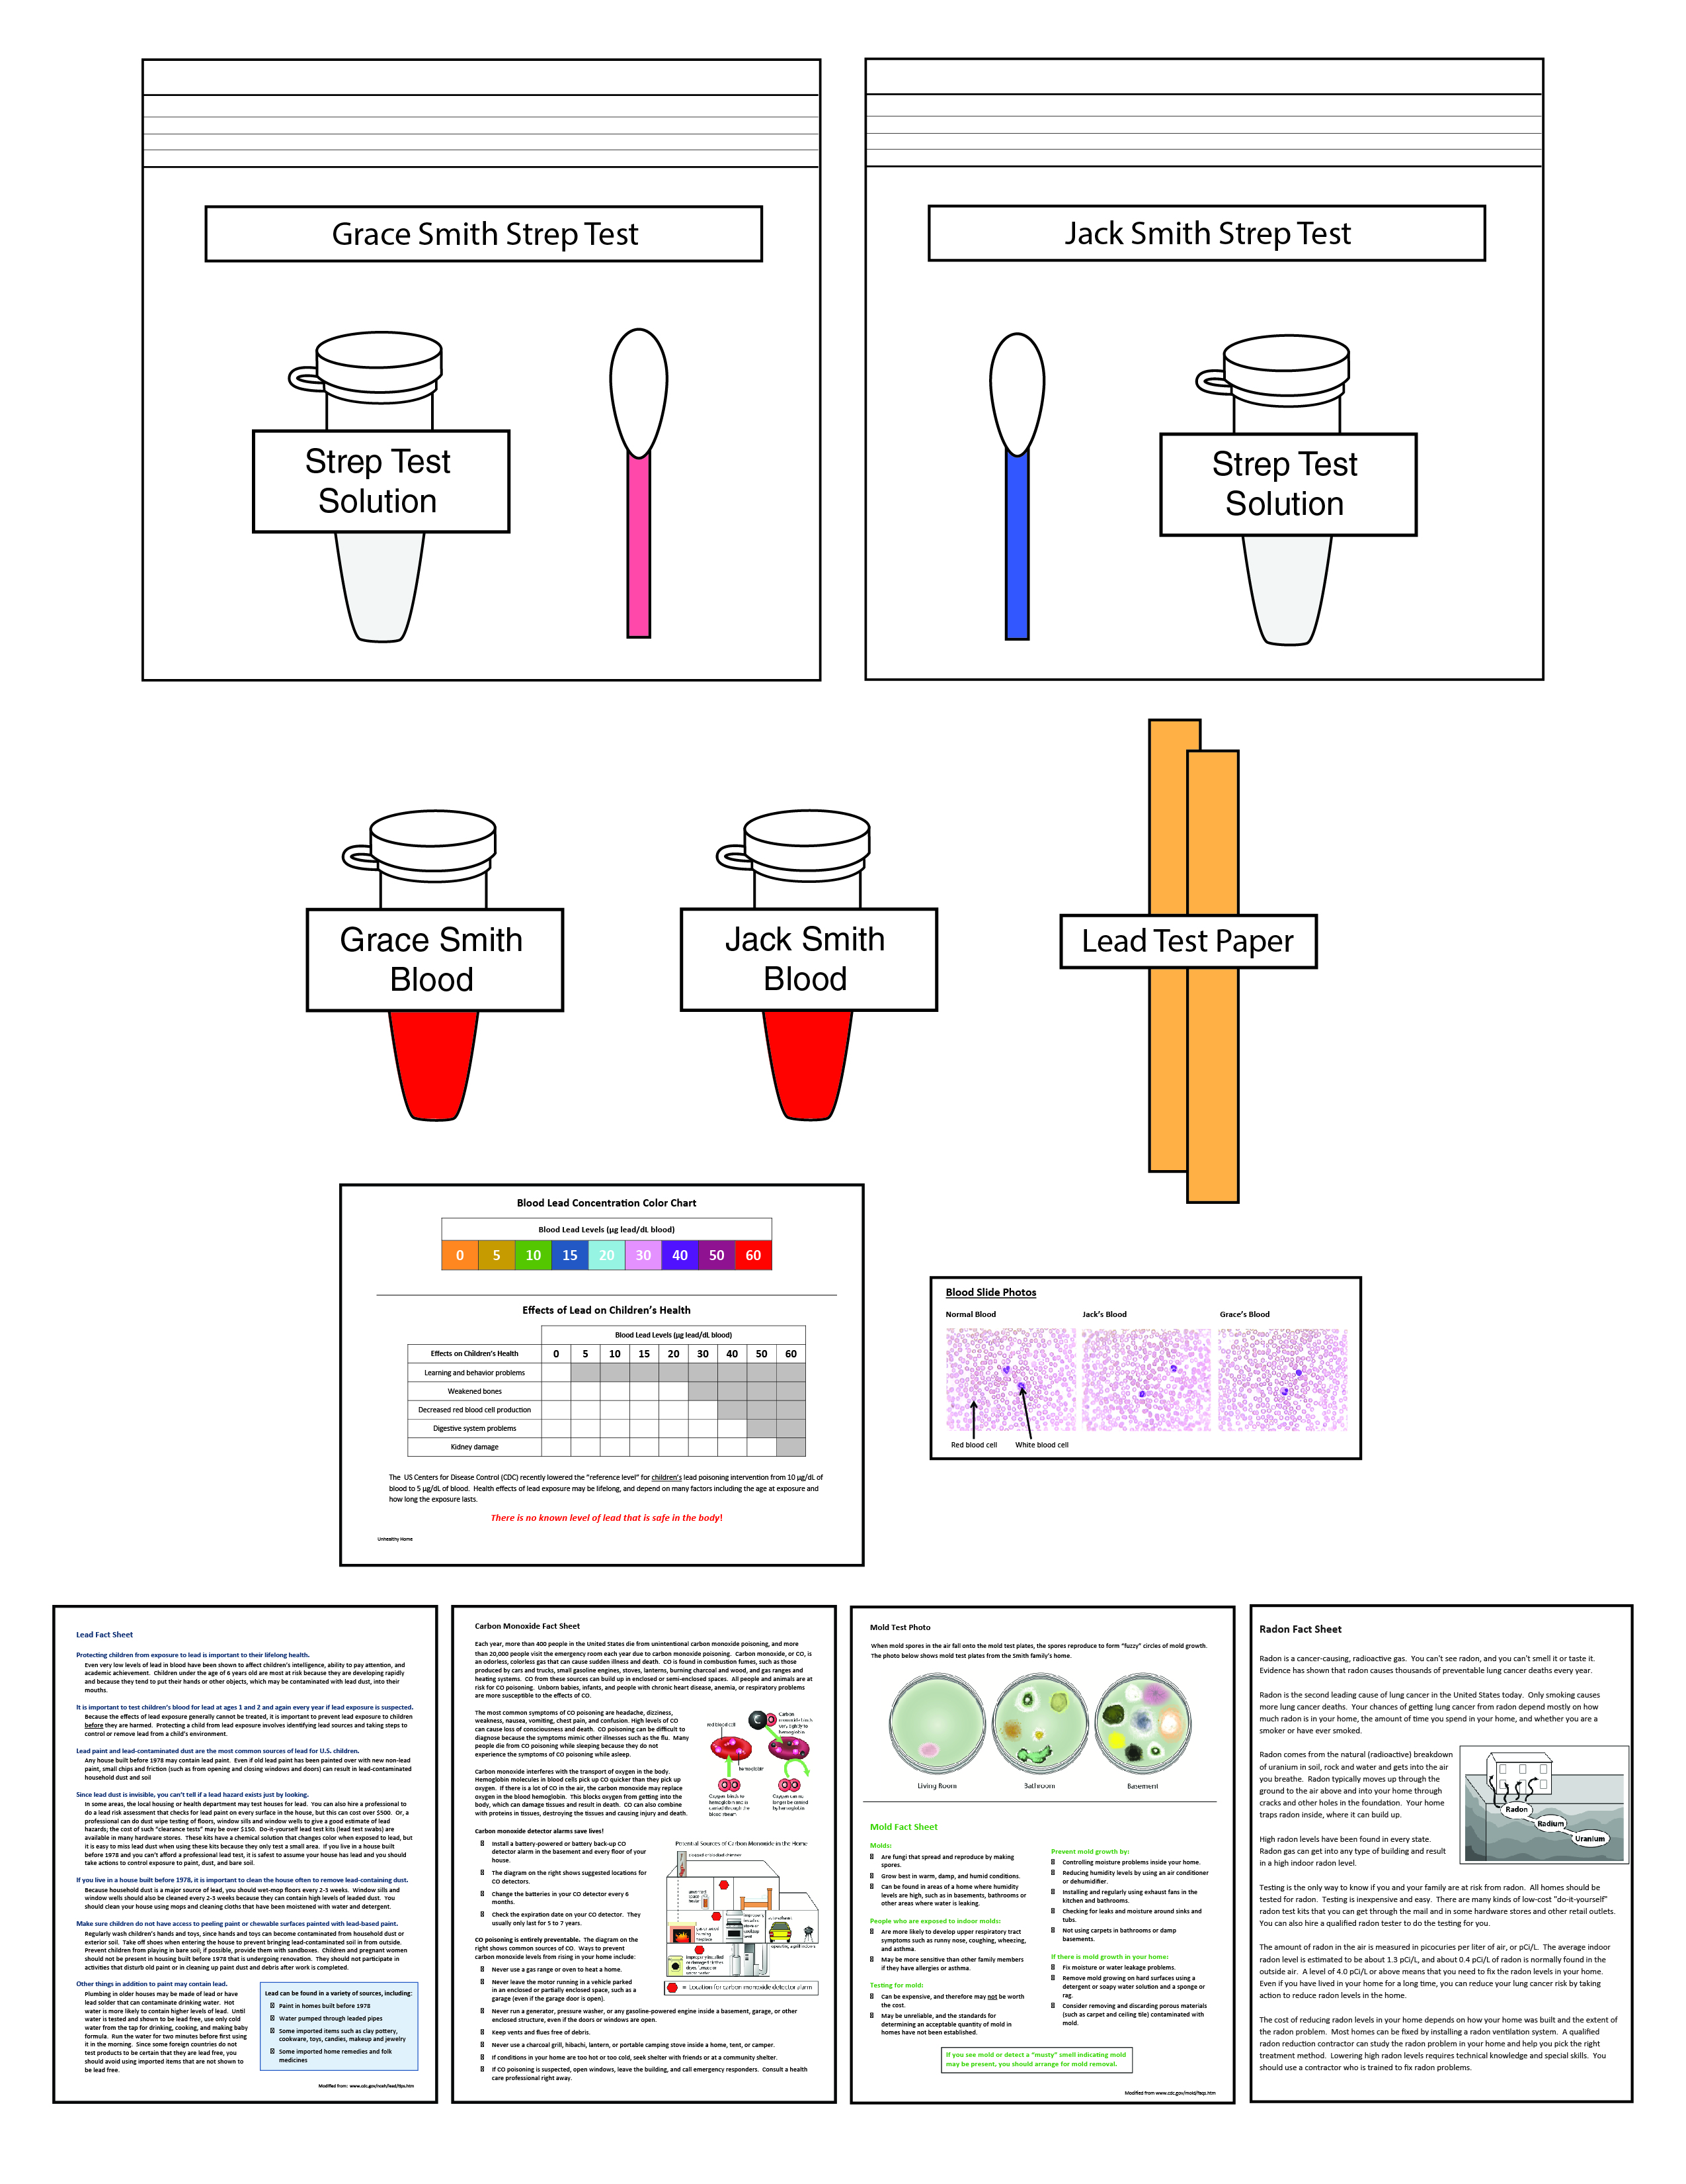

An Unhealthy Home
Notes:
This slide should be on screen as participants enter the room.
Start workshop on time—do not wait for “stragglers”
Welcome participants as they enter room
Do NOT do participant introductions unless the workshop group is a very small one (less than 10 people). Introduce self and briefly explain teaching experience and current position.

Slide 3
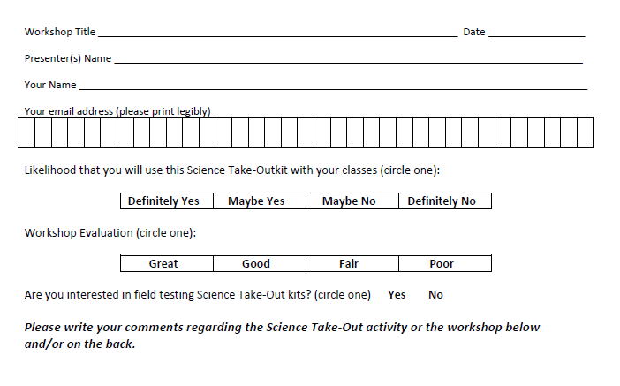
Please complete the “Participant Card”
Notes:
Because this workshop is supported through a grant from the National Institutes of Health, it is important that we collect data from workshop participants.
Please fill in the participant card during the workshop.
Use the space at the bottom and the back of the card to provide comments on the workshop or the kits used during the workshop.
3

Slide 4


Put your student hat on
Experience the kit
Put your teacher hat on
Envision classroom use
  Curriculum integration
  Support for students
Notes:
When we do hands-on workshops we ask you to switch between two hats as you work—your student hat and teacher hat.
We want to you work with partners to experience the kit by completing the activity
We encourage you also have conversations about how you might integrate this into your curriculum and/or support your students.
If you have questions, please call me over while you are working on the activity.
Also, you may find me interrupting to provide further explanation as you work.

Slide 5
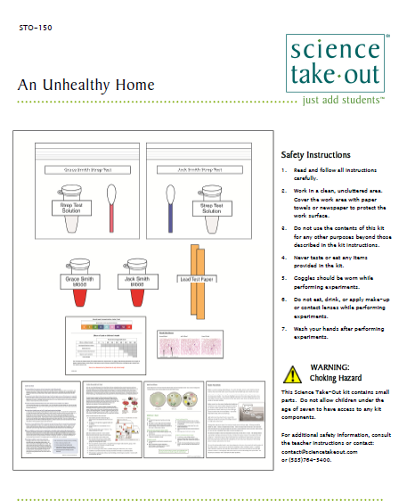
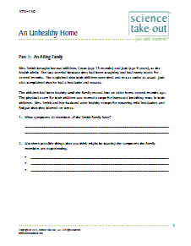
An Unhealthy Home
Student Instructions
Quick Guide
Safety
Turn to this page
Notes:
For today, you will be working in teams of 2.
DISTRIBUTE 1 KIT and 1 STUDENT INSTRUCTIONS to EACH PER PAIR OF TEACHERS
Every kit comes with a colored quick guide and safety instructions sheet. Keep this colored sheet in the kit bag if they plan to refill and reuse the kit.
Each kit comes with ONE student instruction handout. Teachers may make additional copies if their students are working in teams.
One of you should use the student instructions in the bag. The other person should use the additional handout that we have provided.
Explain that the An Unhealthy Home kit fits well with an environmental science unit or human physiology unit.
Explain that students will use the kit materials to learn how environmental factors in homes may affect human health.

Slide 6
Part 1: An Ailing Family
Mrs. Smith brought her two children, Grace (age 18 months) and Jack (age 4 years), to the health clinic. She was worried because they had been coughing and had runny noses for several months. She explained that both children were tired and not as active as usual. Jack also complained that he had a headache and nausea.
The children had been healthy until the family moved into an older home several months ago. The physical exam for both children was normal except for increased breathing rates in both children. Mrs. Smith and her husband were healthy except for recurring mild headaches and fatigue that they blamed on stress.
Notes:
Part 1: An Ailing Family
Suggest that partners take turns reading/doing as they work through the activity. Explain that keeps partners working together. Also explain that it is a great way to keep students on task.
Ask one participant to read the information in the first two paragraphs of Part 1.
Consider having participants share their answers to the questions in Part 1.
Point out that Part 1 may be done for prelab homework.

Slide 7
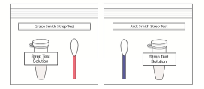
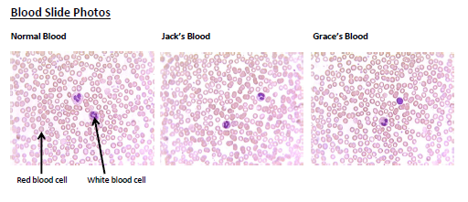
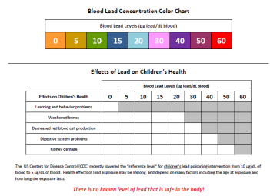

Part 2: Medical Tests
The nurse practitioner at the clinic was concerned because the children had been experiencing symptoms for two months. She ordered a strep test and blood tests (white blood cell count and blood lead level).
Strep Test
A strep test is used to determine if a patient has strep throat, an infection caused by Streptococcus bacteria.
White Blood Cell Count
A larger than normal number of white blood cells indicates that a patient may have an infection.
Blood Lead Test
A blood lead test is used to determine if a patient is suffering from lead poisoning. People who seem healthy can still have high levels of lead in their blood.
Notes:
Part 2: Medical Tests
Note that Part 2 should be done during class.
Ask one participant to read the paragraph at the beginning of Part 2.
Ask participants to work with their partners to complete Part 2. They should follow the instructions for the Strep Tests, White Blood Cell Counts, and Blood Lead Tests.
Ask one group to share their answers to summarize the results of these tests.

Slide 8
Part 3: Healthy Home Inspection
The public health nurse noticed a “musty” odor in the home that might indicate the presence of mold. He suggested that Jack and Grace’s respiratory symptoms might be due to high levels of mold in their home.
Notes:
Part 3: Healthy Home Inspection
Ask one participant to read the first two paragraphs in Part 3.
Students use information from a fact sheet to answer questions about mold contamination.
Part 3 may be done in class or for homework.
Ask participants to work with their partner to answer the questions in Part 3.
Allow 5 minutes. Then explain you would like to move on so that they have time to experience Part 4.

Slide 9
Part 4: Another Health Hazard
The public health nurse noted that the Smiths’ home had not been tested for radon. He suggested that the Smiths purchase and follow the instructions for a short term home radon test kit.
Notes:
Part 4: Another Health Hazard
Ask one participant to read the first paragraph in Part 4.
Students use information from a fact sheet to answer questions about radon hazards
Part 4 may be done in class or for homework.
Ask participants to work with their partner to answer the questions in Part 4.
Allow 5 minutes. Then explain you would like to move on so that they have time to experience Part 5.

Slide 10
Part 5: An Emergency Health Hazard
The public health nurse noticed that the Smith family had a carbon monoxide detector that needed new batteries. When he replaced the batteries in the carbon monoxide detector, it beeped loudly to indicate that the home had high levels of carbon monoxide.
Notes:
Part 5: An Emergency Health Hazard
Ask one participant to read the first two paragraphs in Part 5.
Students use information from a fact sheet to answer questions about radon hazards
Part 5 may be done in class or for homework.
Ask participants to work with their partner to answer the questions in Part 5.
Allow 5 minutes. Then explain you would like to move on to allow time for discussion of how to help students learn more about home health hazards and apply what they learned to their homes.

Slide 11
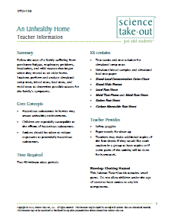
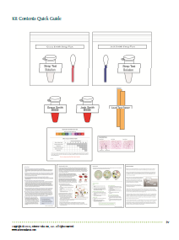
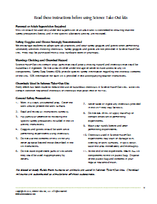
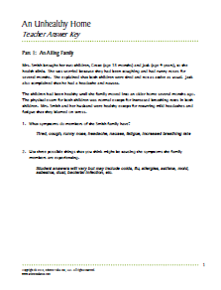
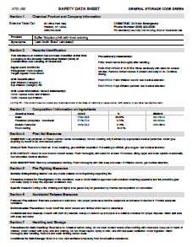
Teacher Information
Quick Guide
Safety
Key
SDS
Notes:
One copy of the Teacher Information is provided with each order. And also can be downloaded from the website (minus the key)
The teacher information includes: Summary, Core Concepts, Kit Contains, Teacher Provides, Time Required, Reusing, and information of refill kit contents.
Additional materials needed for this lab are safety goggles, scissors, tape or glue, and paper towel (for clean up).
Refills are available for the kits so that basic kit contents can be reused.
The teacher information includes hints for reusing kits and information on what is included in a refill kit.

Slide 12
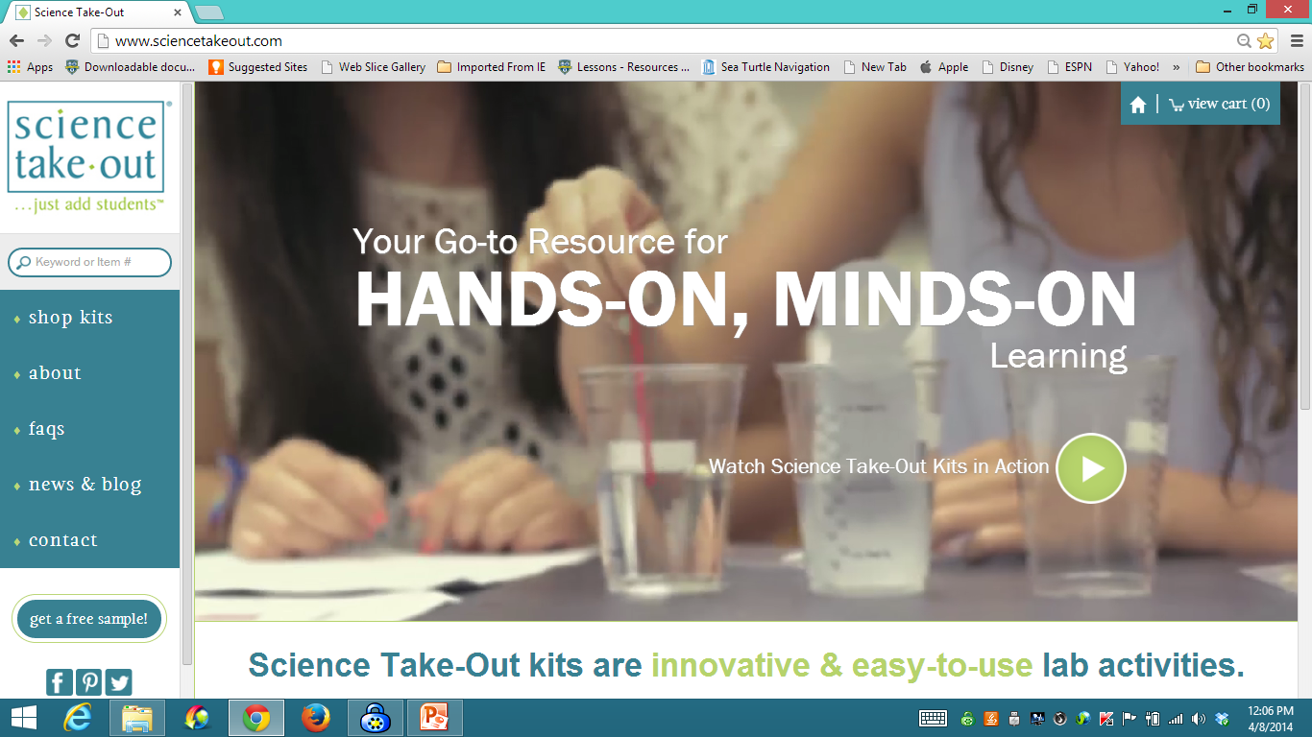
www.sciencetakeout.com
Purchase kits from
Notes:
The kit you used today is available from Science Take-Out as a completely assembled student kit.
Please explore the website to learn about other STO kits.
You can download the complete teacher instructions so that you can see what you are buying.

Slide 13
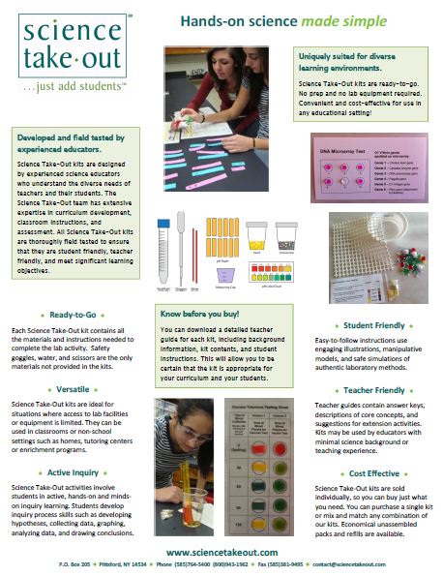
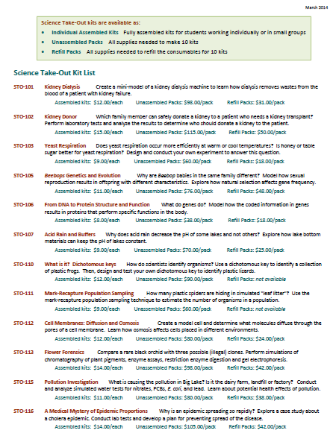
Individual Assembled Kits Fully assembled individual kits
Unassembled Packs All supplies needed to make 10 kits
Refill Packs All supplies needed to refill 10 kits
Notes:
You have a brochure that includes information on other Science Take-Out kits and a price list. Visit the Science Take-Out website to get further information for each kit.
At the website, you can download the teacher information for each kit to help you decide which kits you would like to purchase.
Science Take-Out kits are available as:
Individual Assembled Kits like the kits you used in this workshop
Unassembled Packs that contain all supplies needed to make 10 kits
Refill Packs that contain supplies needed to refill the consumables for 10 kits

Slide 14
Become Involved
as a Field Test Teacher
Help us make new Science Take-Out kits teacher and student friendly.
Indicate this on your card. Science Take-Out will contact you with further information
14
Notes:
Science Take-Out has received an NIH Small Business grant. Support from this grant will allow us to field test Science Take-Out kits
If you would like to be a field test teacher, indicate this by circling yes on your participant card. We will add you to our email list for field test teacher recruitment.
14

Slide 15
Become Involved
as a Workshop Presenter
Present a workshop to introduce colleagues to Science Take-Out kits
Visit the Science Take-Out website for further information
15
Notes:
Receive free kits for presenting Science Take-Out workshops
15

Slide 16
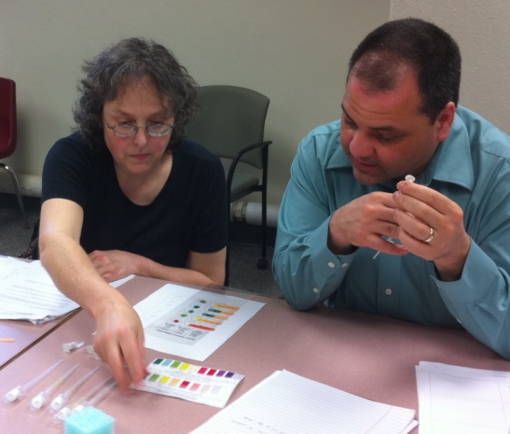
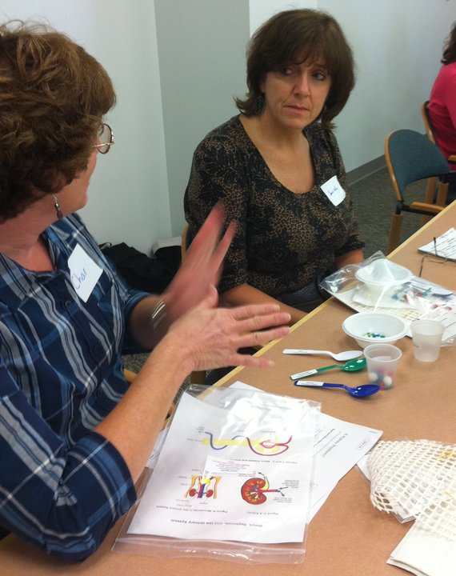
Thanks for being a GREAT group!!!
Please turn in your participant card
before you leave.
Notes:
Encourage teachers to write comments on the back of the participant survey card.
Please remember to collect participant feedback cards!!

