Slide 1

Kidney Donor
Notes:
Should be on screen as participants enter the room.
Start workshop on time—do not wait for “stragglers”
Welcome participants as they enter room
Do NOT do participant introductions unless the workshop group is a very small one (less than 10 people). Introduce self and briefly explain teaching experience and current position.
The activity that you will do today was developed by Life Sciences Learning Center at the University of Rochester. We found that teachers wanted access to the activities that we developed even after our grant support had ended.
To provide for sustained dissemination, we formed a small spin-off company called Science Take-Out. Explain that Science Take-Out is a small company that manufactures and sells hands-on science kits for middle and high school biology students

Slide 2
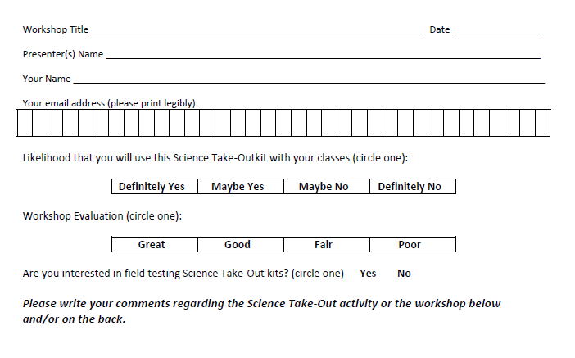
Please complete the “Participant Card”
2
Notes:
Because this workshop is supported through a grant from the National Institutes of Health, it is important that we collect data from workshop participants.
Please fill in the participant card during the workshop.
Use the space at the bottom and the back of the card to provide comments on the workshop or the kits used during the workshop.
2

Slide 3


Put your student hat on
Experience the kit
Put your teacher hat on
Envision classroom use
  Curriculum integration
  Support for students
Notes:
When we do hands-on workshops we ask you to switch between two hats as you work—your student hat and teacher hat.
We want to you work with partners to experience the kit by completing the activity
We encourage you also have conversations about how you might integrate this into your curriculum and/or support your students.
If you have questions, please call me over while you are working on the activity.
Also, you may find me interrupting to provide further explanation as you work.

Slide 4
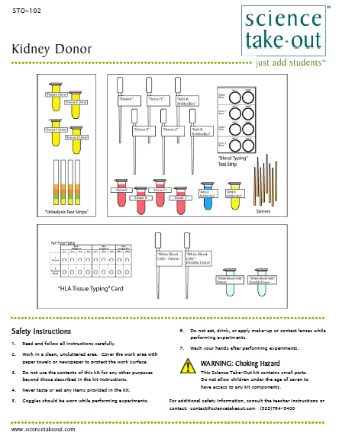
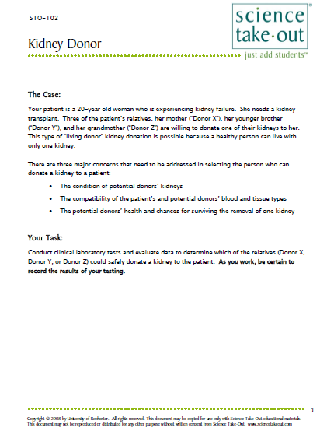
Kidney Donor
Student Handouts
Quick Guide
Safety
Student Instructions
Turn to this page
Notes:
Distribute 1 KIT and 1 copy of the STUDENT INSTRUCTIONS to each PAIR OF TEACHERS
Each kit already comes with ONE student instruction handout.
Every kit comes with a cover sheet with a colored quick guide and safety instructions. Teachers should keep this in the kit if they are refilling it.
Teachers may make additional copies of the student instructions if their students are working in teams.
For today, you will be working in teams of 2.
One of you should use the student instructions in the kit bag. The other person should use the additional handout that we have provided.
Notice that each kit contains safety instructions and also a graphic quick guide. Students can refer to the quick guide to identify the materials they will need. We do not make a materials list. Instead, students are encouraged to get what they need as they work. Some teachers have enlarged and laminated the quick guides to make “placemats” to help students organize kit materials.
Explain that the labeling of droppers and tubes allows for reuse—a significant cost savings. Droppers can be rinsed out, or just squirted out . Tubes can be refilled.

Slide 5
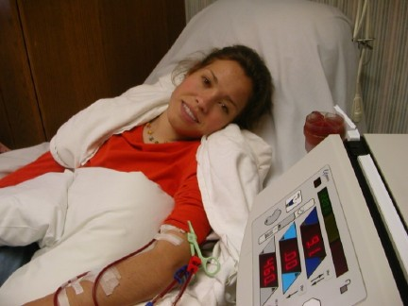



The Case:
Your patient is a 20-year old woman who is experiencing kidney failure. She needs a kidney transplant.
Three of the patient’s relatives, her mother (“Donor X”), her younger brother (“Donor Y”), and her grandmother (“Donor Z”) are willing to donate one of their kidneys to her. This type of “living donor” kidney donation is possible because a healthy person can live with only one kidney.
Brother
Donor Y
Grandmother
Donor Y
Brother
Donor Y
Mom
Donor X
Notes:
Ask someone to read aloud.

Slide 6
There are three major concerns that need to be addressed in selecting the person who can donate a kidney to a patient:
The condition of potential donors’ kidneys
The compatibility of the patient’s and potential donors’
blood and tissue types
The potential donors’ health and chances for surviving
the removal of one kidney
Your Task:
Conduct clinical laboratory tests and evaluate data to determine which of the relatives (Donor X, Donor Y, or Donor Z) could safely donate a kidney to the patient. As you work, be certain to record the results of your testing.
Notes:
Review the three things that must be considered when selecting a kidney donor
Your task, conduct tests to determine who could safely donate a kidney to the patient.
The next four slides will give an overview of the tests students will conduct. Go through these slides VERY briefly.

Slide 7
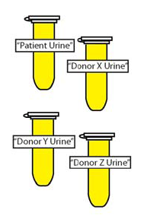
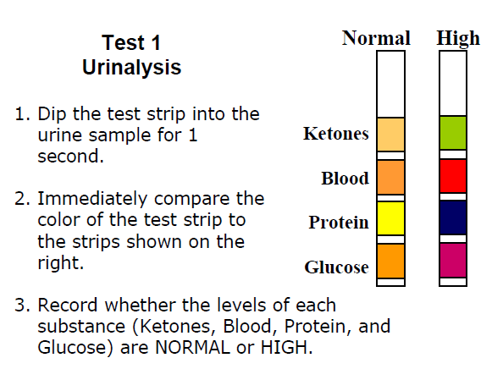
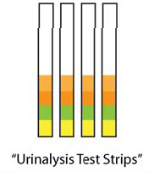
CLINICAL LABORATORY TEST 1:
Urinalysis: Evaluate the Condition of Potential Donors’ Kidneys
Urinalysis involves a number of tests to measure the concentrations of various substances present in the urine. If the level of any of these is not normal, it could indicate that the person may have kidney disease. Urinalysis test strips contain indicators that change color when they come in contact with specific substances in urine.
Notes:
First, students conduct urine tests to determine if the potential DONOR’s kidneys are healthy.

Slide 8
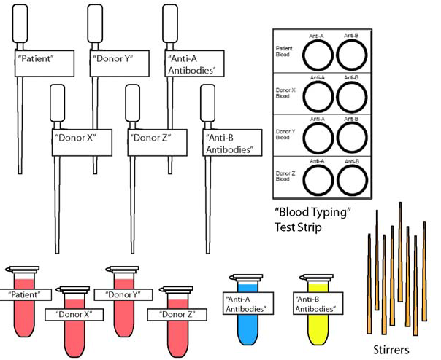
CLINICAL LABORATORY TEST 2:
Blood Typing: Evaluate the Compatibility of the Donors’ and Patient’s Blood
A dangerous reaction may occur if incompatible blood types are mixed. Antigens on the surface of the donor red blood cells may cause the recipients (patient’s) immune system to produce antibodies against the donor’s blood.
When the patient’s antibodies react with antigens on the donor’s red blood cells, dangerous clumps form and block the patient’s blood vessels.
Notes:
Then students conduct tests to determine if the donor’s blood and the patient’s blood are compatible.

Slide 9
CLINICAL LABORATORY TEST 3:
Evaluate the Health of the Donor
It is important that kidney donors are healthy enough to survive the loss of one of their kidneys. Medical researchers have investigated the relationship between weight, age, and exercise on the long term survival of kidney donors (survival of 10 years or more after donating a kidney). The results of their research are shown in the three graphs below.
Notes:
Next, students interpret graphs to determine which DONOR is most likely to survive donating a kidney.

Slide 10
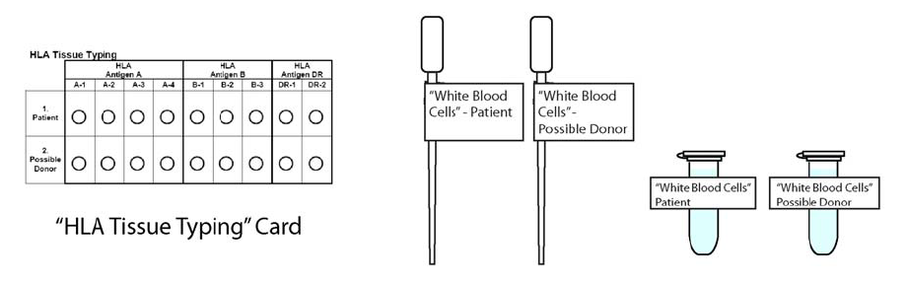
Clinical Laboratory Test 4:
Tissue Typing: Evaluate the Match for Donor and Recipient Antigens
Once you have identified a possible donor, further testing is necessary to determine whether the potential donor’s tissues are a good match for the patient. If the antigens on the donor’s kidney do not match the antigens on the patient’s tissue, the patient’s immune system may produce antibodies that attack the transplanted kidney and cause a rejection reaction.
Notes:
Finally, students will do HLA tissue typing to determine if the potential donor and the patient are “a match.”
Ask teachers to use the instructions to complete as much of the activity as time permits.

Slide 11
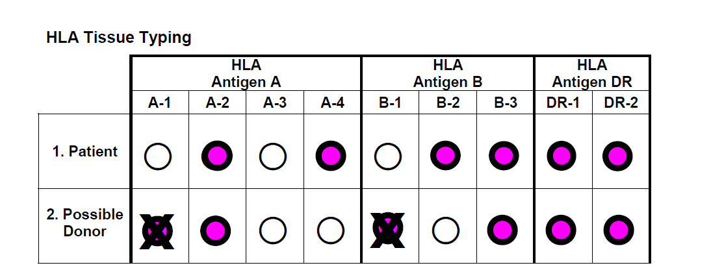
If a possible donor has antigens that are not found in the patient those “foreign” antigens may trigger a rejection reaction. In row 2, write an X on the colored circles that represent donor antigens that would be foreign (mismatched) if they were transplanted into the donor.
How many of the possible donor’s antigens would be mismatched (foreign) if they were transplanted into the donor? _______________
Notes:
Use this slide only if teachers have questions. This part gives some students (and teachers) a bit of a problem. Note that only antigens (pink spots) that are present in the donor can be rejected by the patient. Antigens in the patient’s tissues cannot be rejected by the donor.

Slide 12
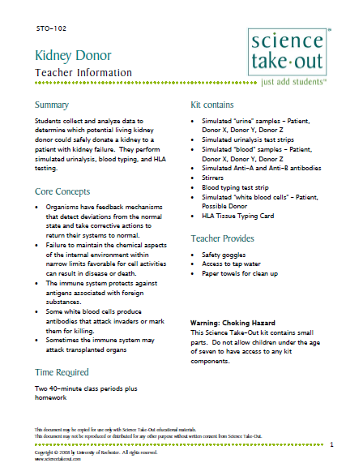
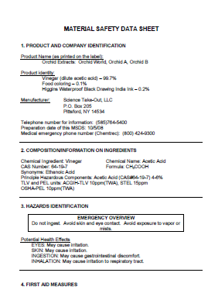
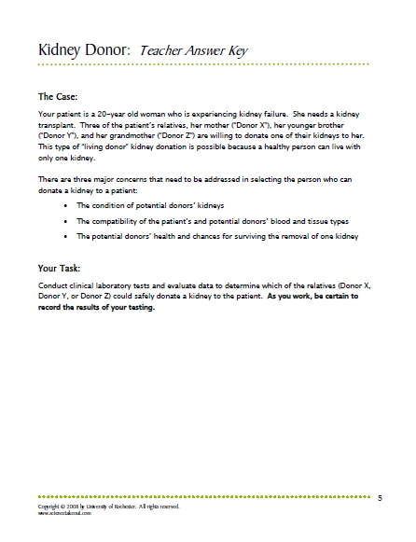
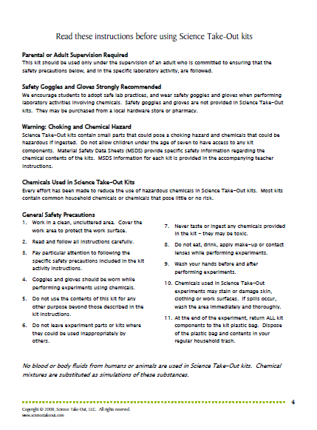
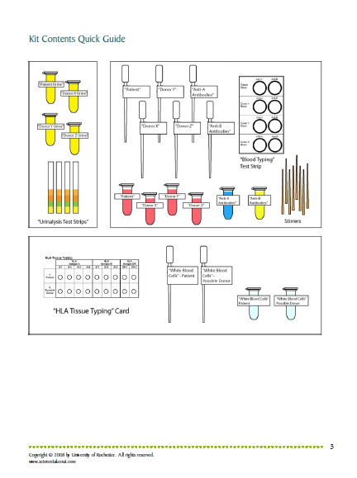
Teacher
Information
MSDS
Key
Safety
Quick Guide
Notes:
One copy of the Teacher Information is provided when you purchase kits. You can also download the teacher information (without answers) from the website.
The teacher information includes: Summary, Core Concepts, Kit Contains, Teacher Provides, Time Required, Hints for Reusing, and information of refill kit contents.
We also sell refill kits so that basic kit contents can be reused.

Slide 13
Create a patient story!
Other Kits Related to Kidney Donor
Diagnosing Diabetes Does the patient have diabetes? | Use a diagnostic test to identify the cause of a patient’s high blood sugar levels.
A Kidney Problem? What is wrong with the patient’s kidneys? | Analyze simulated urine samples and model normal and abnormal kidney function.
Kidney Dialysis How does a kidney dialysis machine work? | Model a kidney dialysis machine and explain how a dialysis machine maintains homeostasis.
Kidney Donor
Notes:
You can create a “patient story” by using three other kits before you use the Kidney Donor kit.
Diagnosing Diabetes—Does the patient have diabetes?
A Kidney Problem—Does the patient have a problem with kidney function?
Kidney Dialysis—The patient needs kidney dialysis. How does a dialysis machine work?
Kidney Donor—The patient needs a kidney transplant.

Slide 14
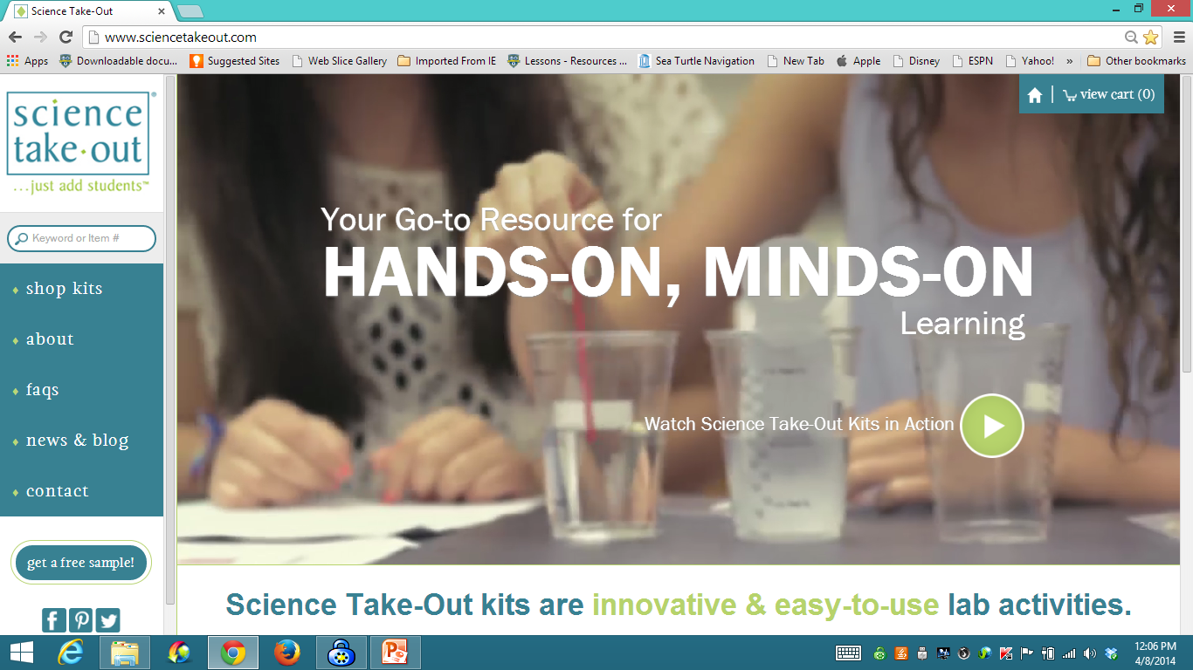
www.sciencetakeout.com
Purchase kits from
Notes:
The kit you used today is available from Science Take-Out as a completely assembled student kit.
Please explore the website to learn about other STO kits.
You can download the complete teacher instructions so that you can see what you are buying.

Slide 15
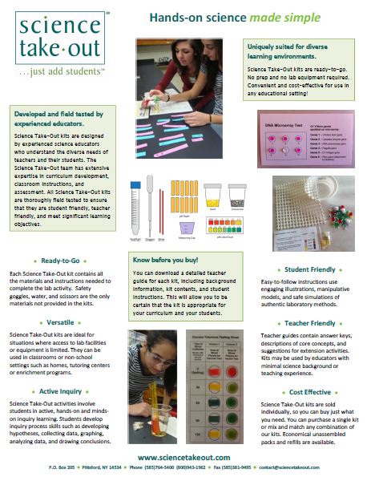
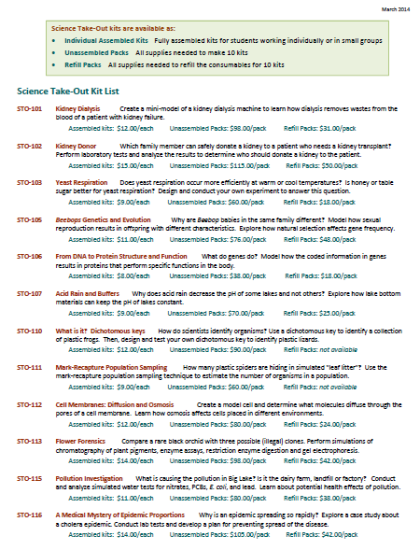
Individual Assembled Kits Fully assembled individual kits
Unassembled Packs All supplies needed to make 10 kits
Refill Packs All supplies needed to refill 10 kits
Notes:
You have a brochure that includes information on other Science Take-Out kits and a price list. Visit the Science Take-Out website to get further information for each kit.
At the website, you can download the teacher information for each kit to help you decide which kits you would like to purchase.
Science Take-Out kits are available as:
Individual Assembled Kits like the kits you used in this workshop
Unassembled Packs that contain all supplies needed to make 10 kits
Refill Packs that contain supplies needed to refill the consumables for 10 kits

Slide 16
Become Involved
as a Field Test Teacher
Help us make new Science Take-Out kits teacher and student friendly.
Indicate this on your card. Science Take-Out will contact you with further information
16
Notes:
Science Take-Out has received an NIH Small Business grant. Support from this grant will allow us to field test Science Take-Out kits
If you would like to be a field test teacher, indicate this by circling yes on your participant card. We will add you to our email list for field test teacher recruitment.
16

Slide 17
Become Involved
as a Workshop Presenter
Present a workshop to introduce colleagues to Science Take-Out kits
Visit the Science Take-Out website for further information
17
Notes:
Science Take-Out has received an NIH Small Business grant. Support from this grant will allow us to field test Science Take-Out kits
If you would like to be a field test teacher, indicate this by circling yes on your participant card. We will add you to our email list for field test teacher recruitment.
17

Slide 18
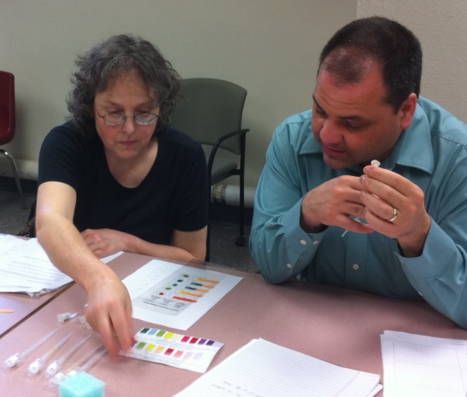
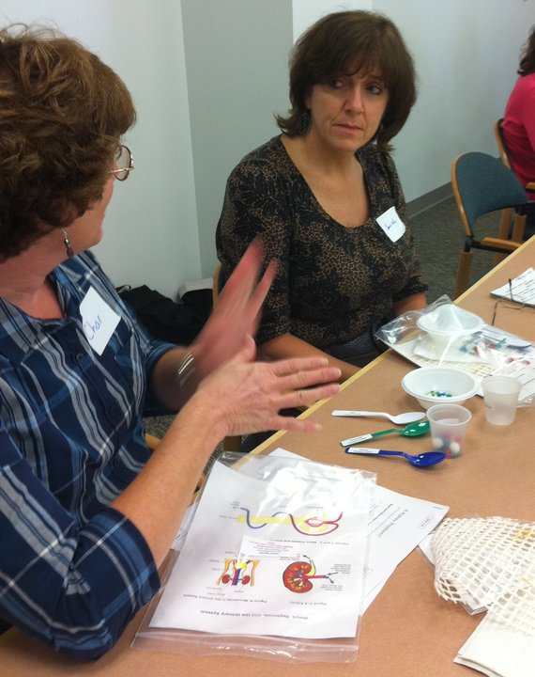
Thanks for being a GREAT group!!!
Please turn in your participant card
before you leave.
Notes:
Encourage teachers to write comments on the back of the participant survey card.
Please remember to collect participant feedback cards!!

