Slide 1
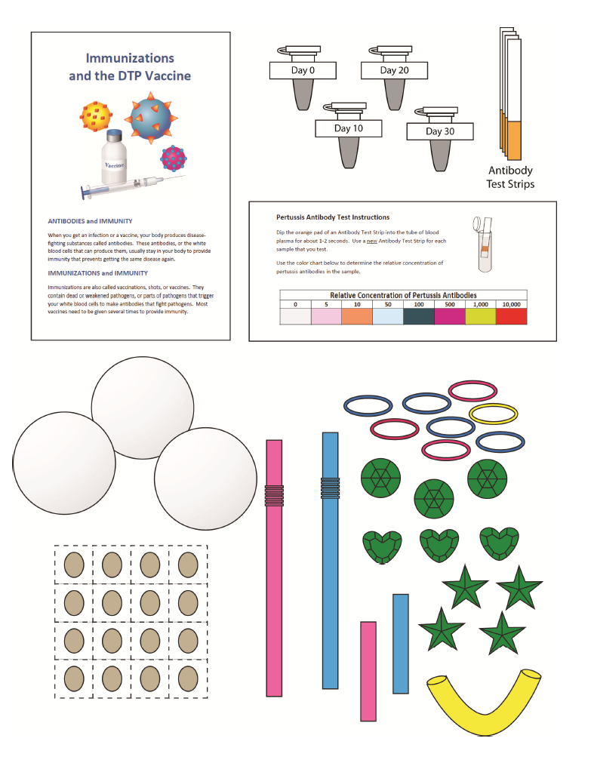
Pathogens, Antibodies and Vaccines
Notes:
This slide should be on screen as participants enter the room.
Start workshop on time—do not wait for “stragglers”
Welcome participants as they enter room
Do NOT do participant introductions unless the workshop group is a very small one (less than 10 people). Introduce self and briefly explain teaching experience and current position.
The activity that you will do today was developed by the Life Sciences Learning Center at the University of Rochester. We found that teachers wanted access to the activities that we developed even after our grant support had ended.
To provide for sustained dissemination, we formed a small spin-off company called Science Take-Out. Explain that Science Take-Out is a small company that manufactures and sells hands-on science kits for middle or high school biology students.

Slide 2
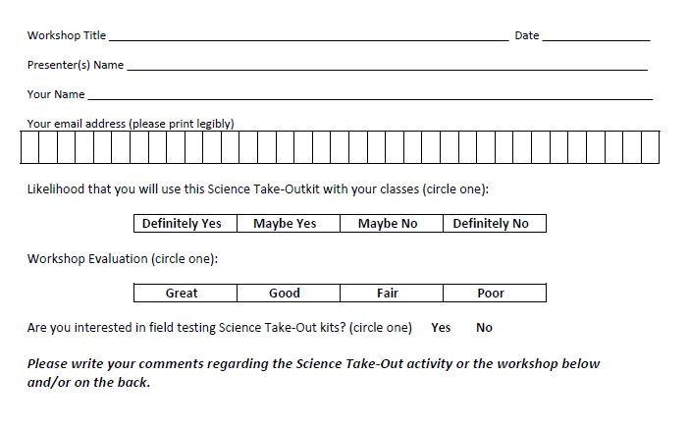
Please complete the “Participant Card”
2
Notes:
Because this workshop is supported through a grant from the National Institutes of Health, it is important that we collect data from workshop participants.
Please fill in the participant card during the workshop.
Use the space at the bottom and the back of the card to provide comments on the workshop or the kits used during the workshop.
2

Slide 3
Put your student hat on
Experience the kit
Put your teacher hat on
Envision classroom use
Curriculum integration
Support for students
Notes:
When we do hands-on workshops we ask you to switch between two hats as you work—your student hat and teacher hat.
We want to you work with partners to experience the kit by completing the activity
We encourage you also have conversations about how you might integrate this into your curriculum and/or support your students.
If you have questions, please call me over while you are working on the activity.
Also, you may find me interrupting to provide further explanation as you work.

Slide 4
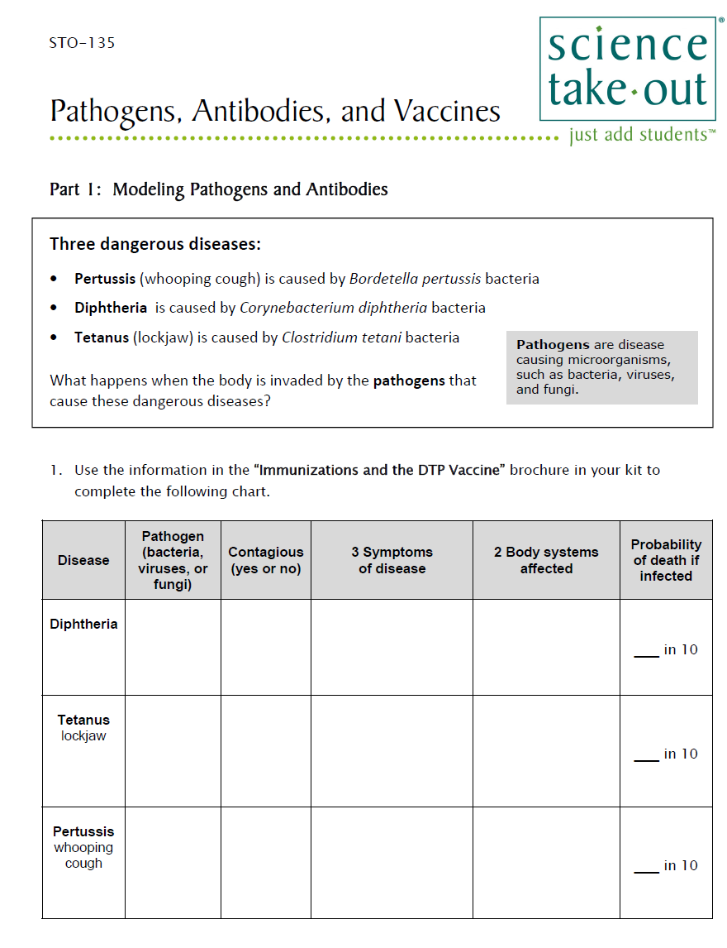
Quick Guide
Student Instructions
Safety
Turn to this page
Notes:
DISTRIBUTE 1 KIT and 1 STUDENT INSTRUCTIONS to EACH PER PAIR OF TEACHERS
Every kit comes with a sheet with a colored quick guide and safety instructions. Teachers should keep this colored sheet in the kit bag if they plan to refill the kit.
Each kit comes with ONE student instruction handout. Teachers may make additional copies if their students are working in teams.
For today, you will be working in teams of 2.
One of you should use the student instructions in the bag. The other person should use the additional handout that we have provided.

Slide 5
Notes:
Part 1: Modeling Pathogens and Antibodies
Explain that this activity fits well with a unit on disease and the immune system.
These pathogens were chosen because the may be prevented by the DPT vaccine that is given to babies AND should be given to teens to maintain their immunity.

Slide 6
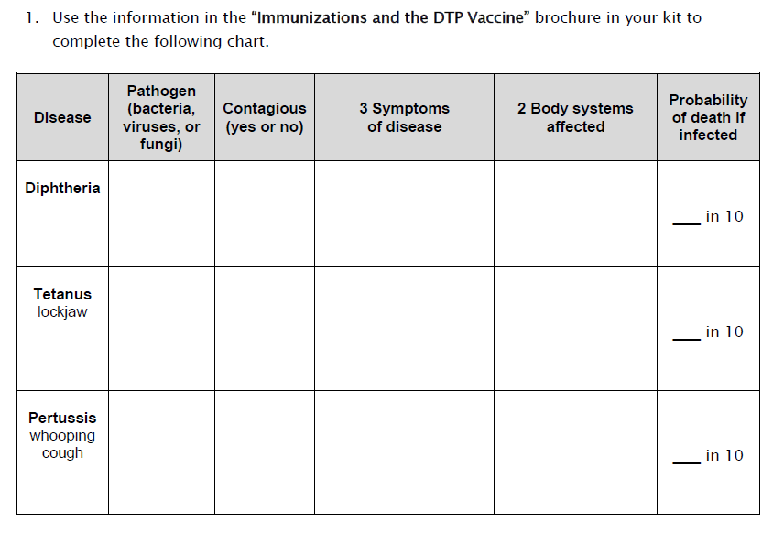
Notes:
Read instruction 1
Ask teachers to use information in brochure to complete the chart

Slide 7
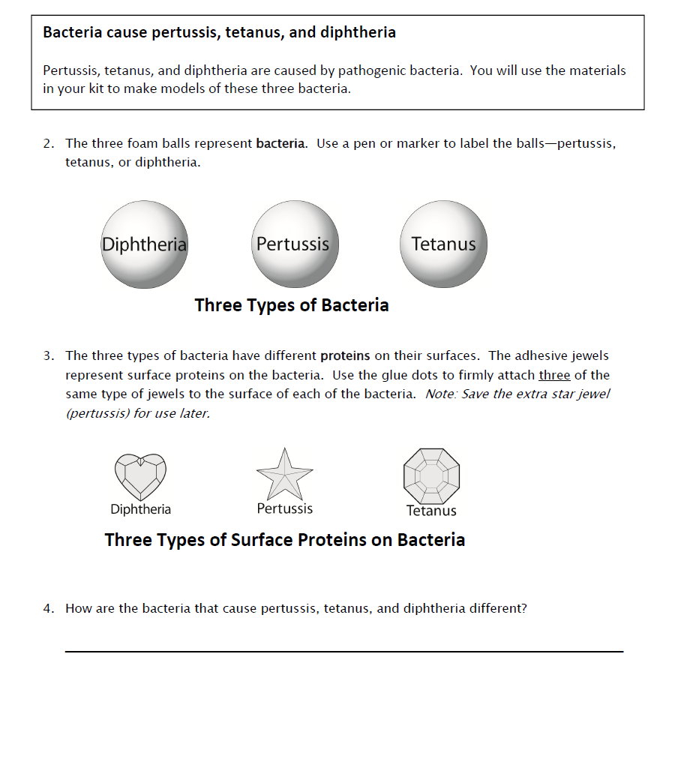
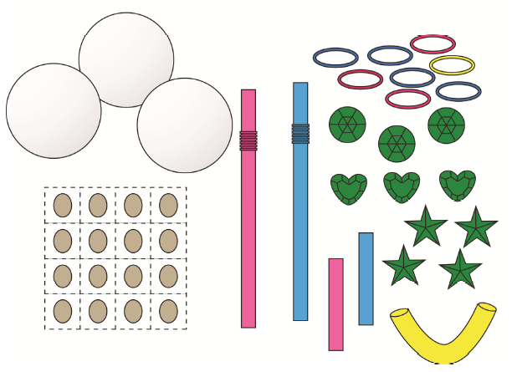
Notes:
Ask teachers to read the instructions and complete Part 1.

Slide 8
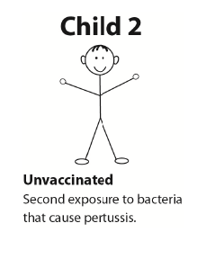
Notes:
Part 3: Antibodies and Immunity
Students will compare the antibody levels of three children who have been exposed to the bacteria that cause pertussis.

Slide 9
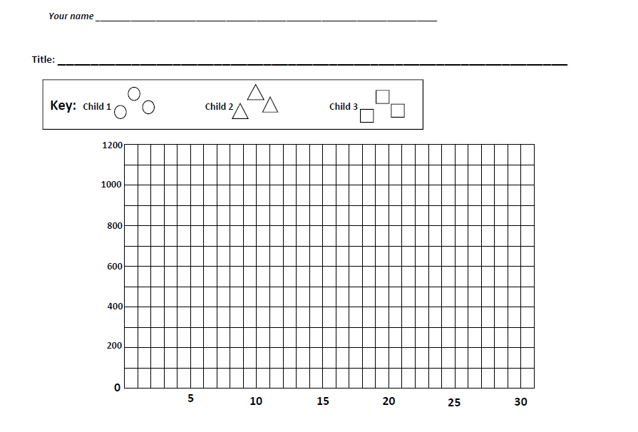
Notes:
For the Child 1 and Child 2, students will use the information in the student instructions to graph the data for child 1 and child 2. Note that the graph is provided at the end of the lab so that students don’t need to keep flipping pages.

Slide 10
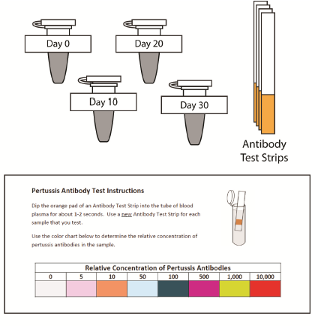
Notes:
For Child 3 they will test and then graph the child’s antibody levels.

Slide 11
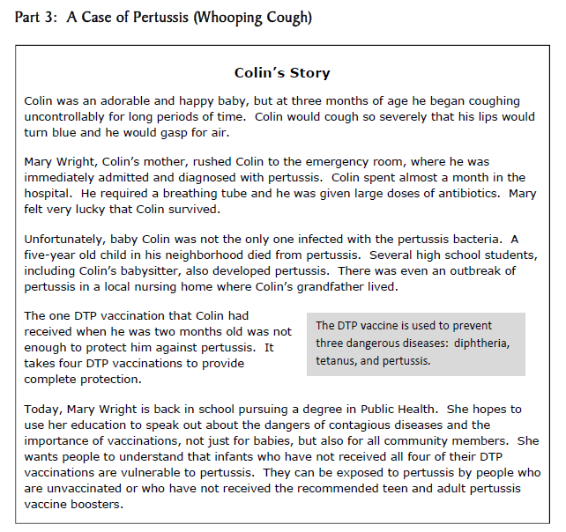
Notes:
Part 3: A Case of Pertussis (whooping cough)
Students are introduced to a mini-case involving a young child and community members who have pertussis. They use the information in the Immunizations and the DTP Vaccine brochure to learn more about how pertussis, diphtheria and tetanus can be prevented. This information emphasizes the importance of booster shots for teens and older people.

Slide 12
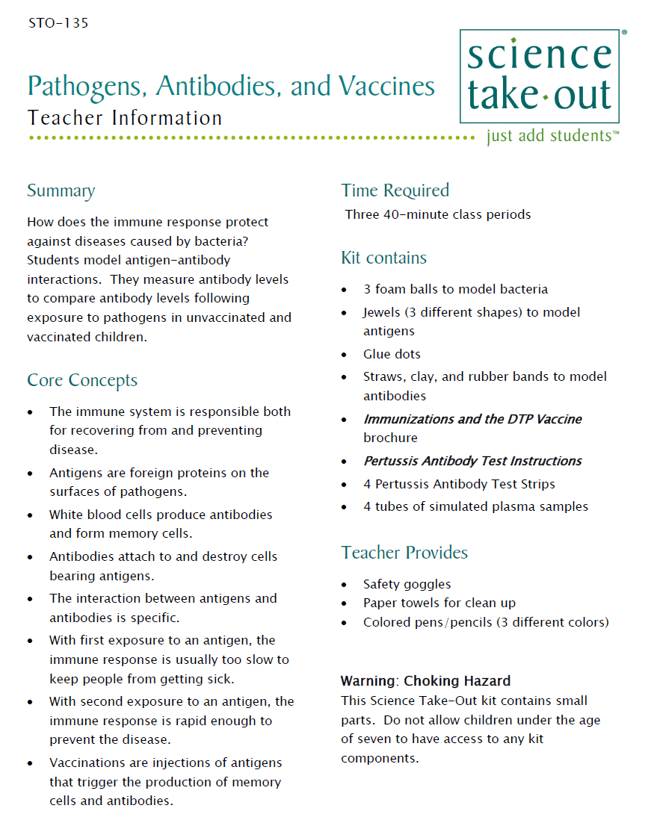
Teacher Information
Quick Guide
Safety
Key
MSDS
Notes:
One copy of the Teacher Information is provided with each order. And also can be downloaded from the website (minus the key)
The teacher information includes: Summary, Core Concepts, Kit Contains, Teacher Provides, Time Required, Reusing, and information of refill kit contents.
Additional materials needed for this lab are safety goggles, scissors, tape or glue, and paper towel (for clean up).
Refills are available for the kits so that basic kit contents can be reused.
The teacher information includes hints for reusing kits and information on what is included in a refill kit.

Slide 13
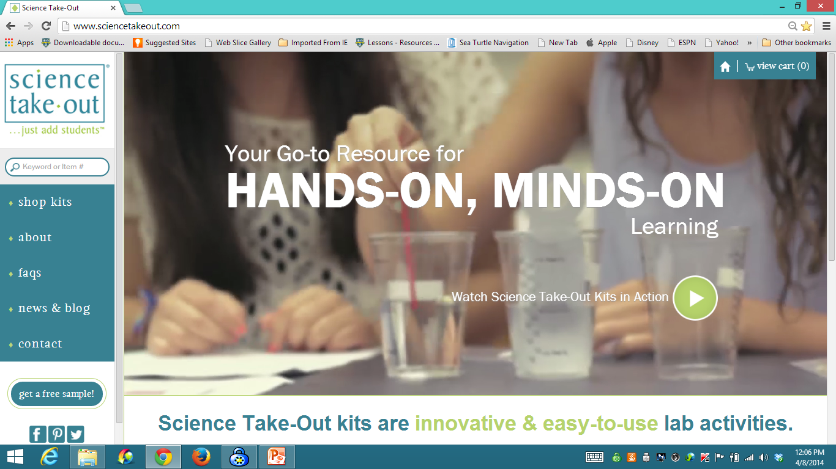
www.sciencetakeout.com
Purchase kits from
Notes:
The kit you used today is available from Science Take-Out as a completely assembled student kit.
Please explore the website to learn about other STO kits.
You can download the complete teacher instructions so that you can see what you are buying.

Slide 14
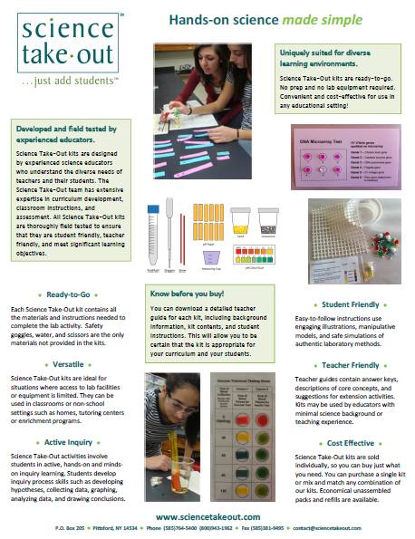
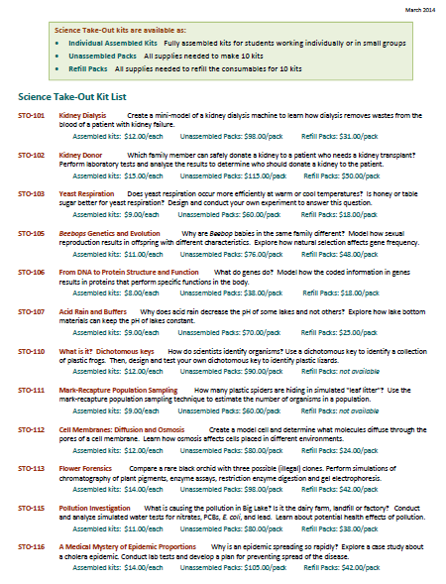
Individual Assembled Kits Fully assembled individual kits
Unassembled Packs All supplies needed to make 10 kits
Refill Packs All supplies needed to refill 10 kits
Notes:
You have a brochure that includes information on other Science Take-Out kits and a price list. Visit the Science Take-Out website to get further information for each kit.
At the website, you can download the teacher information for each kit to help you decide which kits you would like to purchase.
Science Take-Out kits are available as:
Individual Assembled Kits like the kits you used in this workshop
Unassembled Packs that contain all supplies needed to make 10 kits
Refill Packs that contain supplies needed to refill the consumables for 10 kits

Slide 15
Become Involved
as a Field Test Teacher
Help us make new Science Take-Out kits teacher and student friendly.
Indicate this on your card. Science Take-Out will contact you with further information
15
Notes:
Science Take-Out has received an NIH Small Business grant. Support from this grant will allow us to field test Science Take-Out kits
If you would like to be a field test teacher, indicate this by circling yes on your participant card. We will add you to our email list for field test teacher recruitment.
15

Slide 16
Become Involved
as a Workshop Presenter
Present a workshop to introduce colleagues to Science Take-Out kits
Visit the Science Take-Out website for further information
16
Notes:
Science Take-Out has received an NIH Small Business grant. Support from this grant will allow us to field test Science Take-Out kits
If you would like to be a field test teacher, indicate this by circling yes on your participant card. We will add you to our email list for field test teacher recruitment.
16

Slide 17
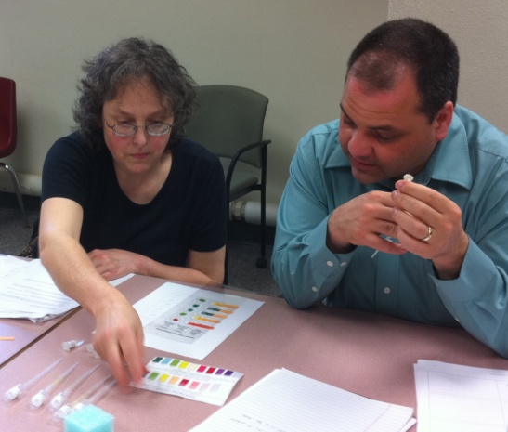
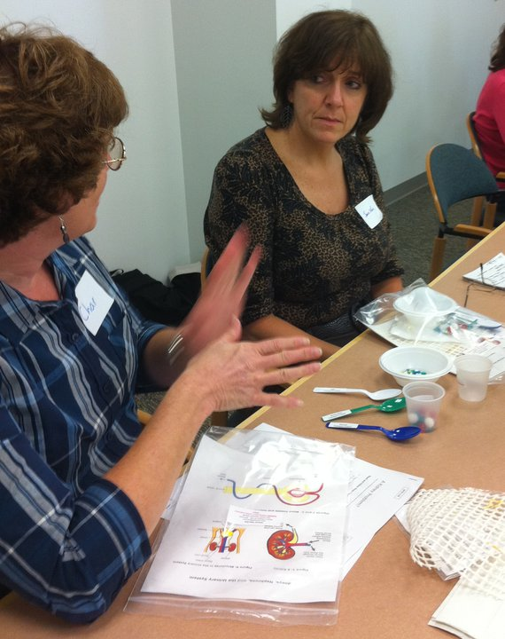
Thanks for being a GREAT group!!!
Please turn in your participant card
before you leave.
Notes:
Encourage teachers to write comments on the back of the participant survey card.
Please remember to collect participant feedback cards!!

