Slide 1
WARNING TO PRESENTER!
Participants will need access to hot tap water and paper towel for this activity.
If there is not hot water faucet in the room, you will need to provide cups of hot water for each team.
Cold water may be used but the diffusion process will take longer. .
Notes:
See notes on slide.

Slide 2
Kidney Dialysis
Notes:
Should be on screen as participants enter the room.
Start workshop on time—do not wait for “stragglers”
Welcome participants as they enter the room
Do NOT take time for participant introductions unless the workshop group is a very small one (less than 10 people)
Introduce yourself and briefly explain your teaching experience and current position
Explain that this workshop is sponsored by Science Take-Out, a small company that manufactures and sells hands-on science kits for middle or high school biology students
The company began as a “spin-off” initially formed to disseminate hands-on laboratory activities developed by the Life Sciences Learning Center, an outreach center at the University of Rochester.

Slide 3
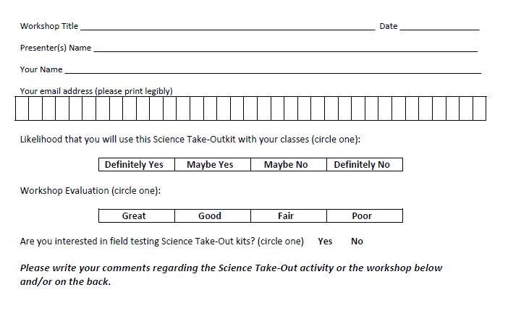
Please complete the “Participant Card”
3
Notes:
Because this workshop is supported through a grant from the National Institutes of Health, it is important that we collect data from workshop participants.
Please fill in the participant card during the workshop.
Use the space at the bottom and the back of the card to provide comments on the workshop or the kits used during the workshop.
3

Slide 4
Put your student hat on
Experience the kit
Put your teacher hat on
Envision classroom use
Curriculum integration
Support for students
Notes:
When we do hands-on workshops we ask you to switch between two hats as you work—your student hat and teacher hat.
We want to you work with partners to experience the kit by completing the activity
We encourage you also have conversations about how you might integrate this into your curriculum and/or support your students.
If you have questions, please call me over while you are working on the activity.
Also, you may find me interrupting to provide further explanation as you work.

Slide 5
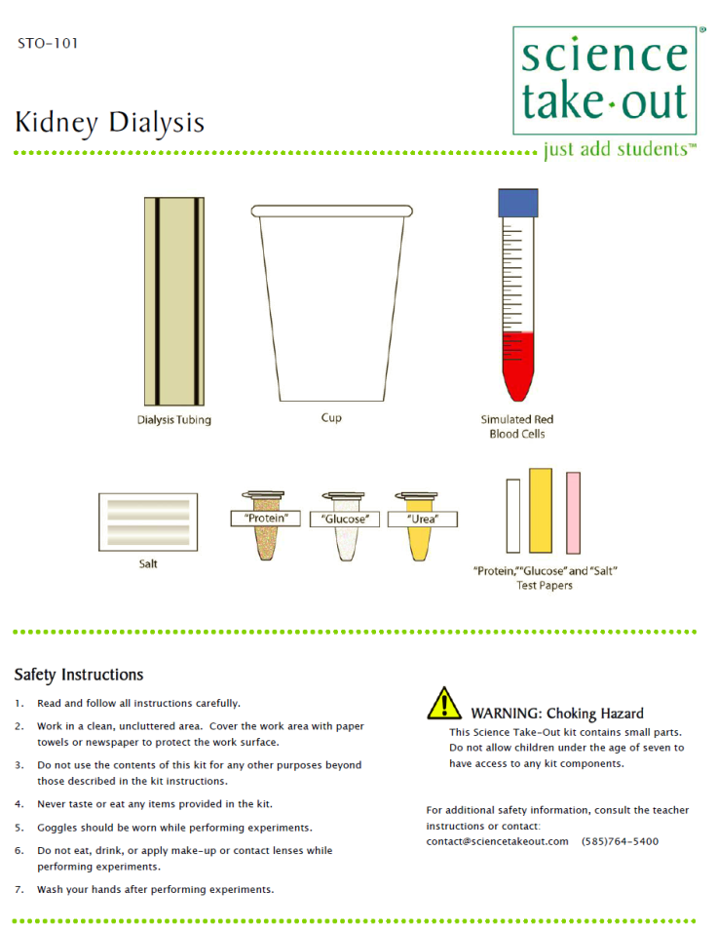
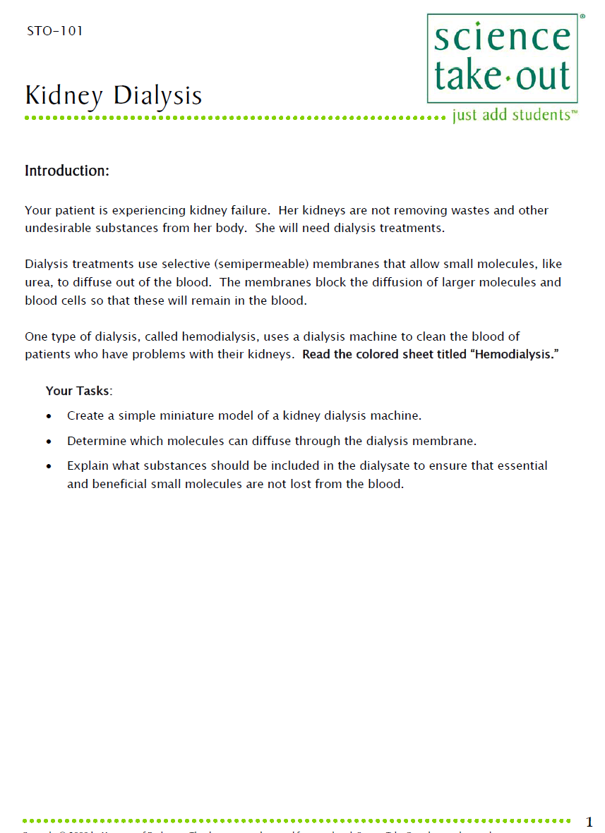
Kidney Dialysis Student Handouts
Quick Guide
Safety
Student Instructions
Turn to this page
Notes:
DISTRIBUTE Kidney Dialysis KITS—ONE kit plus one student handout PER PAIR OF TEACHERS
For today, you will be working in teams of 2. Kits typically come with ONE student handout in the bag. One teacher should use the student handout that comes in the kit. The other teacher should use the extra copy provided.
Teachers may make additional copies if their students are working in teams.
Notice that each kit contains safety instructions and also a graphic quick guide. Students can refer to the quick guide to identify the materials they will need. We do not make a materials list. Instead, students are encouraged to get what they need from the bag as they work.
Some teachers have enlarged and laminated the quick guides to make “placemats” to help students organize kit materials.
Let me explain when I use this kit. I use it BEFORE talking about how the process of kidney dialysis. For many of my labs, I took a “do it first” then “talk about it” approach. Yes, students will have questions as they work, but they will care about the answers to the questions.

Slide 6
Introduction:
Your patient is experiencing kidney failure. Her kidneys are not removing wastes and other undesirable substances from her body. She will need dialysis treatments.
Dialysis treatments use selective (semipermeable) membranes that allow small molecules, like urea, to diffuse out of the blood. The membranes block the diffusion of larger molecules and blood cells so that these will remain in the blood.
Notes:
Ask someone to read the introduction aloud.
What is the patient’s problem?
What are dialysis treatments?

Slide 7
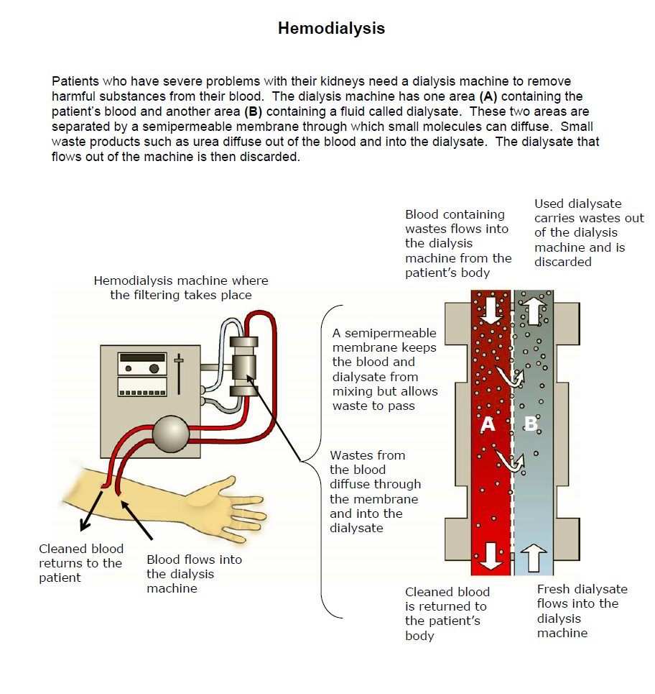
One type of dialysis, called hemodialysis, uses a dialysis machine to clean the blood of patients who have problems with their kidneys. Read the colored sheet titled “Hemodialysis.”
Notes:
Ask participants to read the colored handout HEMODIALYSIS that is in their kit.
Point out that students may read this information but not really understand it.

Slide 8
Your Tasks:
Create a simple miniature model of a kidney dialysis machine.
Determine which molecules can diffuse through the dialysis membrane.
Explain what substances should be included in the dialysate to ensure that essential and beneficial small molecules are not lost from the blood.
Notes:
Explain that students will do three things to help them understand how kidney dialysis works.

Slide 9
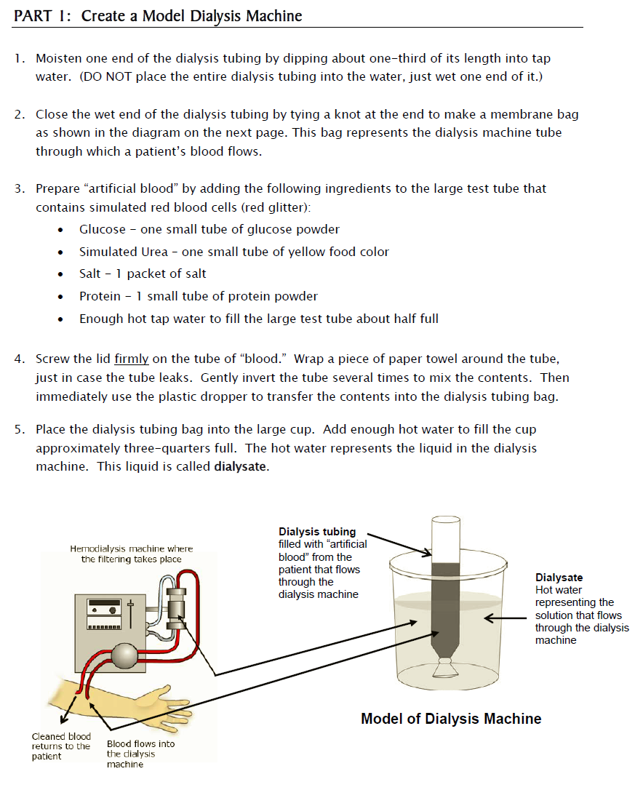
Notes:
In Part 1, students create a model dialysis machine.
Ask participants to read and follow the instructions for Part 1

Slide 10
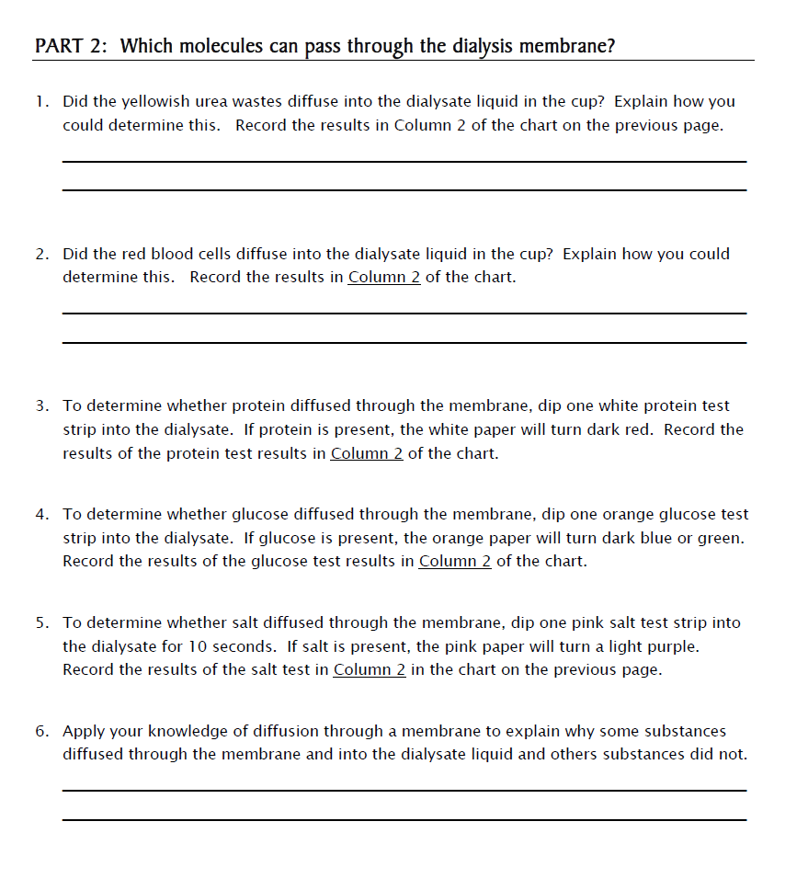
Notes:
I have found that teachers work at very different paces. You may wait until all teachers finish Part 1 OR when the first groups finish you may show this slide, read the introduction to Part 2, and encourage teachers to begin Part 2 when they have finished Part 1.

Slide 11
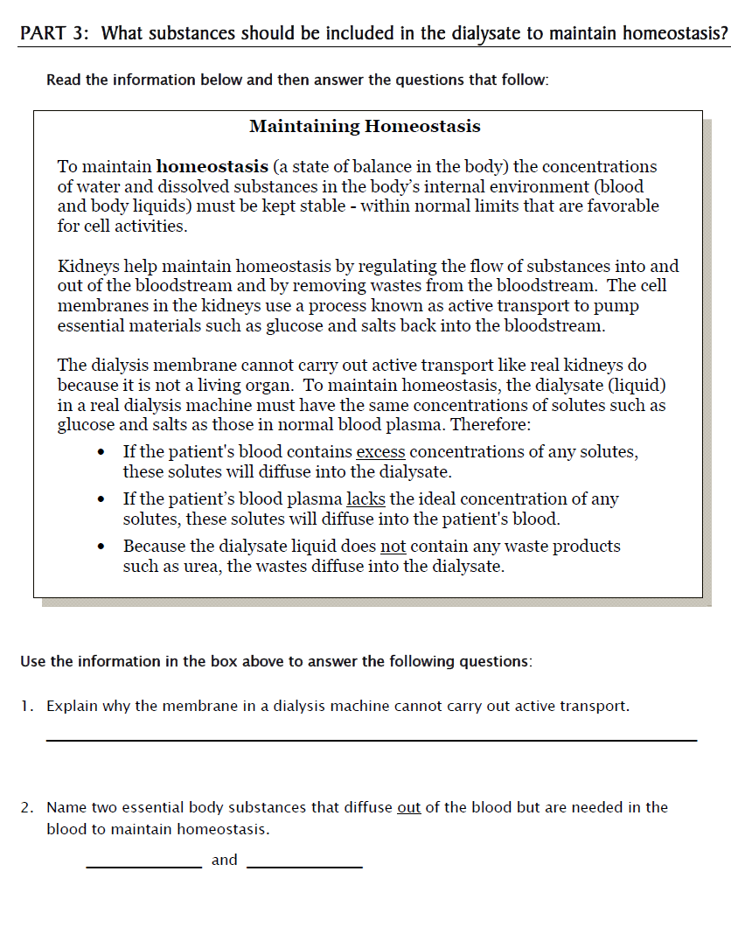
Notes:
Part 3 can be done the next day because students can use the data from Parts 1 and 2.
I do not recommend that this be done as homework unless students are advanced students! If done for homework, be sure to have students discuss their answers in the next class. If done for homework, students will need to refer to the Peritoneal Dialysis handout in the kit. You may make extra copies of this handout.

Slide 12
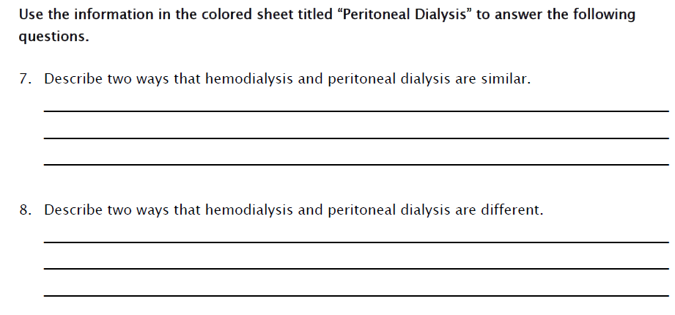
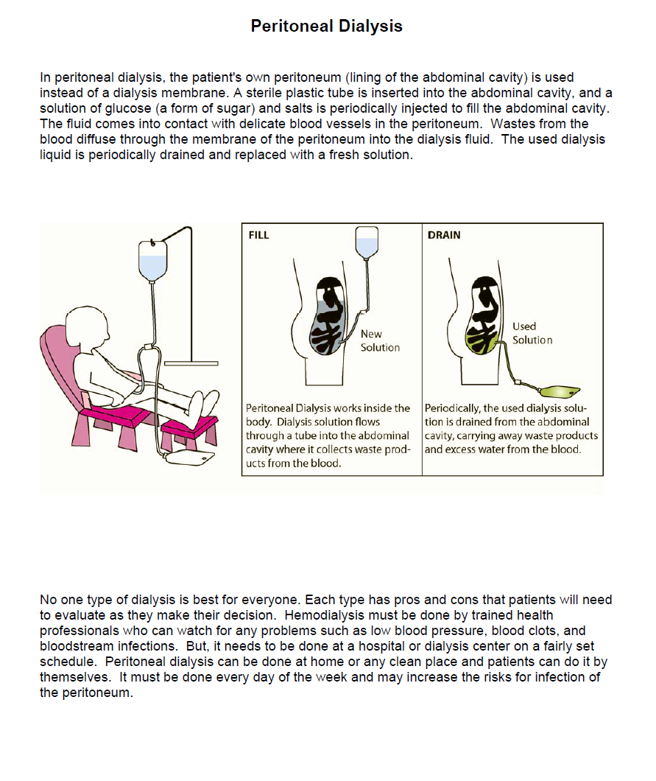
Notes:
If done for homework, students will need to refer to the Peritoneal Dialysis handout in the kit. You may make extra copies of this handout if needed.

Slide 13
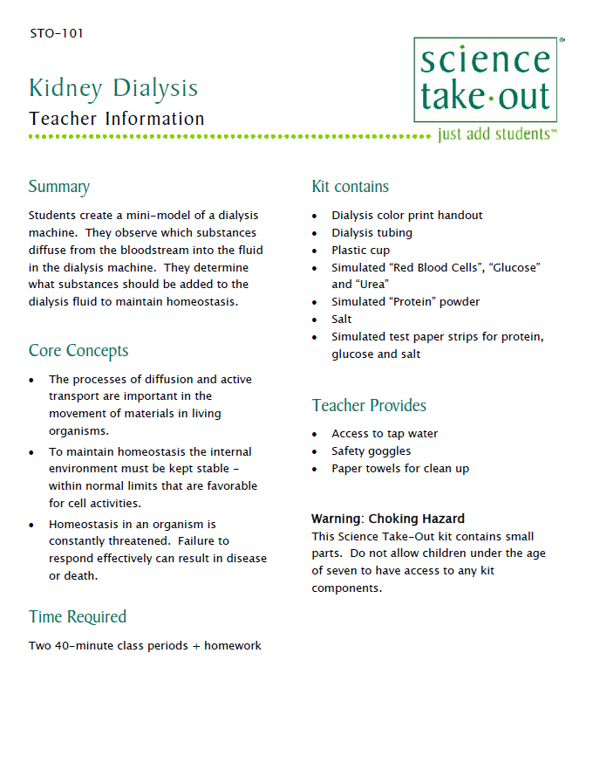
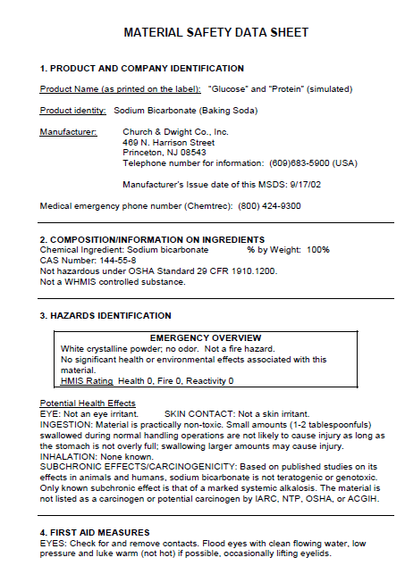
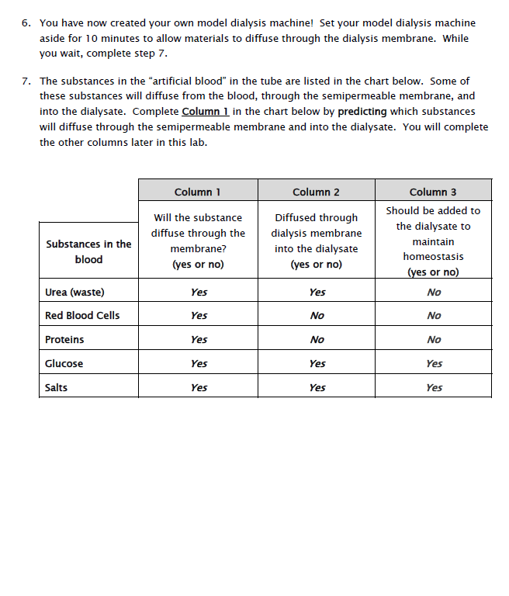
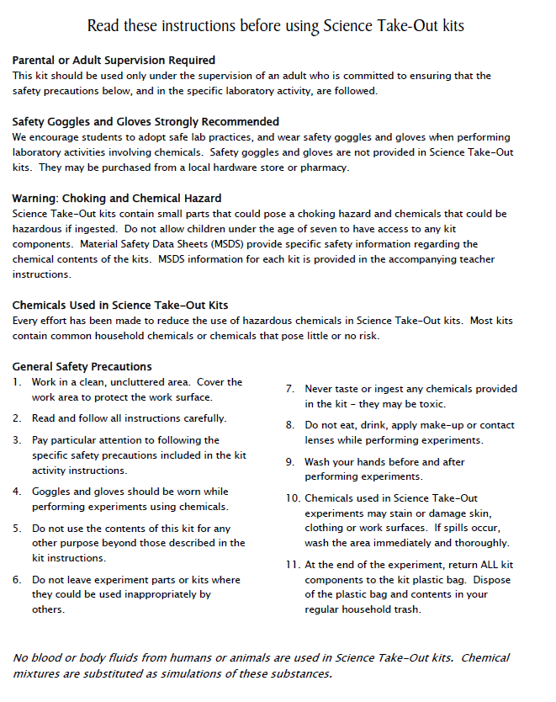
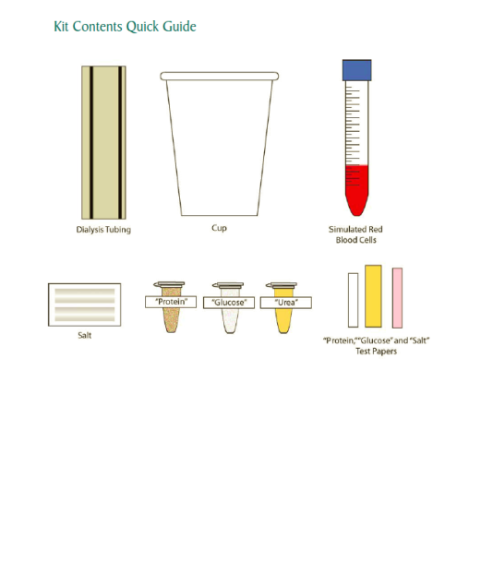
Teacher Information
MSDS
Key
Safety
Quick Guide
Notes:
One copy of the Teacher Information is provided when you purchase kits. You can also download the teacher information (without answers) from the website.
The teacher information includes: Summary, Core Concepts, Kit Contains, Teacher Provides, Time Required, Hints for Reusing, and information of refill kit contents.
We also sell refill kits so that basic kit contents can be reused.

Slide 14
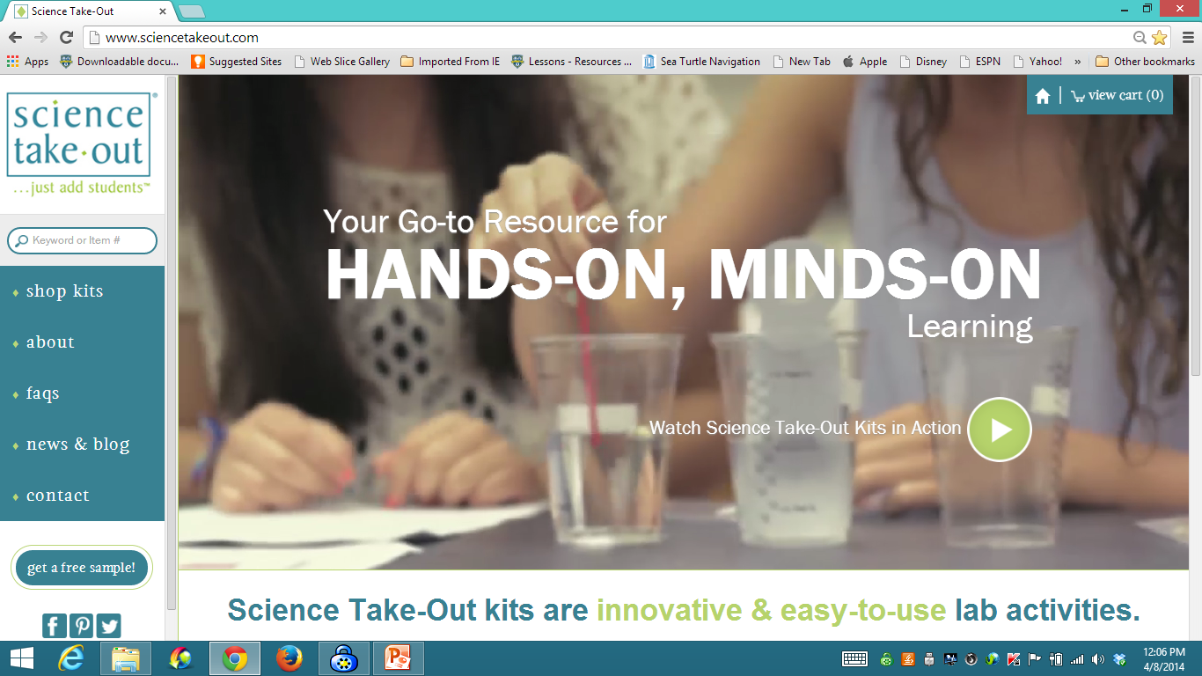
www.sciencetakeout.com
Purchase kits from
Notes:
The kit you used today is available from Science Take-Out as a completely assembled student kit.
Please explore the website to learn about other STO kits.
You can download the complete teacher instructions so that you can see what you are buying.

Slide 15
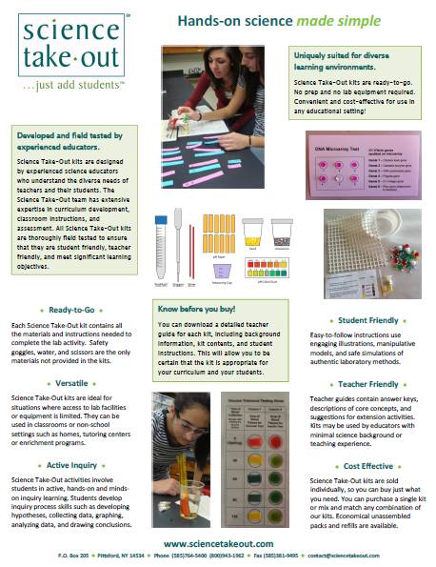
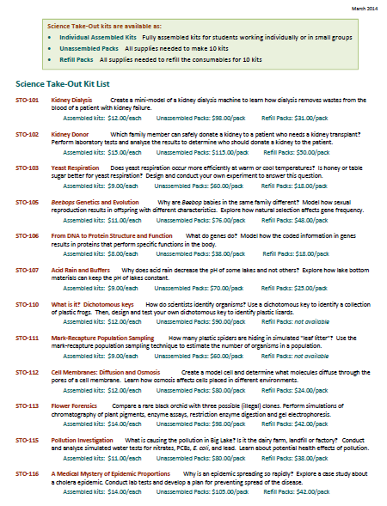
Individual Assembled Kits Fully assembled individual kits
Unassembled Packs All supplies needed to make 10 kits
Refill Packs All supplies needed to refill 10 kits
Notes:
You have a brochure that includes information on other Science Take-Out kits and a price list. Visit the Science Take-Out website to get further information for each kit.
At the website, you can download the teacher information for each kit to help you decide which kits you would like to purchase.
Science Take-Out kits are available as:
Individual Assembled Kits like the kits you used in this workshop
Unassembled Packs that contain all supplies needed to make 10 kits
Refill Packs that contain supplies needed to refill the consumables for 10 kits

Slide 16
Become Involved
as a Field Test Teacher
Help us make new Science Take-Out kits teacher and student friendly.
Indicate this on your card. Science Take-Out will contact you with further information
16
Notes:
Science Take-Out has received an NIH Small Business grant. Support from this grant will allow us to field test Science Take-Out kits
If you would like to be a field test teacher, indicate this by circling yes on your participant card. We will add you to our email list for field test teacher recruitment.
16

Slide 17
Become Involved
as a Workshop Presenter
Present a workshop to introduce colleagues to Science Take-Out kits
Visit the Science Take-Out website for further information
17
Notes:
Science Take-Out has received an NIH Small Business grant. Support from this grant will allow us to field test Science Take-Out kits
If you would like to be a field test teacher, indicate this by circling yes on your participant card. We will add you to our email list for field test teacher recruitment.
17

Slide 18
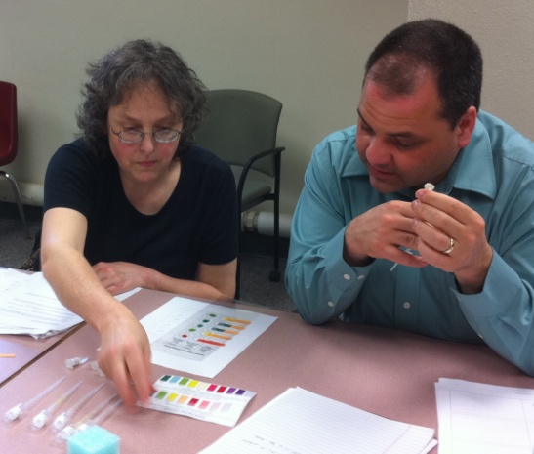
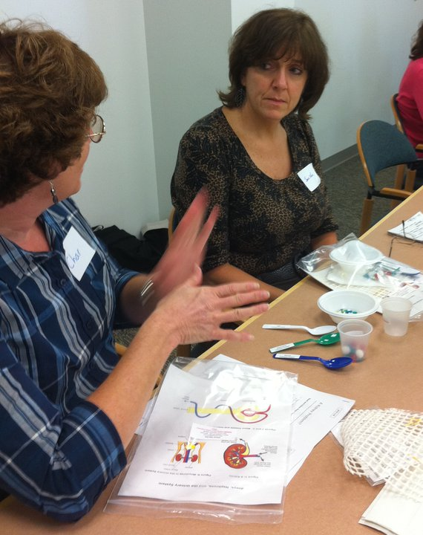
Thanks for being a GREAT group!!!
Please turn in your participant card
before you leave.
Notes:
Encourage teachers to write comments on the back of the participant survey card.
Please remember to collect participant feedback cards!!

