Slide 1
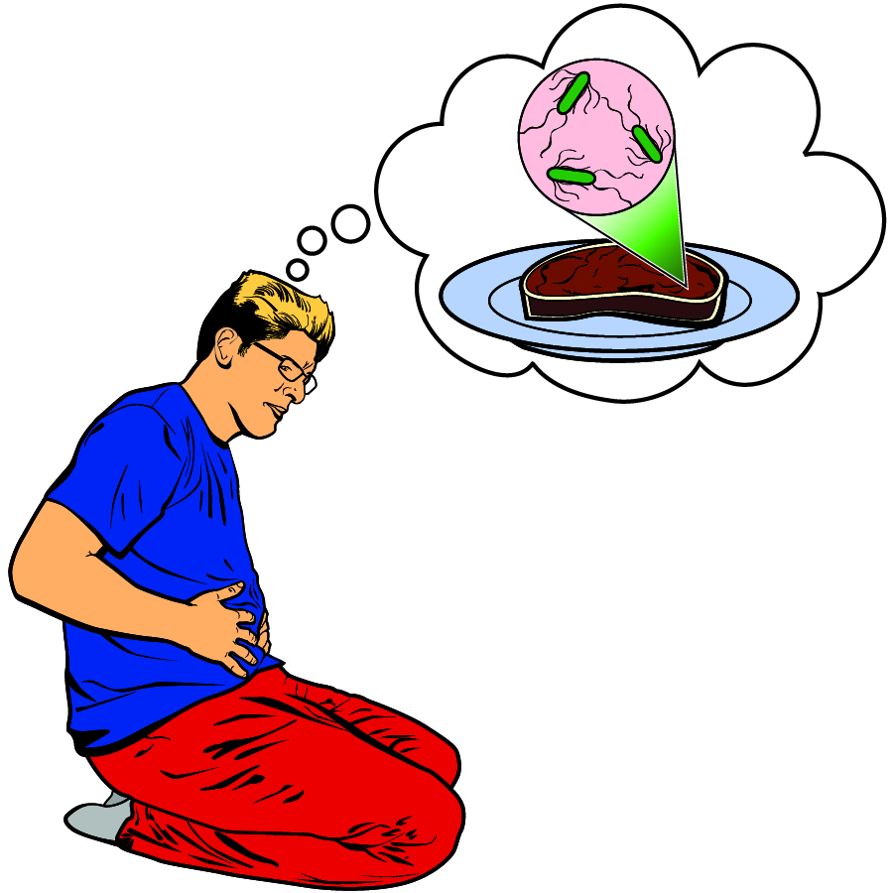
A Case of Food Poisoning
Notes:
This slide should be on screen as participants enter the room.
Start workshop on time—do not wait for “stragglers”
Welcome participants as they enter room
Do NOT do participant introductions unless the workshop group is a very small one (less than 10 people). Introduce self and briefly explain teaching experience and current position.
The activity that you will do today was developed by the Life Sciences Learning Center at the University of Rochester. We found that teachers wanted access to the activities that we developed even after our grant support had ended.
To provide for sustained dissemination, we formed a small spin-off company called Science Take-Out. Explain that Science Take-Out is a small company that manufactures and sells hands-on science kits for middle or high school biology students.

Slide 2
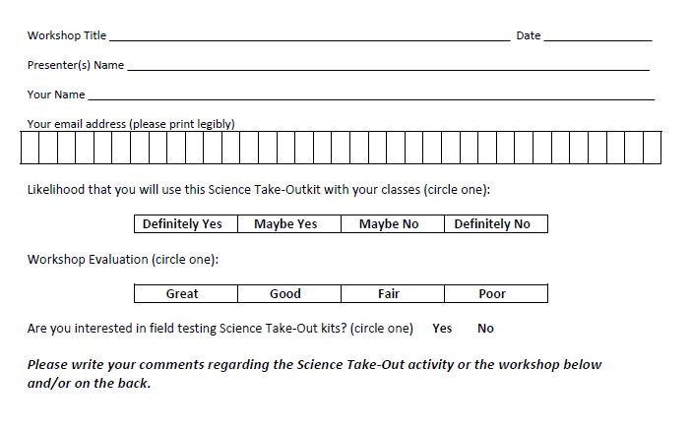
Please complete the “Participant Card”
2
Notes:
Because this workshop is supported through a grant from the National Institutes of Health, it is important that we collect data from workshop participants.
Please fill in the participant card during the workshop.
Use the space at the bottom and the back of the card to provide comments on the workshop or the kits used during the workshop.
2

Slide 3
Put your student hat on
Experience the kit
Put your teacher hat on
Envision classroom use
Curriculum integration
Support for students
Notes:
When we do hands-on workshops we ask you to switch between two hats as you work—your student hat and teacher hat.
We want to you work with partners to experience the kit by completing the activity
We encourage you also have conversations about how you might integrate this into your curriculum and/or support your students.
If you have questions, please call me over while you are working on the activity.
Also, you may find me interrupting to provide further explanation as you work.

Slide 4
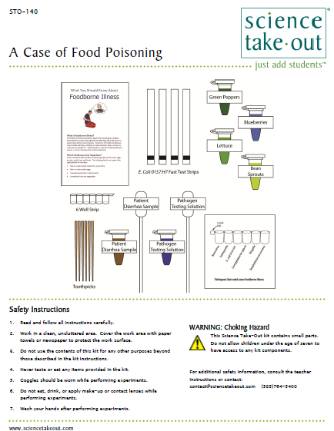
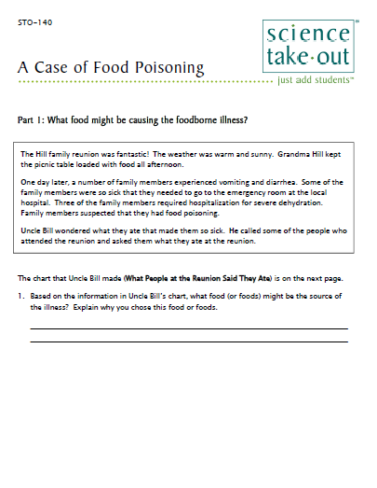
A Case of Food Poisoning Student Handouts
Student Instructions
Quick Guide
Safety
Turn to this page
Notes:
DISTRIBUTE 1 KIT and 1 STUDENT INSTRUCTIONS to EACH PER PAIR OF TEACHERS
Every kit comes with a sheet with a colored quick guide and safety instructions. Teachers should keep this colored sheet in the kit bag if they plan to refill the kit.
Each kit comes with ONE student instruction handout. Teachers may make additional copies if their students are working in teams.
For today, you will be working in teams of 2.
One of you should use the student instructions in the bag. The other person should use the additional handout that we have provided.

Slide 5
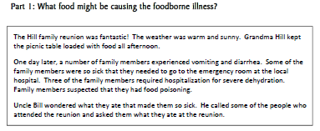
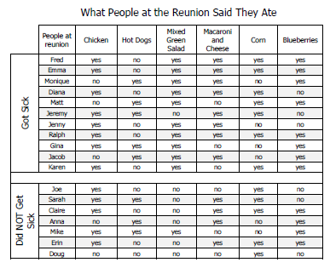
Notes:
Part 1: What food might be causing the foodborne illness?
The A Case of Food Poisoning begins with a case about family members affected by food poisoning (also called foodborne illness).
Ask one participant to read the information in the box.
Ask participants work with their partner to use the information on the next page to determine what food or foods may be causing the foodborne illness.
Note that Part 1 may be done as prelab homework.

Slide 6
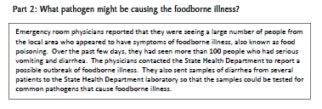
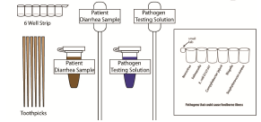
Notes:
Part 2: What pathogen might be causing the foodborne illness?
Ask one participant to read the information in the box.
Ask participants work with their partner to complete Part 2.

Slide 7
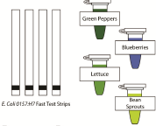
Notes:
Part 3: Which food is contaminated?
Ask one participant to read the information in the box.
Ask participants to work with their partner to complete Part 3.

Slide 8
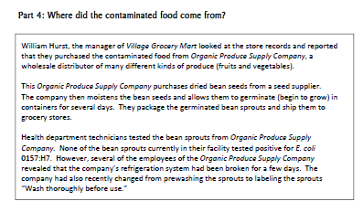
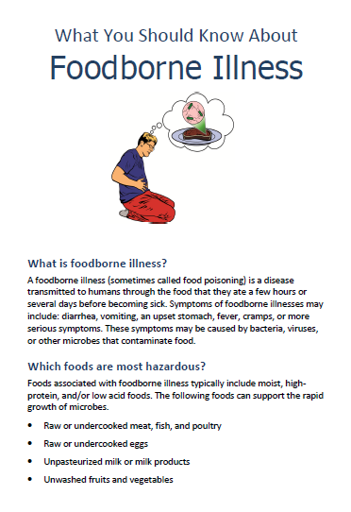
Notes:
Part 4: Where did the contaminated food come from?
Notice that we have “chunked” the activities in the A Case of Food Poisoning kit into parts that can be easily completed in a single class period. Some parts need to be done in class.
Ask one participant to read the information in the box.
Ask participants work with their partner to complete Part 4. the information on the next page to determine what food or foods may be causing the foodborne illness.
Part 4 does not require any hands-on work so it may be done for homework.
Teachers may make additional copies of the “What You Should Know About Foodborne Illness” brochure.

Slide 9
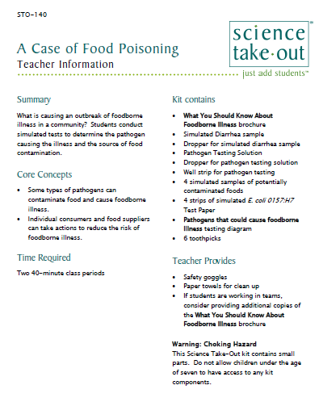
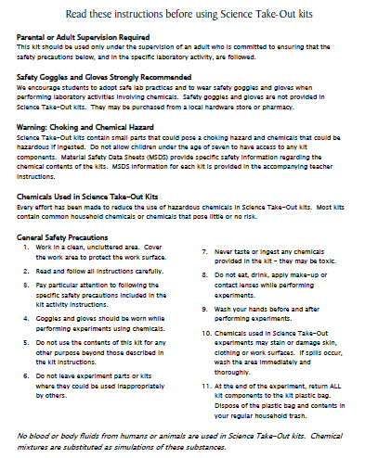
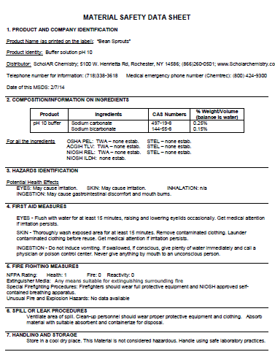
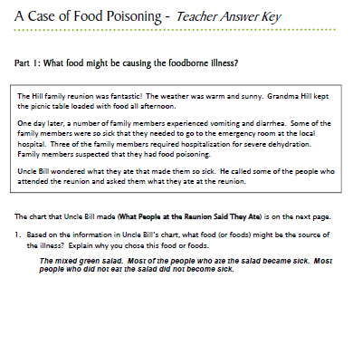
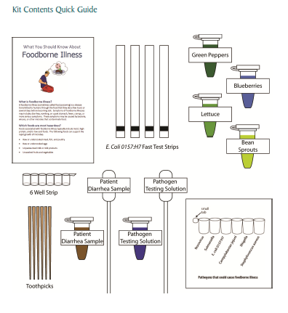
Teacher Information
Safety
MSDS
Key
Quick Guide
Notes:
One copy of the Teacher Information is provided with each order.
The teacher information includes: Summary, Core Concepts, Kit Contains, Teacher Provides, Time Required, Reusing, and information of refill kit contents.
Additional materials needed for this lab are safety goggles, scissors, tape or glue, and paper towel (for clean up).
Refills are available for the kits so that basic kit contents can be reused.
The teacher information includes hints for reusing kits and information on what is included in a refill kit.

Slide 10
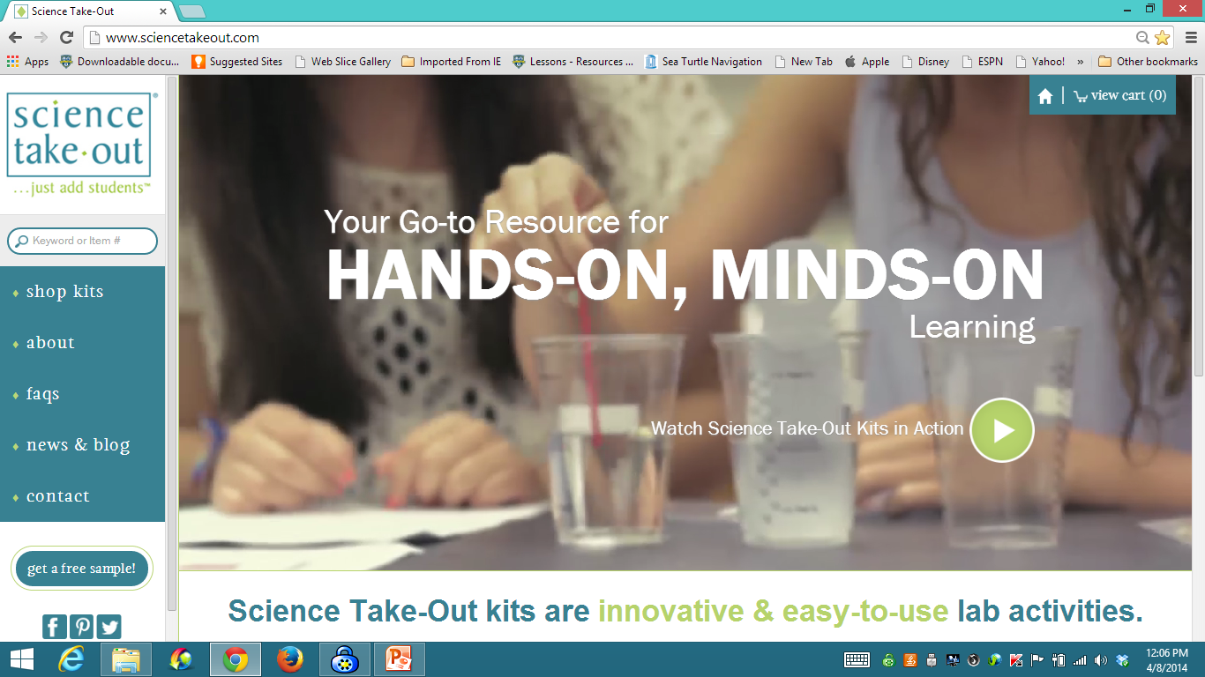
www.sciencetakeout.com
Purchase kits from
Notes:
The kit you used today is available from Science Take-Out as a completely assembled student kit.
Please explore the website to learn about other STO kits.
You can download the complete teacher instructions so that you can see what you are buying.

Slide 11
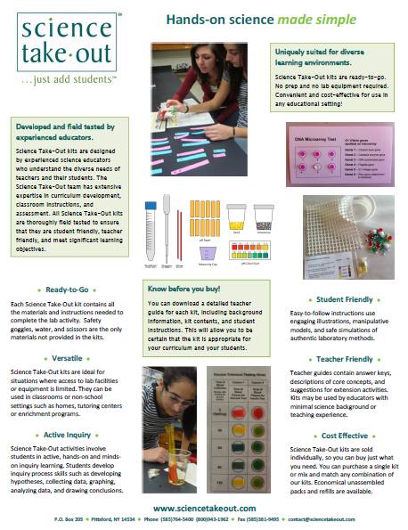
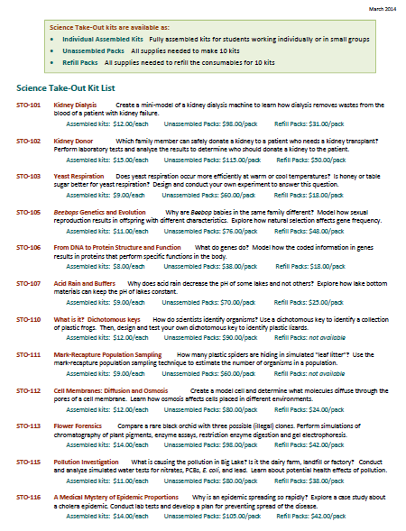
Individual Assembled Kits Fully assembled individual kits
Unassembled Packs All supplies needed to make 10 kits
Refill Packs All supplies needed to refill 10 kits
Notes:
You have a brochure that includes information on other Science Take-Out kits and a price list. Visit the Science Take-Out website to get further information for each kit.
At the website, you can download the teacher information for each kit to help you decide which kits you would like to purchase.
Science Take-Out kits are available as:
Individual Assembled Kits like the kits you used in this workshop
Unassembled Packs that contain all supplies needed to make 10 kits
Refill Packs that contain supplies needed to refill the consumables for 10 kits

Slide 12
Become Involved
as a Field Test Teacher
Help us make new Science Take-Out kits teacher and student friendly.
Indicate this on your card. Science Take-Out will contact you with further information
12
Notes:
Science Take-Out has received an NIH Small Business grant. Support from this grant will allow us to field test Science Take-Out kits
If you would like to be a field test teacher, indicate this by circling yes on your participant card. We will add you to our email list for field test teacher recruitment.
12

Slide 13
Become Involved
as a Workshop Presenter
Present a workshop to introduce colleagues to Science Take-Out kits
Visit the Science Take-Out website for further information
13
Notes:
Science Take-Out has received an NIH Small Business grant. Support from this grant will allow us to field test Science Take-Out kits
If you would like to be a field test teacher, indicate this by circling yes on your participant card. We will add you to our email list for field test teacher recruitment.
13

Slide 14
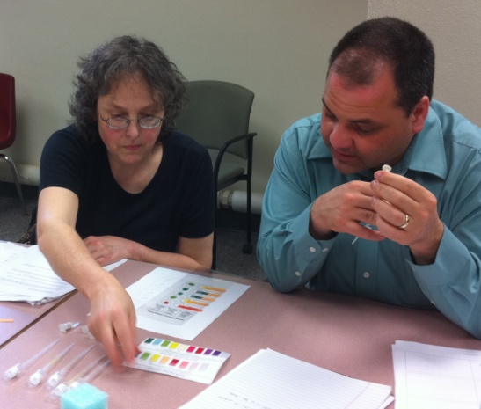
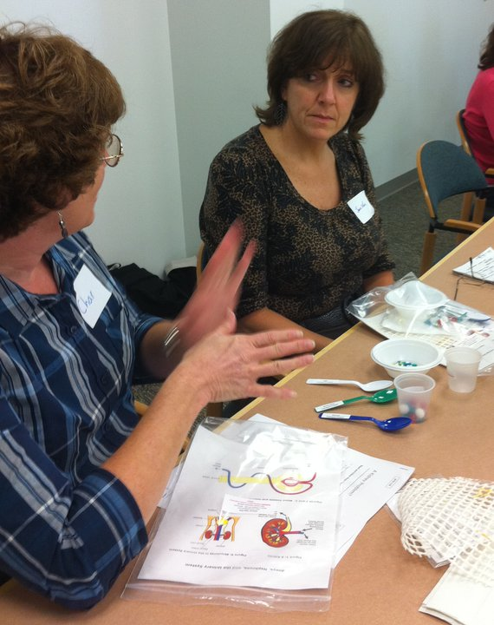
Thanks for being a GREAT group!!!
Please turn in your participant card
before you leave.
Notes:
Encourage teachers to write comments on the back of the participant survey card.
Please remember to collect participant feedback cards!!

