Slide 1
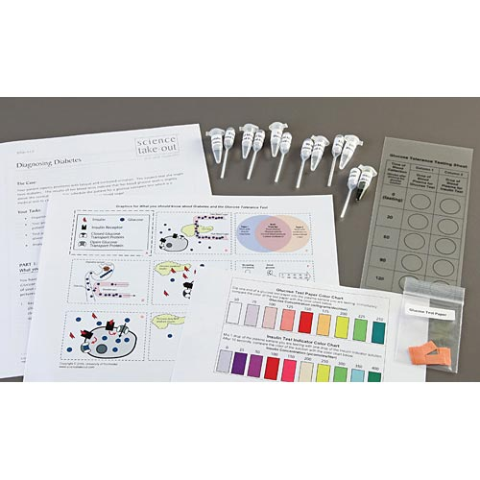

Diagnosing Diabetes
Notes:
This slide should be on screen as participants enter the room.
Start workshop on time—do not wait for “stragglers”
Welcome participants as they enter room
Do NOT do participant introductions unless the workshop group is a very small one (less than 10 people). Introduce self and briefly explain teaching experience and current position.
The activity that you will do today was developed by the Life Sciences Learning Center at the University of Rochester. We found that teachers wanted access to the activities that we developed even after our grant support had ended.
To provide for sustained dissemination, we formed a small spin-off company called Science Take-Out. Explain that Science Take-Out is a small company that manufactures and sells hands-on science kits for middle or high school biology students.

Slide 2
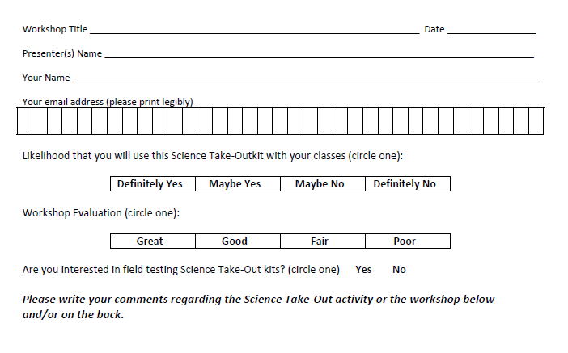
Please complete the “Participant Card”
2
Notes:
Because this workshop is supported through a grant from the National Institutes of Health, it is important that we collect data from workshop participants.
Please fill in the participant card during the workshop.
Use the space at the bottom and the back of the card to provide comments on the workshop or the kits used during the workshop.
2

Slide 3


Put your student hat on
Experience the kit
Put your teacher hat on
Envision classroom use
  Curriculum integration
  Support for students
Notes:
When we do hands-on workshops we ask you to switch between two hats as you work—your student hat and teacher hat.
We want to you work with partners to experience the kit by completing the activity
We encourage you also have conversations about how you might integrate this into your curriculum and/or support your students.
If you have questions, please call me over while you are working on the activity.
Also, you may find me interrupting to provide further explanation as you work.

Slide 4
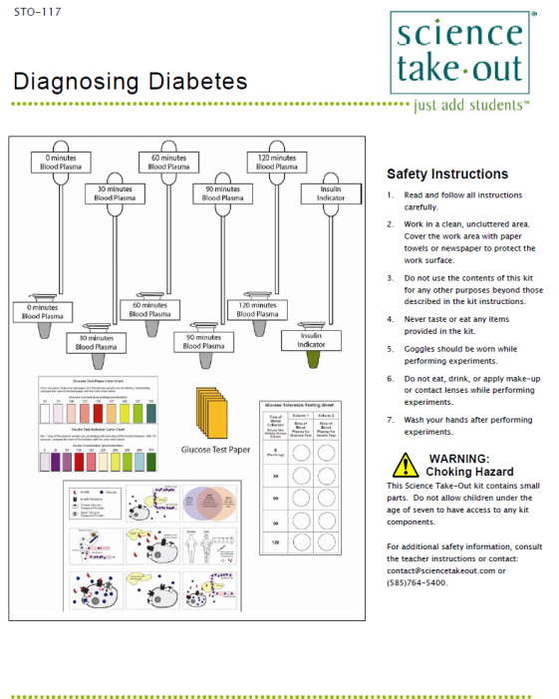
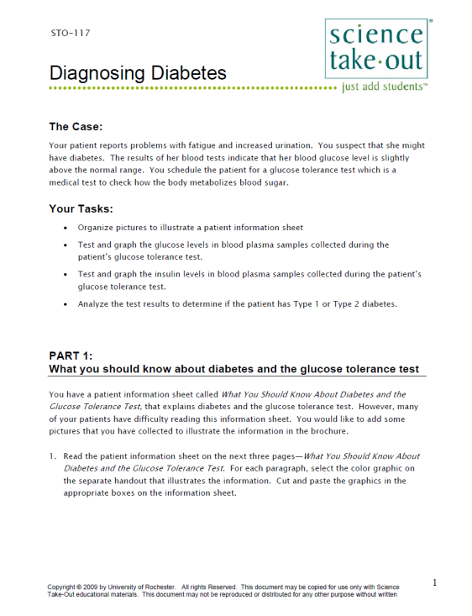
Diagnosing Diabetes
Student Handouts
Student Instructions
Quick Guide
Safety
Turn to this page
Notes:
DISTRIBUTE 1 KIT and 1 STUDENT INSTRUCTIONS to EACH PER PAIR OF TEACHERS
Every kit comes with a sheet with a colored quick guide and safety instructions. Teachers should keep this colored sheet in the kit bag if they plan to refill the kit.
Each kit comes with ONE student instruction handout. Teachers may make additional copies if their students are working in teams.
For today, you will be working in teams of 2.
One of you should use the student instructions in the bag. The other person should use the additional handout that we have provided.

Slide 5
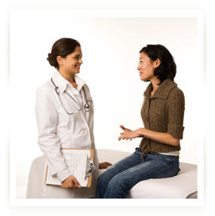
The Case
The patient reports problems with fatigue and increased urination. You suspect she might have diabetes. The results of her blood tests indicate that her blood glucose level is slightly above normal range. You schedule the patient for a glucose tolerance test which is a medical test to check how the body metabolizes blood sugar.
Notes:
The Diagnosing Diabetes activity begins with a mini-case. Information about a patient.
I would suggest reading this aloud to the class. OR consider “embellishing” the case OR ask two students to create a mini-play to illustrate the case.

Slide 6
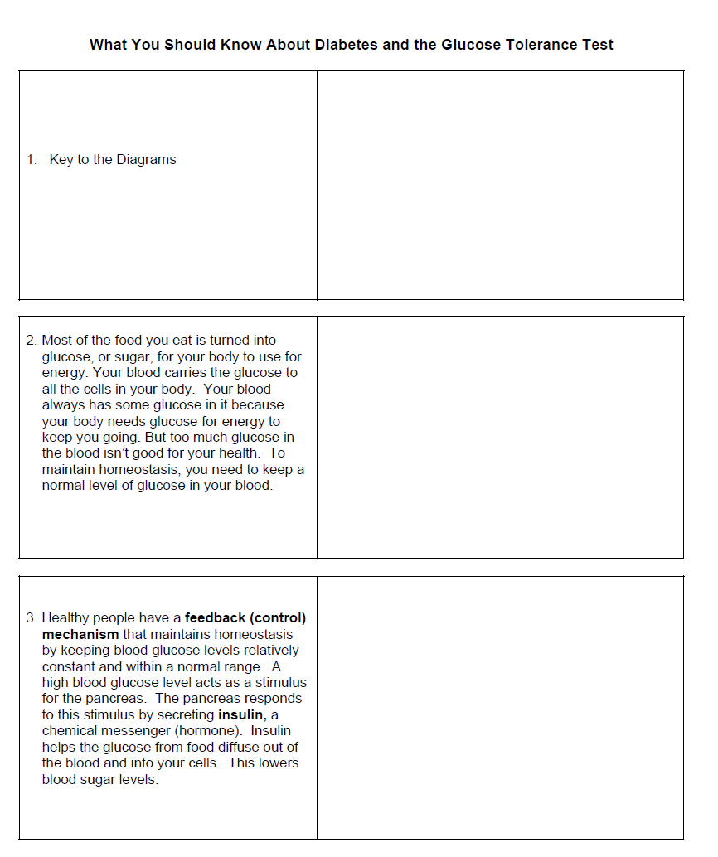
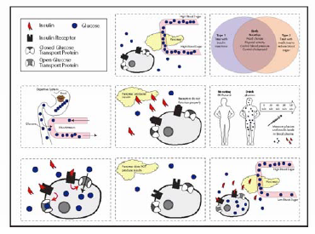
PART 1:
What you should know about diabetes and the glucose tolerance test
You have a patient information sheet called What You Should Know About Diabetes and the Glucose Tolerance Test, that explains diabetes and the glucose tolerance test. However, many of your patients have difficulty reading this information sheet. You would like to add some pictures that you have collected to illustrate the information in the brochure.
1. Read the patient information sheet on the next three pages—What You Should Know About Diabetes and the Glucose Tolerance Test. For each paragraph, select the color graphic on the separate handout that illustrates the information. Cut and paste the graphics in the appropriate boxes on the information sheet.
Notes:
Part 1: What you should know about diabetes and the glucose tolerance test - first two paragraphs.
Active reading to develop literacy skills—matching written information with graphic information
For use in more advanced classes, ask students to make their own graphics
Usually, students cut out the graphic cards on the colored sheet in their kit. But for today, to speed things along you do not need to cut the cards out.
So that you can experience “bits” of each activity, we will be giving you time to just get started and get a feel for each part of the Diagnosing Diabetes kit activities.
Please take 5 minutes to work with your partner to complete Part 1.

Slide 7
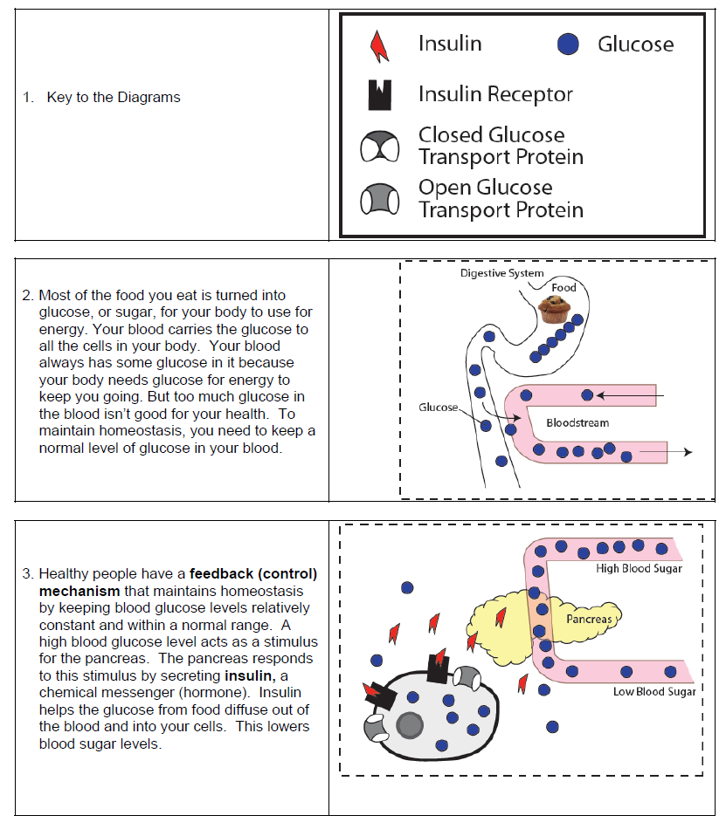
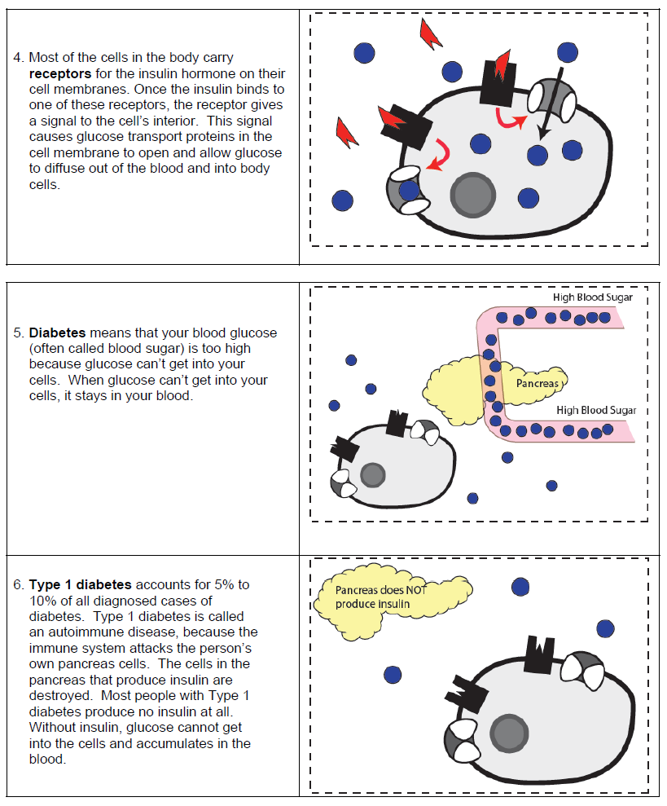
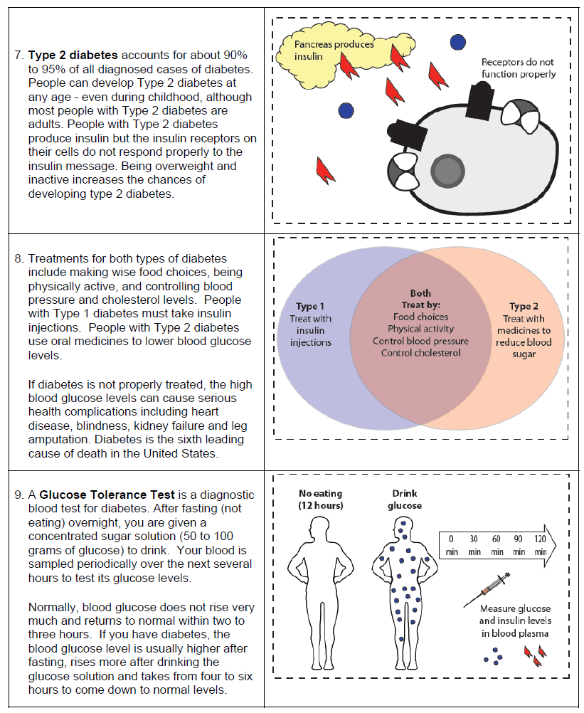
Key
Notes:
The teacher information provided with the kits includes a KEY To check your answers. For review, you might also consider having students cover up the reading and see if they can explain (by talking or writing) what the picture represents.

Slide 8
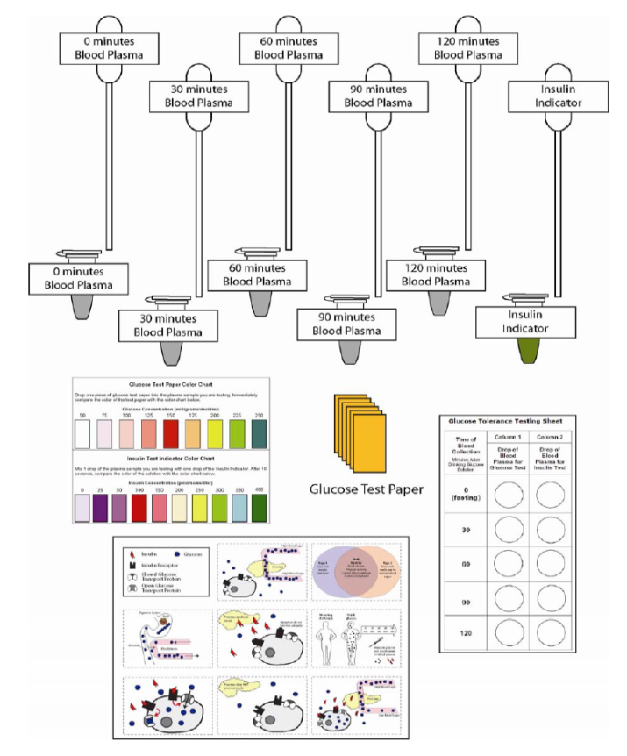
PART 2:
Analyzing Blood Glucose Levels
To prepare for the glucose tolerance test, your patient fasted for 12 hours. To begin the test she drank a solution that contained a measured amount of glucose. Blood samples were collected immediately before she drank the glucose solution and every half hour after she drank the glucose solution. The blood sample was centrifuged to separate it into blood cells and blood plasma. You will test the concentration of glucose in the patient’s blood plasma to determine if she has diabetes.
Notes:
Notice that we have “chunked” the activity into parts that can be easily completed in a single class period. Some parts need to be done in class. Other parts may be done as homework.
Read first paragraph of Part 2 aloud and “embellish” if you wish
Ask students: What will you be doing in this part of the lab?
Take a few minutes to organize the materials you will need for Part 2.
Explain that the labeling of droppers and tubes allows for reuse—a significant cost savings. Droppers can be rinsed out, or just squirted out. Tubes can be refilled. Even the test sheet is made of plastic that can be rinsed, dried, and reused.
Use 5 minutes to work on part 2.

Slide 9
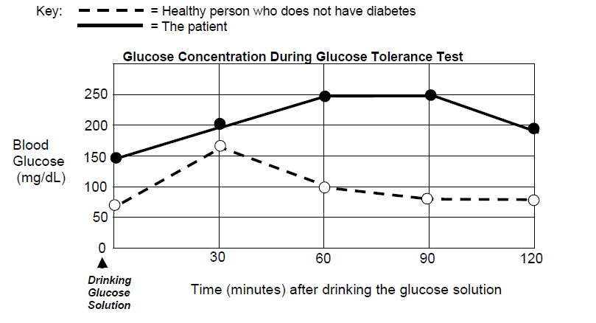
Based on the information in this graph, do you think the patient has diabetes? Support your answer with evidence from the graph.
Do you have enough information to determine if the patient has Type 1 or Type 2 diabetes. If not, how would you go about figuring this out?
Notes:
During class you do not have to go over the answers to all of the questions.
But you should call on volunteers to read their answers to questions 9 and 10 because these serve as an introduction to Part 3.

Slide 10

PART 3:
Analyzing Blood Insulin Levels
There are two types of diabetes that result in higher than normal blood glucose levels - called Type 1 and Type 2 diabetes. A person with Type 1 diabetes does not produce insulin. A person with Type 2 diabetes does produce insulin but their cells are unable to respond to the insulin message.
To determine whether the patient has Type 1 or Type 2 diabetes, you need to test the concentration of insulin in the patient’s blood plasma.
Notes:
Read the first two paragraphs of Part 3 aloud and embellish if you wish.
What will you be doing in this part of the lab?
Please take 5 minutes to work on Part 3

Slide 11
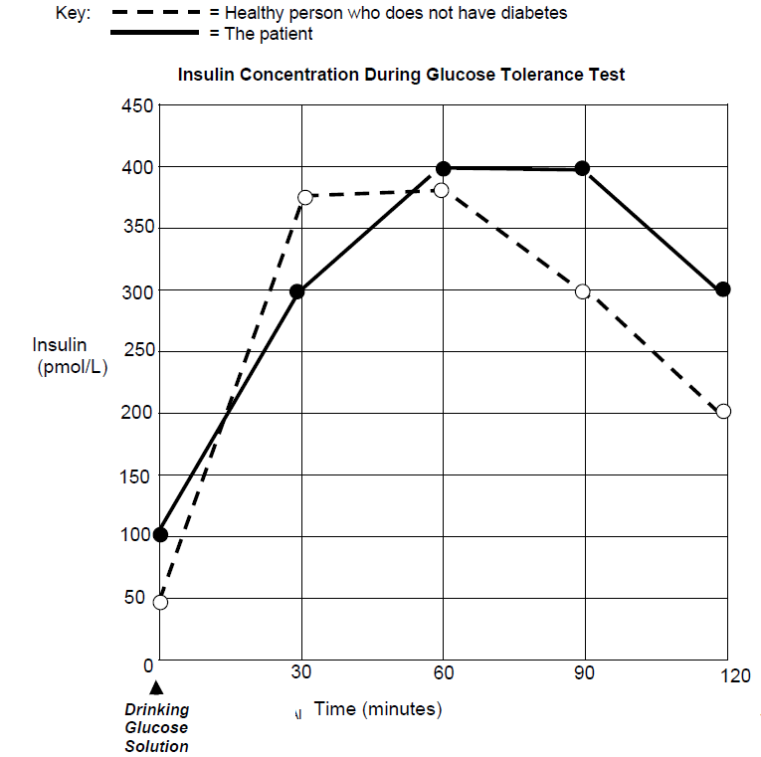
6. Based on the information in the graph, do you think the patient has
Type 1 or Type 2 diabetes? Support your answer with information
from the graph.
Notes:
Call on a volunteer to answer question 6.

Slide 12
Alternative Inquiry Approach
Your lab kit contains blood plasma samples collected from the patient during a glucose tolerance test. Use the materials in your lab kit to determine if the patient has Type 1 or Type 2 diabetes.
Prepare a laboratory report that includes the following:
  Procedure
  Data tables
  Graphs
  Conclusions
  Discussion of how the data supports the conclusions
Notes:
If you would prefer a more “open-ended” inquiry approach to Parts 2 and 3, consider asking students to use the materials in their kits to design and conduct their own investigation.

Slide 13
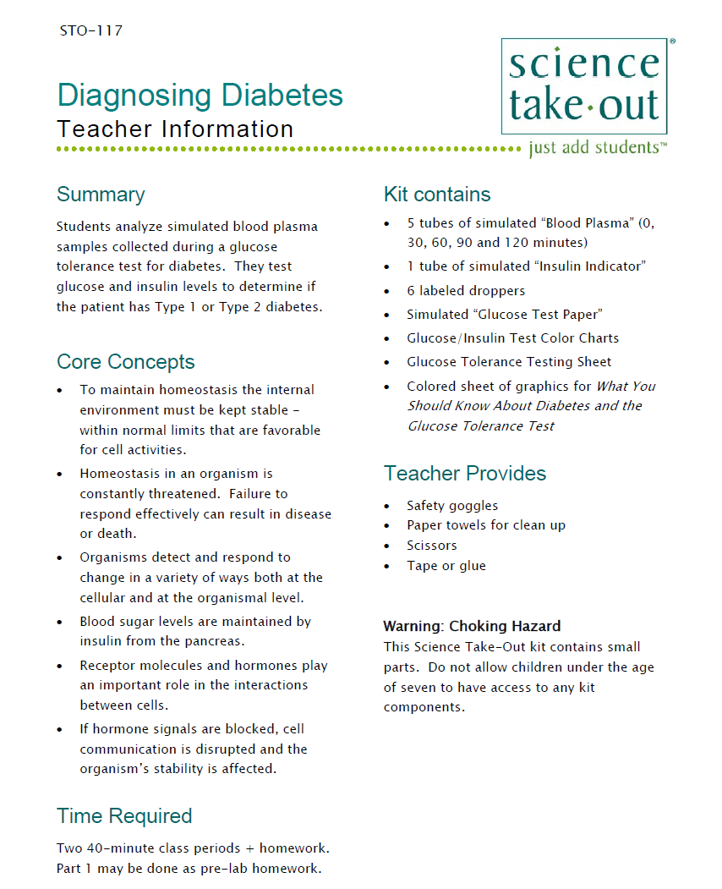
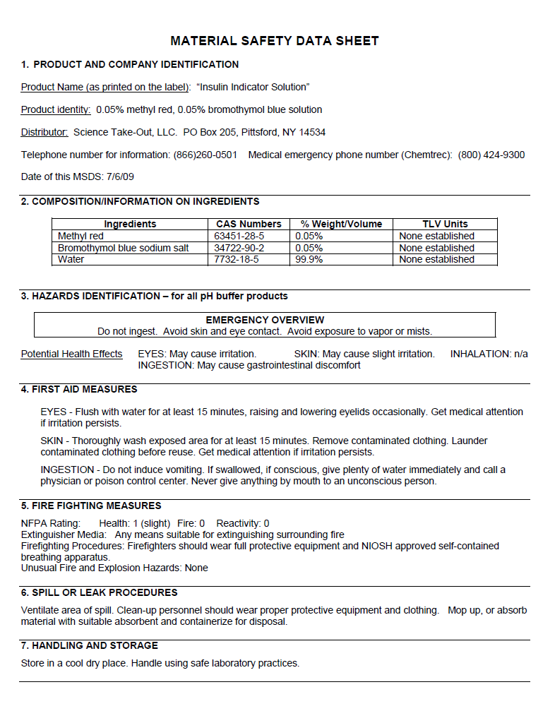
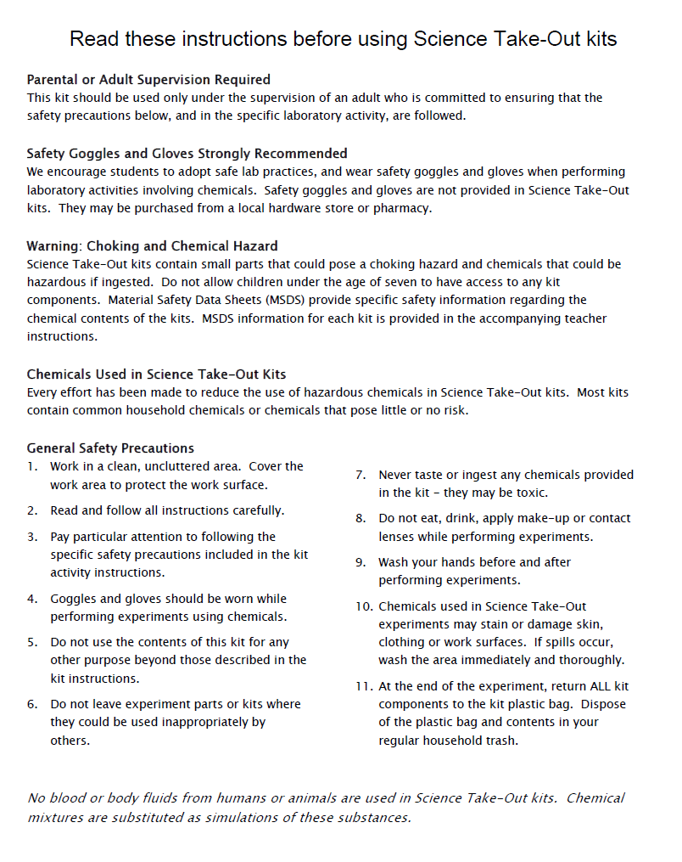
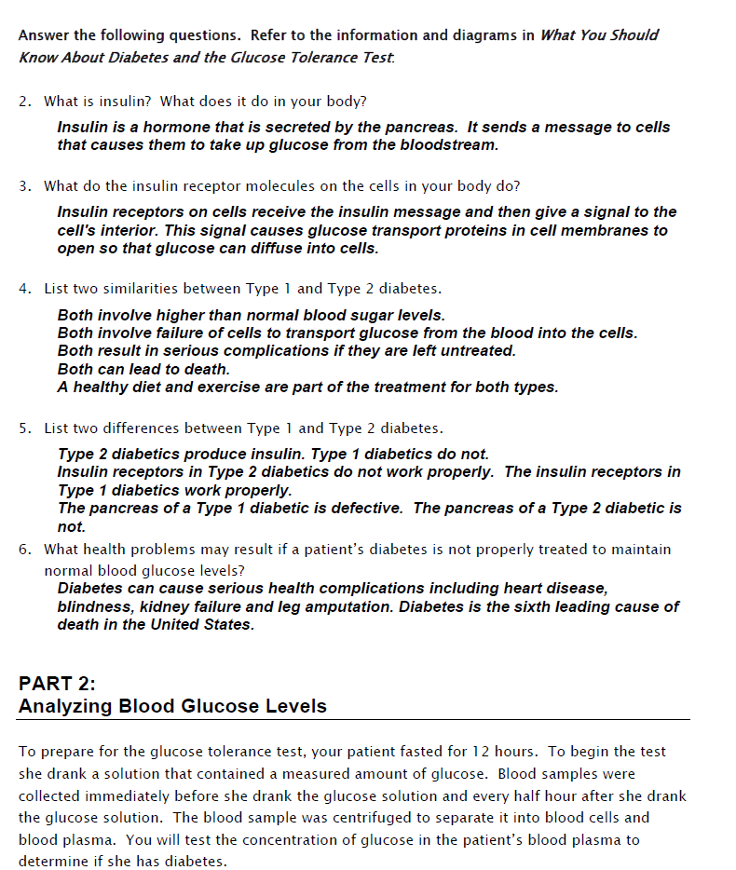
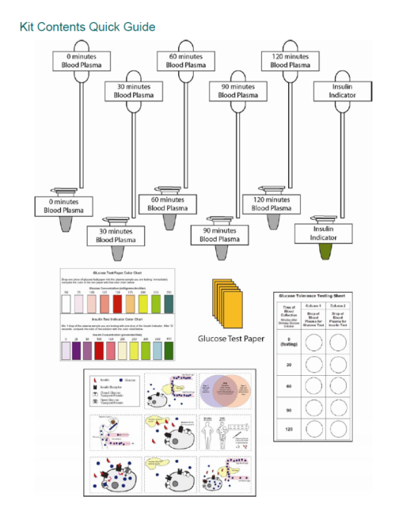
Teacher Information
Safety
MSDS
Key
Quick Guide
Notes:
One copy of the Teacher Information is provided with each order.
The teacher information includes: Summary, Core Concepts, Kit Contains, Teacher Provides, Time Required, Reusing, and information of refill kit contents.
Additional materials needed for this lab are safety goggles, scissors, tape or glue, and paper towel (for clean up).
Refills are available for the kits so that basic kit contents can be reused.
The teacher information includes hints for reusing kits and information on what is included in a refill kit.

Slide 14
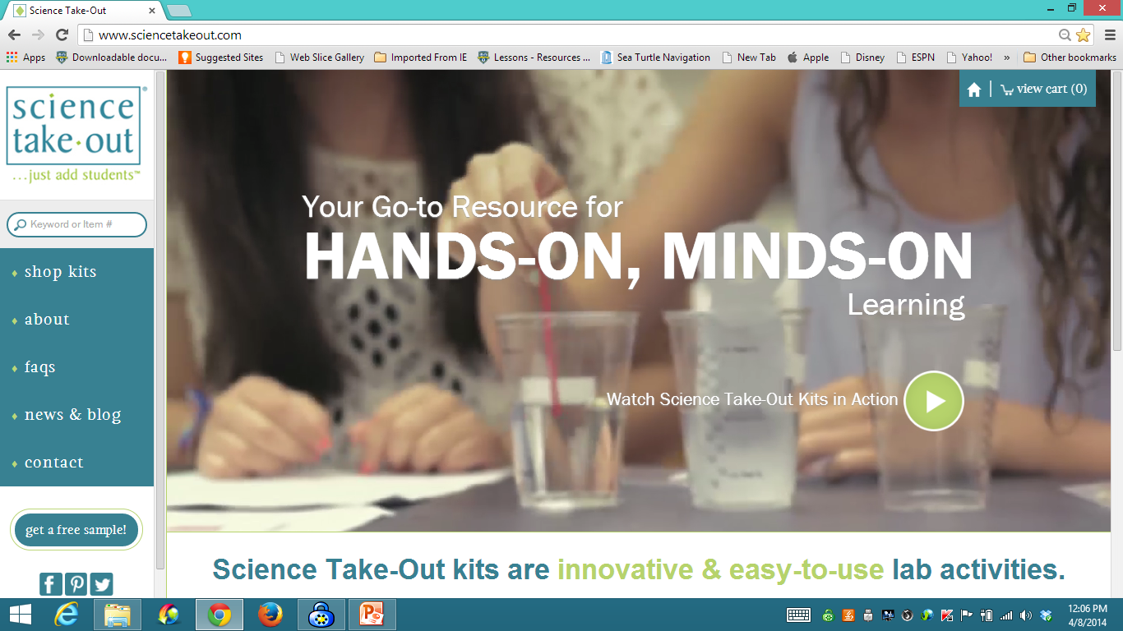
www.sciencetakeout.com
Purchase kits from
Notes:
The kit you used today is available from Science Take-Out as a completely assembled student kit.
Please explore the website to learn about other STO kits.
You can download the complete teacher instructions so that you can see what you are buying.

Slide 15
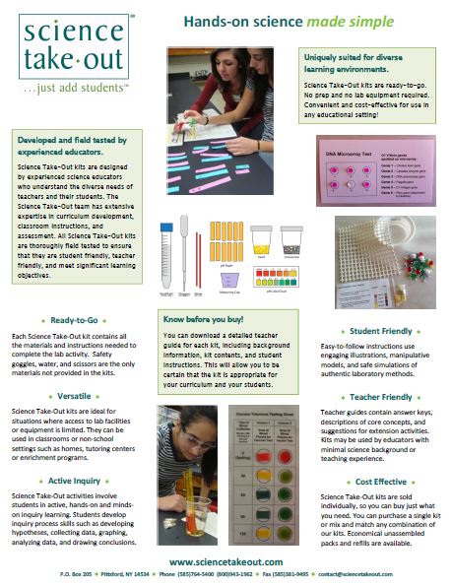
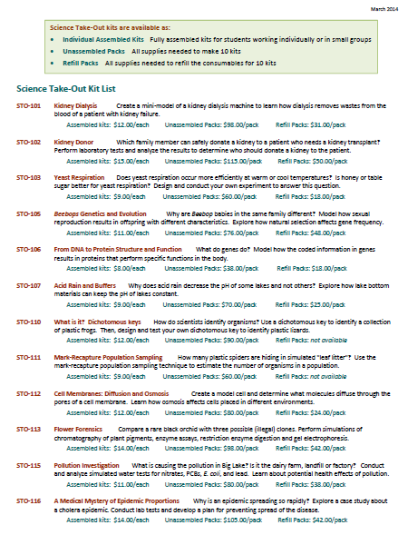
Individual Assembled Kits Fully assembled individual kits
Unassembled Packs All supplies needed to make 10 kits
Refill Packs All supplies needed to refill 10 kits
Notes:
You have a brochure that includes information on other Science Take-Out kits and a price list. Visit the Science Take-Out website to get further information for each kit.
At the website, you can download the teacher information for each kit to help you decide which kits you would like to purchase.
Science Take-Out kits are available as:
Individual Assembled Kits like the kits you used in this workshop
Unassembled Packs that contain all supplies needed to make 10 kits
Refill Packs that contain supplies needed to refill the consumables for 10 kits

Slide 16
Become Involved
as a Field Test Teacher
Help us make new Science Take-Out kits teacher and student friendly.
Indicate this on your card. Science Take-Out will contact you with further information
16
Notes:
Science Take-Out has received an NIH Small Business grant. Support from this grant will allow us to field test Science Take-Out kits
If you would like to be a field test teacher, indicate this by circling yes on your participant card. We will add you to our email list for field test teacher recruitment.
16

Slide 17
Become Involved
as a Workshop Presenter
Present a workshop to introduce colleagues to Science Take-Out kits
Visit the Science Take-Out website for further information
17
Notes:
Science Take-Out has received an NIH Small Business grant. Support from this grant will allow us to field test Science Take-Out kits
If you would like to be a field test teacher, indicate this by circling yes on your participant card. We will add you to our email list for field test teacher recruitment.
17

Slide 18
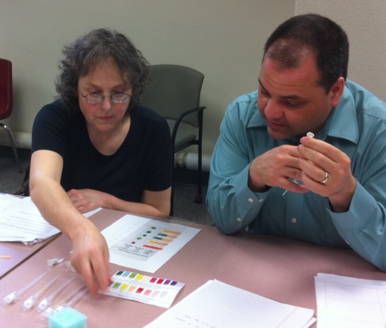
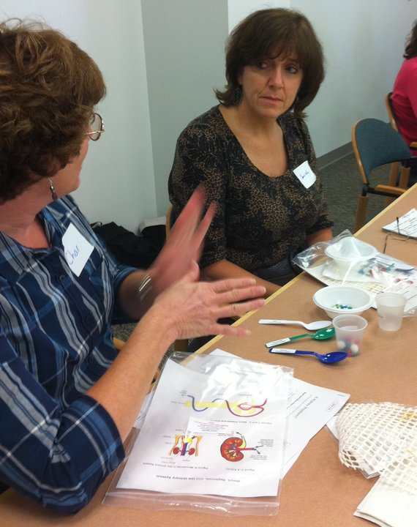
Thanks for being a GREAT group!!!
Please turn in your participant card
before you leave.
Notes:
Encourage teachers to write comments on the back of the participant survey card.
Please remember to collect participant feedback cards!!

