Slide 1
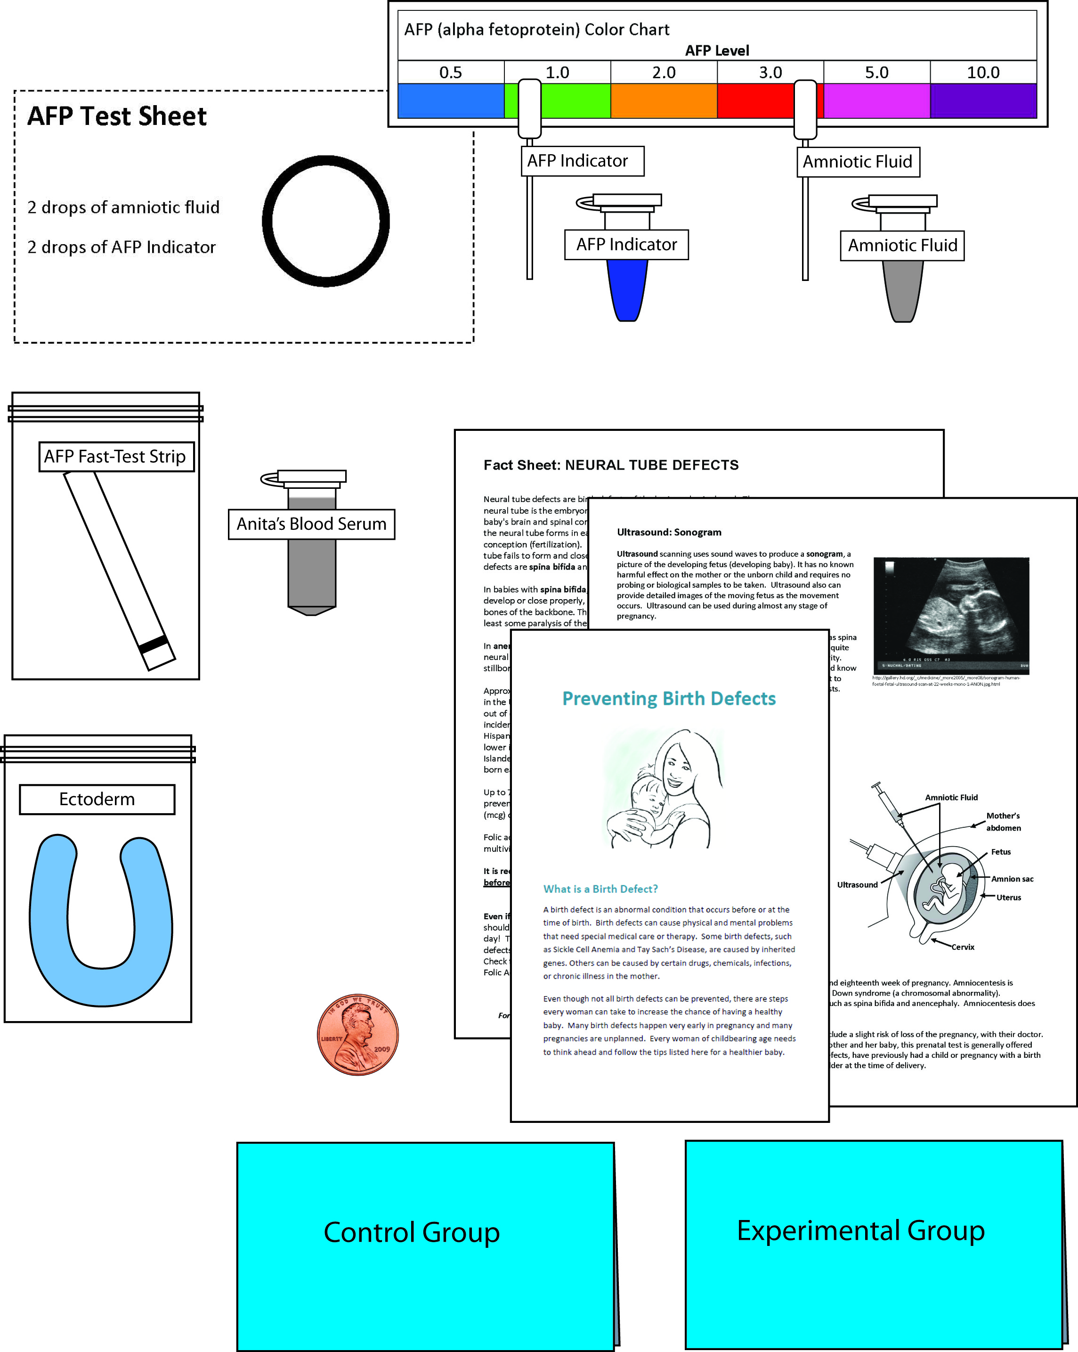
Birth Defects and Folic Acid
Notes:
This slide should be on screen as participants enter the room.
Start workshop on time—do not wait for “stragglers”
Welcome participants as they enter room
Do NOT do participant introductions unless the workshop group is a very small one (less than 10 people). Introduce self and briefly explain teaching experience and current position.
The activity that you will do today was developed by a company called Science Take-Out. Explain that Science Take-Out is a small company that manufactures and sells hands-on science kits for middle or high school biology students.

Slide 2
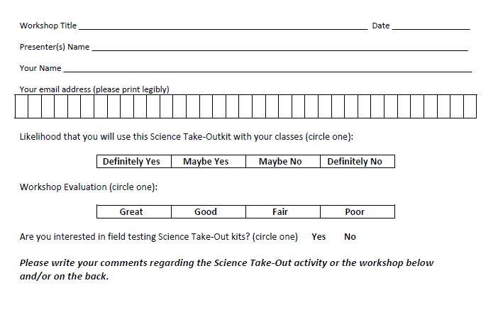
Please complete the “Participant Card”
2
Notes:
Because this workshop is supported through a grant from the National Institutes of Health, it is important that we collect data from workshop participants.
Please fill in the participant card during the workshop.
Use the space at the bottom and the back of the card to provide comments on the workshop or the kits used during the workshop.
2

Slide 3
Put your student hat on
Experience the kit
Put your teacher hat on
Envision classroom use
Curriculum integration
Support for students
Notes:
When we do hands-on workshops we ask you to switch between two hats as you work—your student hat and teacher hat.
We want to you work with partners to experience the kit by completing the activity
We encourage you also have conversations about how you might integrate this into your curriculum and/or support your students.
If you have questions, please call me over while you are working on the activity.
Also, you may find me interrupting to provide further explanation as you work.

Slide 4
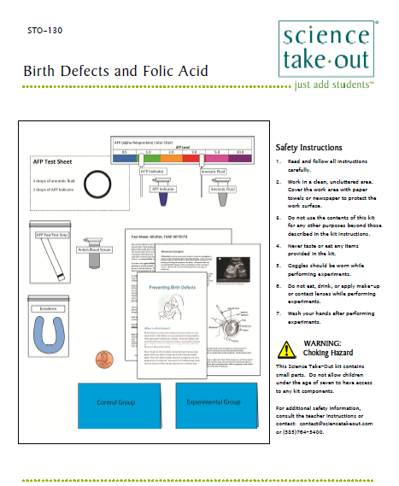
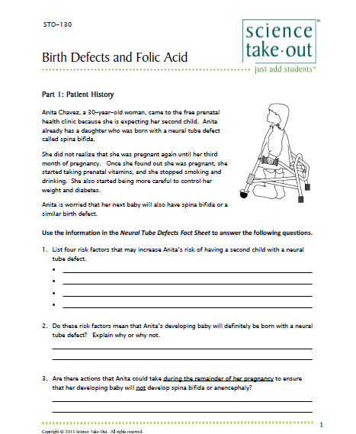
Student Handouts
Student Instructions
Quick Guide
Safety
Turn to this page
Notes:
DISTRIBUTE 1 KIT and 1 STUDENT INSTRUCTIONS to EACH PER PAIR OF TEACHERS
Every kit comes with a sheet with a colored quick guide and safety instructions. Teachers should keep this colored sheet in the kit bag if they plan to refill the kit.
Each kit comes with ONE student instruction handout. Teachers may make additional copies if their students are working in teams.
For today, you will be working in teams of 2.
One of you should use the student instructions in the bag. The other person should use the additional handout that we have provided.

Slide 5
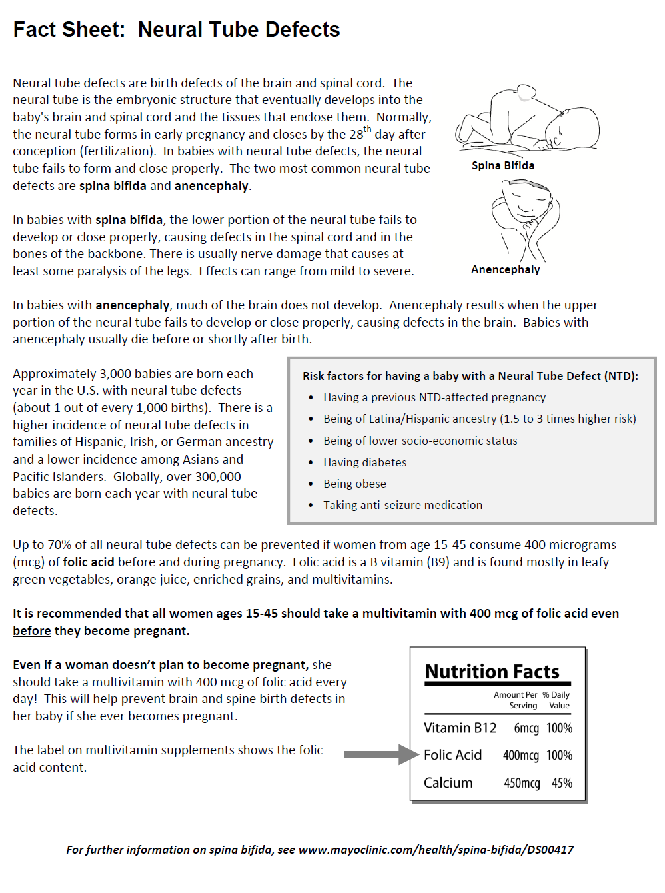
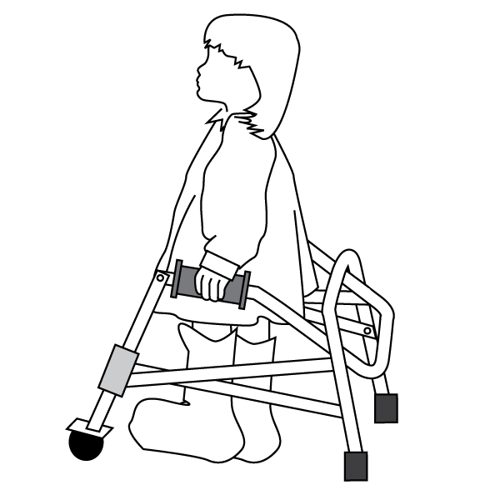
Part 1: Patient History
Anita Chavez, a 30-year-old woman, came to the free prenatal health clinic because she is expecting her second child. Anita already has a daughter who was born with a neural tube defect called spina bifida.
She did not realize that she was pregnant again until her third month of pregnancy. Once she found out she was pregnant, she started taking prenatal vitamins, and she stopped smoking and drinking. She also started being more careful to control her weight and diabetes.
Anita is worried that her next baby will also have spina bifida or a similar birth defect.
Notes:
Explain that this activity fits well with a reproduction and development unit.
Part 1: Patient History
Ask one participant to read Part 1 aloud.
Part 1 may be done for homework IF you make a copy of the Fact Sheet: Neural Tube Defects for each student.
Explain that Part 1 introduces a case study that will continue through the entire kit activity.
Ask participants to work quickly to complete the questions in Part 1.

Slide 6
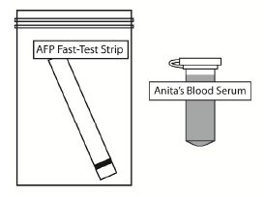
Part 2: Testing Anita’s Blood—Alpha-Fetoprotein Test
Anita’s doctor orders an alpha-fetoprotein (AFP) blood test. This test is done to check the level of AFP in a pregnant woman's blood. AFP is a substance made in the liver of an unborn baby. Normally, low levels of AFP can be found in the blood of a pregnant woman. A high level of AFP in the mother’s blood means that her developing baby is more likely to have a birth defect.
However, if a high level of AFP is found, a neural tube defect is present only a small percentage of the time. The AFP test may give a false positive result. A false positive result means that the test may indicate that baby has a problem when it is in fact healthy. High levels of AFP can be caused by other factors — including if there is a miscalculation in fetal age or if the mother is carrying multiple fetuses (twins or more).
Notes:
Part 2: Testing Anita’s Blood—Alpha-Fetoprotein Test introduces students to a blood test that may indicate whether a woman is carrying a child with a birth defect.
Ask someone to read the first two paragraphs in Part 2.
For Part 2, you will need these supplies from your kit.
Note: The AFP test is not specific for spina bifida. It may also indicate other possible birth defects.

Slide 7
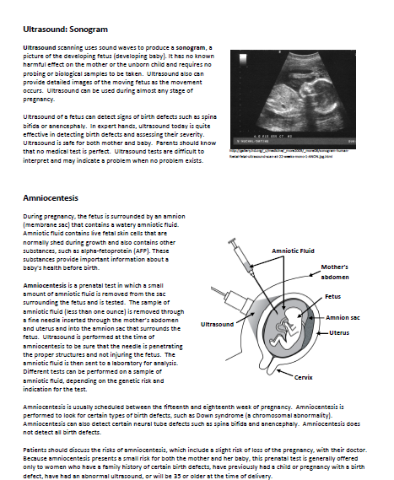
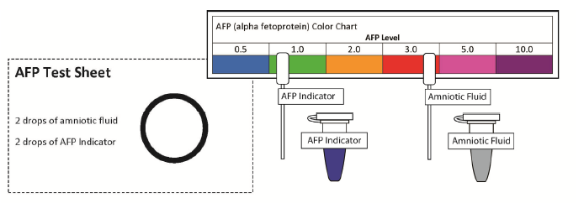
Part 3: Further Testing—Ultrasound and Amniocentesis
Anita’s doctor explains that she should go for further testing that will provide more information about her baby’s development. He schedules her for a sonogram and amniocentesis. He gives Anita an information sheet that explains the sonogram and amniocentesis procedures.
Notes:
Part 3: Further Testing—Sonogram and Amniocentesis
Part 3 introduces students to additional tests that can be done to determine if a developing baby has a birth defect.
Ask participants to complete Part 3.

Slide 8
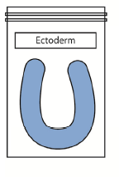
Part 4: What Happens During Development to Cause a Neural Tube Defect?
The exact cause of neural tube defects remains a mystery. No one knows what disrupts development of the nervous system to cause these birth defects. Scientists suspect genetic, nutritional, and environmental factors play a role.
The human nervous system develops from embryonic tissue called ectoderm. Ectoderm gives rise to the skin, brain, spinal cord, and branching nerves. Use the clay (ectoderm) in your kit and the diagrams below to model neural tube development.
Notes:
In Part 4: What Happens During Development to Cause a Neural Tube Defect interpret text and graphics to make a model of neural tube development.

Slide 9
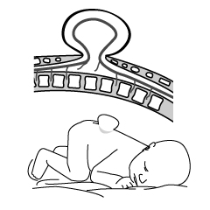
Part 5: A Difficult Decision
During Anita’s fifth month of pregnancy, she has another sonogram. This sonogram reveals that her baby is a boy who has a severe type of spina bifida. With this type, a sac of fluid comes through an opening in the baby’s back. Part of the spinal cord and nerves are in this sac and are damaged. This type of spina bifida causes moderate to severe problems such as difficulty going to the bathroom, loss of feeling in the legs or feet, and lack of mobility in the legs.
Anita’s doctor explains that she needs to make a serious decision.
Notes:
Part 5: A Difficult Decision engages students in understanding that health problems may involve making decisions that have both risks and benefits.
Ask someone to read the first paragraph aloud.
Go on to next slide

Slide 10
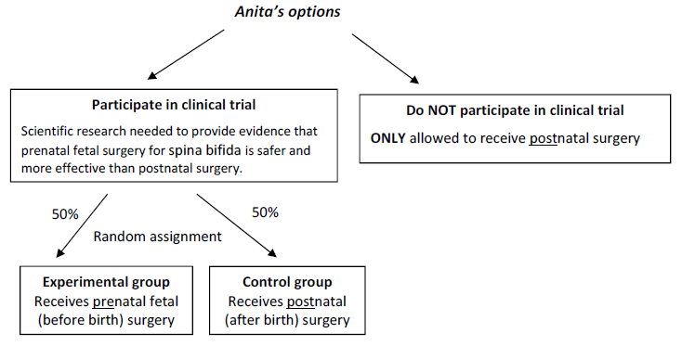
Anita chooses to participate in the clinical trial
Students explore the outcome of being in the experimental vs control group
Notes:
Emphasize that Anita chose to participate in the clinical trial. But this does not ensure that her baby will have the prenatal surgery.
Students flip a coin to assign her to the control or experimental group.
Students read the outcome of her random assignment to the control or experimental group.

Slide 11
Part 6: Could neural tube defects be prevented?
Studies have shown that if all women who could become pregnant were to take a multivitamin with the B-vitamin folic acid, the risk of neural tube defects could be reduced by up to 70%. Folic acid is a water soluble B-vitamin that helps build healthy cells. Because it is water soluble, folic acid does not stay in the body for very long, so women need to take it every day to help reduce the risk of neural tube defects.
The U.S. Food and Drug Administration recommends that women of childbearing age (15-45) take 400 micrograms (mcg) of folic acid vitamin supplement daily, regardless whether they are planning a pregnancy or not. This is due to the fact that folic acid only works before women know they are pregnant. So if women wait to start folic acid until they know they are pregnant, it will likely be too late for the vitamin to offer protection from neural tube defects.
Notes:
Part 6: Could neural tube defects be prevented?
Makes students aware of the importance of folic acid (a vitamin) in preventing neural tube defects.
Part 6 may be done for homework.

Slide 12
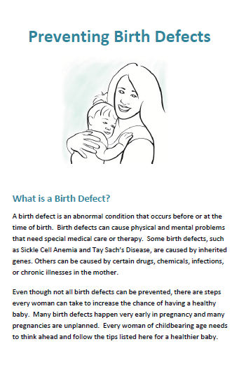
Part 7: Preventing other birth defects
There are many other types of birth defects. Some of these are inherited — caused by defective genes inherited from the parents. Others are a result of the environmental factors — exposure of an embryo or fetus to harmful substances or pathogens while they are in the uterus (womb). Others may be due to an interaction between genes and the environment. There are actions that a woman can take to reduce the risks of having a child with birth defects.
The exposure of an embryo or fetus to harmful substances or pathogens may have no effect, or they may cause major (obvious at birth) birth defects, or minor (subtle but noticed later in life) birth defects.
Notes:
Part 7: Preventing other birth defects makes students aware that there are other actions that a woman can take to reduce the risks of having a child with birth defects.
An emphasis is placed on the fact that a developing embryo/fetus is most susceptible to environmental factors during the early stages of pregnancy.
Part 7 may be done for homework IF you make copies of the Preventing Birth Defects brochure for each student.

Slide 13
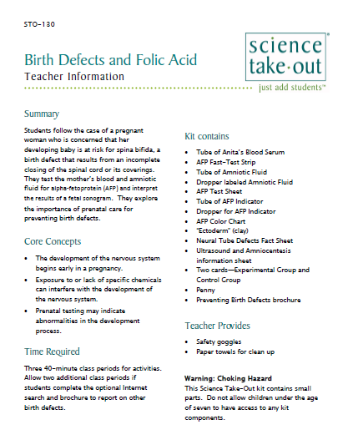
Teacher Information
Quick Guide
Safety
Answer Key
MSDS
Notes:
One copy of the Teacher Information is provided with each order. And also can be downloaded from the website (minus the key)
The teacher information includes: Summary, Core Concepts, Kit Contains, Teacher Provides, Time Required, Reusing, and information of refill kit contents.
Additional materials needed for this lab are safety goggles, scissors, tape or glue, and paper towel (for clean up).
Refills are available for the kits so that basic kit contents can be reused.
The teacher information includes hints for reusing kits and information on what is included in a refill kit.

Slide 14
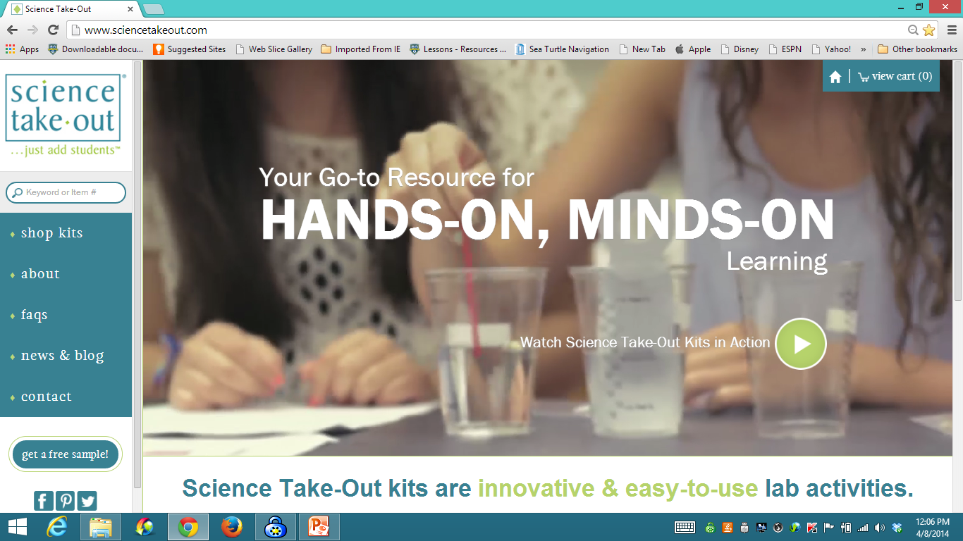
www.sciencetakeout.com
Purchase kits from
Notes:
The kit you used today is available from Science Take-Out as a completely assembled student kit.
Please explore the website to learn about other STO kits.
You can download the complete teacher instructions so that you can see what you are buying.

Slide 15
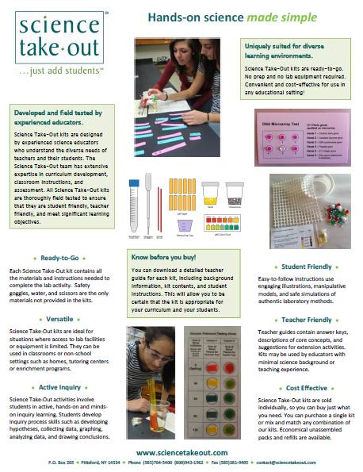
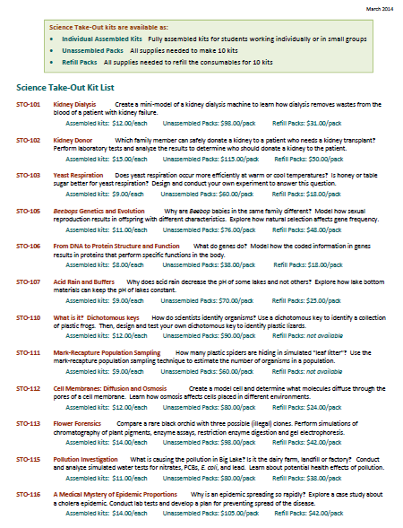
Individual Assembled Kits Fully assembled individual kits
Unassembled Packs All supplies needed to make 10 kits
Refill Packs All supplies needed to refill 10 kits
Notes:
You have a brochure that includes information on other Science Take-Out kits and a price list. Visit the Science Take-Out website to get further information for each kit.
At the website, you can download the teacher information for each kit to help you decide which kits you would like to purchase.
Science Take-Out kits are available as:
Individual Assembled Kits like the kits you used in this workshop
Unassembled Packs that contain all supplies needed to make 10 kits
Refill Packs that contain supplies needed to refill the consumables for 10 kits

Slide 16
Become Involved
as a Field Test Teacher
Help us make new Science Take-Out kits teacher and student friendly.
Indicate this on your card. Science Take-Out will contact you with further information
16
Notes:
Science Take-Out has received an NIH Small Business grant. Support from this grant will allow us to field test Science Take-Out kits
If you would like to be a field test teacher, indicate this by circling yes on your participant card. We will add you to our email list for field test teacher recruitment.
16

Slide 17
Become Involved
as a Workshop Presenter
Present a workshop to introduce colleagues to Science Take-Out kits
Visit the Science Take-Out website for further information
17
Notes:
Science Take-Out has received an NIH Small Business grant. Support from this grant will allow us to field test Science Take-Out kits
If you would like to be a field test teacher, indicate this by circling yes on your participant card. We will add you to our email list for field test teacher recruitment.
17

Slide 18
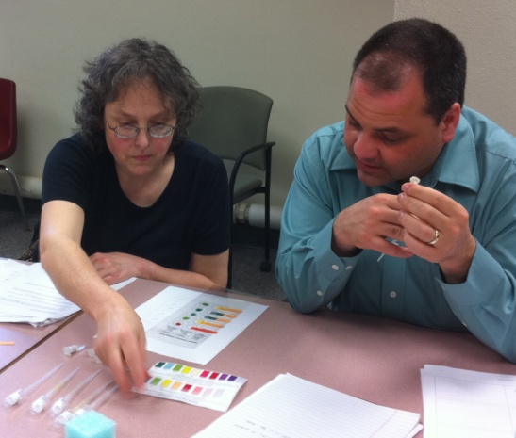
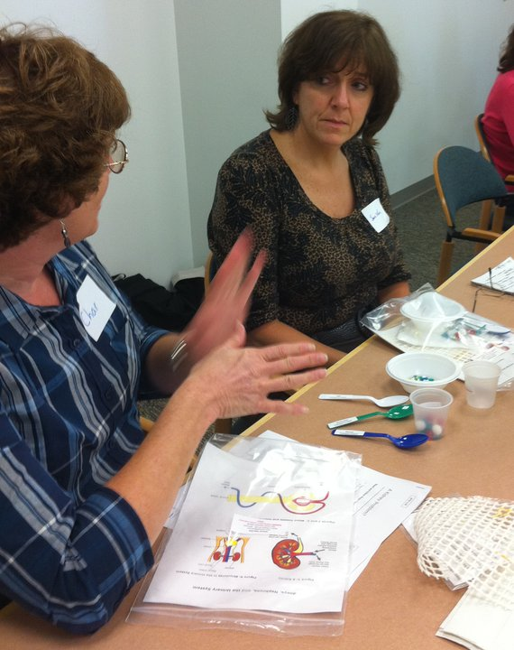
Thanks for being a GREAT group!!!
Please turn in your participant card
before you leave.
Notes:
Encourage teachers to write comments on the back of the participant survey card.
Please remember to collect participant feedback cards!!

